Slide 1

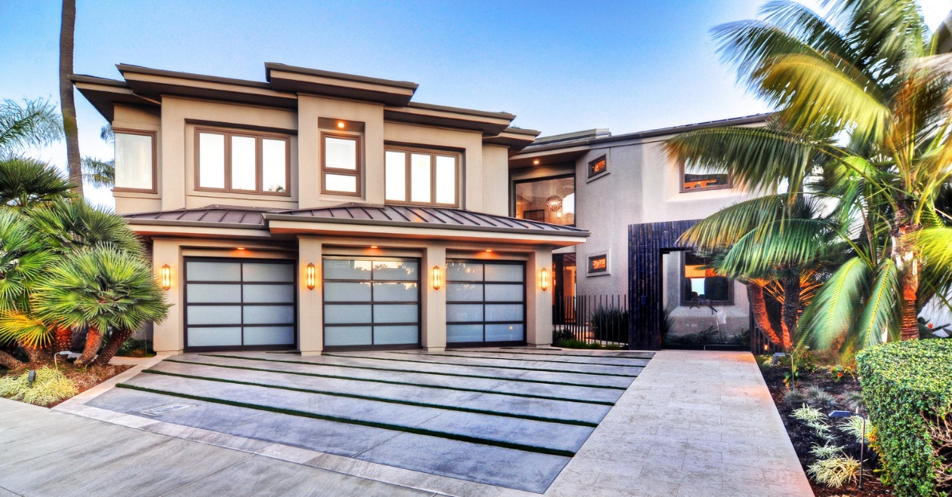

Berkshire Hathaway
HomeServices
California Properties
Prepared for: Mr. Client
Presented by: Amir Vahdat

Slide 2


Slide 3
Your Needs Come First
The process of marketing and selling your house must match your objectives, priorities and needs.
In order to best serve you, I want to learn more about your plans and housing priorities. The following topics outlined below can help me understand your goals and help us build a strong working relationship:
  How we will work together in the marketing and sale of your property.
  The objectives you want to achieve from the sale of your house and the support you expect to receive from me.
  How the homeselling process should be tailored to fit the characteristics of your
  property.

Slide 4
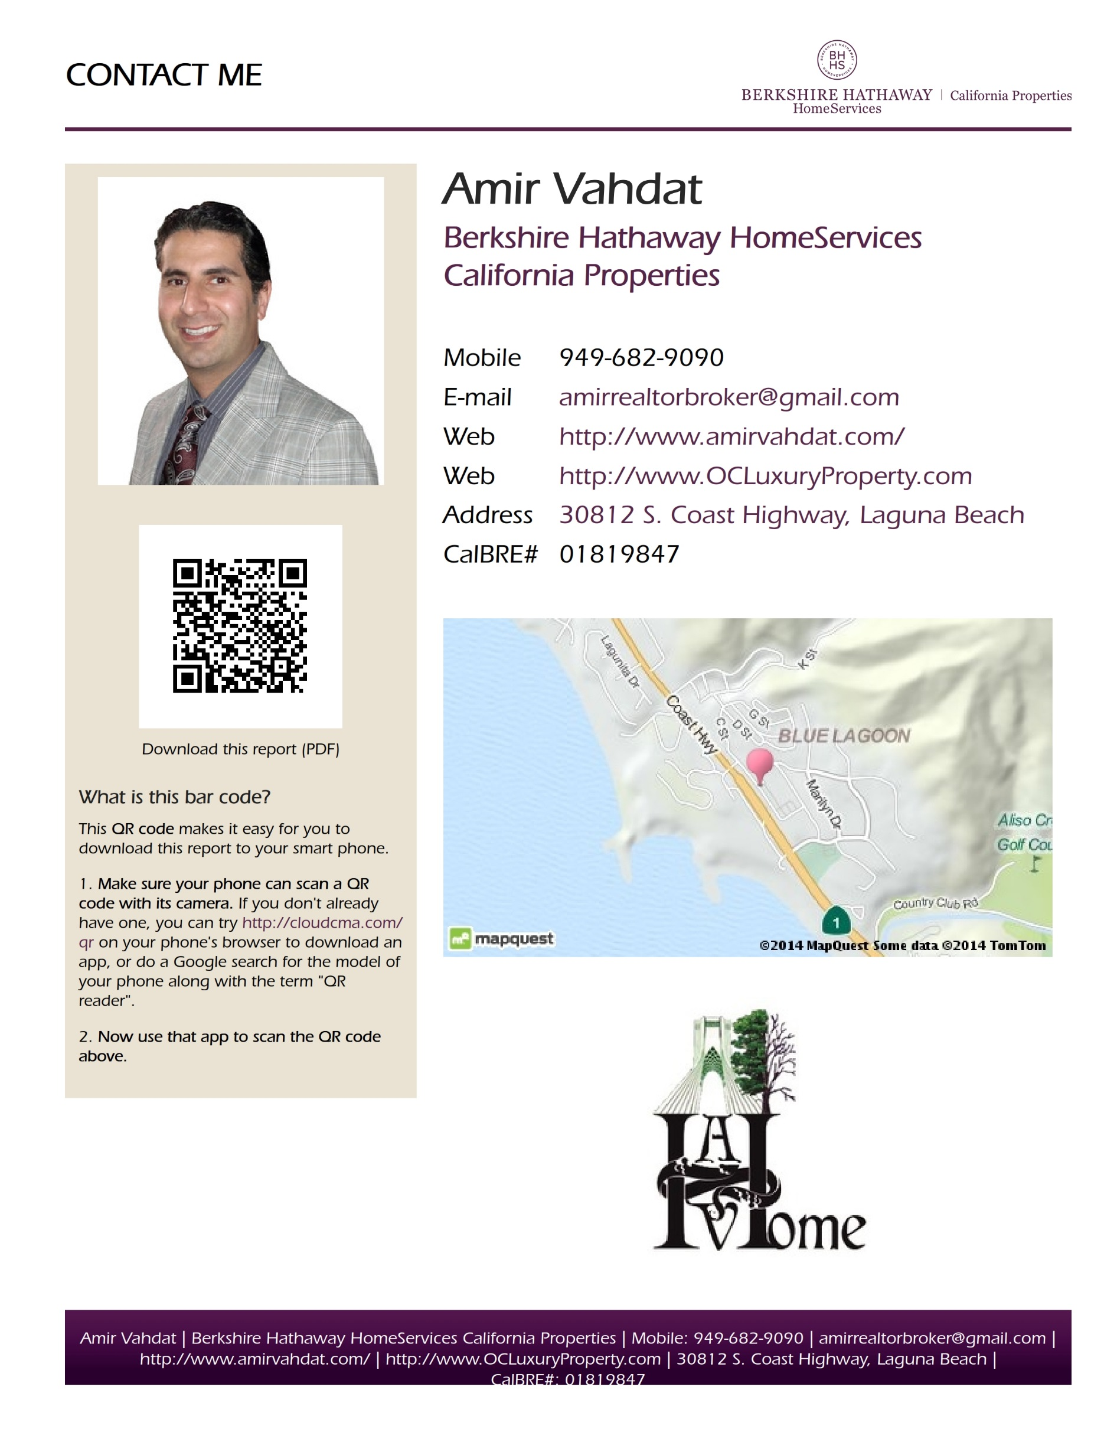

Slide 5


O.C. Luxury Property
Amir’s Mission
Amir is passionate about delivering exceptional consumer experiences. By offering a complete suite of real estate services, he ensure that we meet our consumers’ every need. Amir believes that access to the best and most timely information can dramatically shape our decisions. Today’s consumer needs a trusted resource that can help them navigate the complex process that real estate has become. With Amir’s team, extensive knowledge in every aspect of the field, and fueled by consumer research and insights, they are the go-to source for information and education. As committed to growth and innovation as we are to our consumers, Amir have launched OCLuxuryProperty on Facebook, LinkedIn, WordPress and the website itself which, is our groundbreaking new web feature that facilitates open communication with consumers, allowing them to tap into the wealth of knowledge of top industry experts
It is important to know the real estate company you choose is supported by power, experience and assets of a global leader. Berkshire Hathaway HomeServices is owned by Warren Buffet so you can choose them with exceptional assurance. They are one of the largest global real estate companies. Amir’s offices are based in Orange County, so he is well positioned to do business in Southern California. If you, your friends, or anyone you know are thinking of buying, selling or leasing, Amir would greatly appreciate your referral.
Personal Philosophy
Amir value physical health and well-being and believe they are essential for a happy life. Therefore he will aim at maintaining his own personal health and well-being to model these to his family and to keep in the best possible physical state to be able to do his job well. Amir value friendship, therefore he will act with friendliness towards colleagues, neighbors, and people who he knows, both online and face-to-face. He also value friendship as a sustaining force when difficulties arise in life, therefore he will call upon friends and colleagues to help him work through his own difficulties. Amir value responsibility and see this as each human’s duty to honor the rest of creation: other people, other living creatures and the environment.
Business Philosophy
Amir Vahdat does not believe in doing anything half way. His commitment to clients and customers is to provide them with the respect and the outstanding customer service they deserve and doing his job well. With great experience as a Laguna Beach Realtor and servicing all areas in Orange County, Amir help both buyers and sellers meet their real estate objectives. Amir have extensive knowledge of each of the communities located in and around Laguna Beach, and he will work tirelessly on your behalf to make your next south Orange County home buying or selling experience, a pleasant and successful one.
© 2013 Berkshire Hathaway HomeServices California Properties

Slide 6

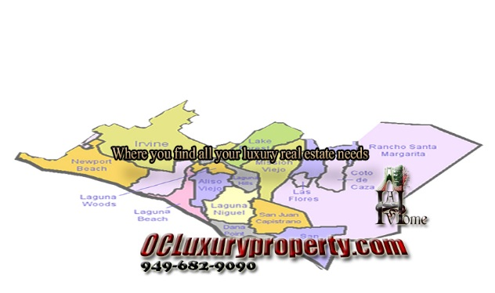
Marketing
Amir is committed to represent his clients with aggressive marketing and advertising campaigns. He regularly advertises his listings with The Real Estate Book, Virtual Tours, Flyers, Multiple Listing Service (MLS) and all the social media pages and Websites Leads: Every single home buyer leads, through all the social media pages and also, Realtor.com, OCLuxuryProperty.com, TheLagunaBeachRealEstate.com, Homes.com, and amirvahdat.com will get your home info and will be directed to get a showing. Amir believes that the more you put your properties out there, the more chances that property has of being noticed and sold.
Sellers
Sellers are presented with a professional competitive marketing analysis (CMA) package that is filled with useful information about selling a home as well as the benefits of doing business with Amir and his team of Prudential California Realty. The team produces virtual tours, listings on the Internet site, open houses and solid communication with clients from beginning to end. It is Amir's commitment to help sell your home or property in a timely fashion while helping you attain the highest possible price for your real estate. I also add your home address to Prudential Realty pocket listing (Pre-MLS) source, so all the prudential agents all over the world would have your homes listing information at their email. If you are interested in receiving a free home valuation, I encourage you to fill out my free home valuation form.
Amir’s suite of marketing tools includes:
· Buyer Tour: Combine MLS property data, school information, loan scenarios, and more.
· Design Center: Create professional-quality flyers, brochures and postcards.
· Neighborhood Envoy: Generate detailed neighborhood reports for the buyers.
· Social Prospecting: Aggregate our contacts from Facebook, Google+ and LinkedIn.
· Social Broadcaster: Promote the listing simultaneously across social media networks.
· Amir’s Websites: Full-featured, CRMLS-branded website with integrated IDX search.
Buyers
For buyers looking for homes or other real estate opportunities here in Laguna Beach or other surrounding communities, I will work with you to find your ideal home. Using excellent listening skills and tremendous market knowledge, my team treats you as its most important customer. Amir's Website is filled with information about living in south Orange County. The General Links page is a handy gateway to access Orange County activities, news, and school information. I will provide you with all of the necessary tools for finding the right property. From free access to search almost all Orange County area homes, to the ability to fill out My Dream Home Finder Form, everything I can possibly provide will be at your service. In addition, once we've narrowed down what you are looking for, we can begin the home showing process so you can get a closer look at the homes that should be a good fit. I help negotiate the best possible deal for my clients with each and every real estate transaction. Nothing satisfies me more than seeing the smiles that come with a successful real estate transaction. Thanks again for considering me as your Realtor.
© 2013 Berkshire Hathaway HomeServices California Properties

Slide 7

Understanding Your Expectations
The following topics will help me understand what is most important to you in the sale of your property.
Communication
Motivation
Time frame
Relocation assistance
Homeselling decisions
Price
Marketing plan
Previous homeselling experience
Positive experiences
Concerns
Expectations

Slide 8

MARKETING
YOUR PROPERTY

Slide 9

CREATING DEMAND
A Strategic Approach
Anyone can find a buyer for your home. The challenge is to create the kind of demand for your property that attracts more buyers and gets you the best outcome. That requires a careful mix of strategies, including:
Intensive local and national networking
Aggressive print exposure
Expansive online exposure
Custom direct mail advertising and marketing materials
Your agent will draw on these strategies to create a custom property marketing plan designed to get you optimum results. Then we’ll orchestrate every detail to ensure a successful close.
It takes a skillful combination of marketing techniques to direct maximum attention to your home. Your agent will devise a custom plan designed to bring qualified buyers to your door.

Slide 10
A Marketing Plan for Your Property
Marketing Tactic | Implementation
Install lock box with key Install yard sign Submit property information to www.Berkshirehathawayhs.com Submit property information to Multiple Listing Service Promote to BHHS sales professionals at office meeting Preview for BHHS sales professionals Promote to other sales professionals at Board of REALTORS® Real estate professionals preview Advertise in newspaper Open House Distribute “Just Listed” eCards and postcards | 4/7 (ongoing) Week of x/x (ongoing) Week of x/x (ongoing) Week of x/x (ongoing) x/x (weekly) x/x x/x x/x x/x (twice monthly or more) x/x (twice monthly or more) Week of x/x

Slide 11
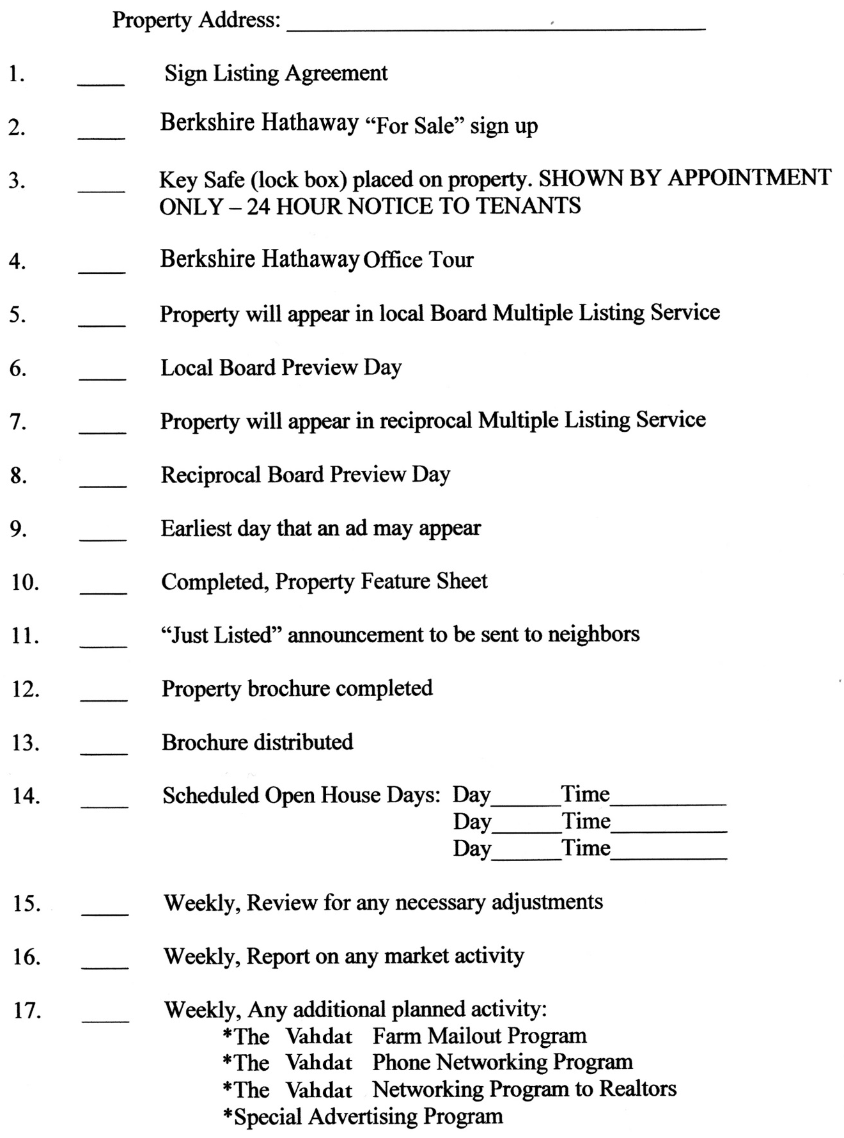
Marketing Schedule
© 2013 Berkshire Hathaway HomeServices California Properties

Slide 12

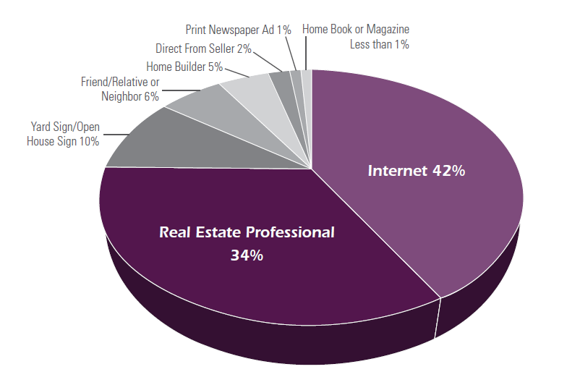
HOW BUYERS
Find Their Home
Though home buyers may use several information sources in their search process, they are most likely to find the home they purchase through a real estate sales professional and the internet.
Percentages may not equal 100% because of rounding.
Source: The 2012 National Association of Realtors® Profile of Home Buyers and Sellers.

Slide 13








ATTRACTING BUYERS
A Multi-Channel Approach
Home buyers once searched the newspaper for properties. Now, 87% of them start their search on the Internet.* And they don’t stop at one or two websites — they explore a whole range of online real estate destinations.
To get your property extensive exposure and attract multiple competitive buyers, Berkshire Hathaway HomeServices California Properties will syndicate your home to these websites:
Aol.com
Arizona Republic Chicago Tribune Contra Costa Times Cyberhomes.com Desert Sun eRealInvestor.com FrontDoor (HGTV) HotPads.com Homefinder.com Homes.com Kiplinger LATimes.com LuxuryRegistry.com Mercury News Miami Herald
Monterey County Herald MSN
NewYorkTimes.com OCRegister.com Oodle.com Prudential.com Realtor.com Relocation.com
San Francisco Chronicle SignonSanDiego.com Trulia.com
U.S. News and World Report Wall St. Journal
Washington Post Yahoo Real Estate Zillow.com
©2014 An Independently owned and operated franchisee of BHH Affiliates, LLC. Listing syndication is the process of publishing listings to other websites. Publishing listings is at the discretion of the 3rd party publishers in the listing syndication process. Berkshire Hathaway HomeServices California Properties subscribes to an upgraded, enhanced process of listing syndication, and follows industry best practices to help consumers easily find our listings.

Slide 14
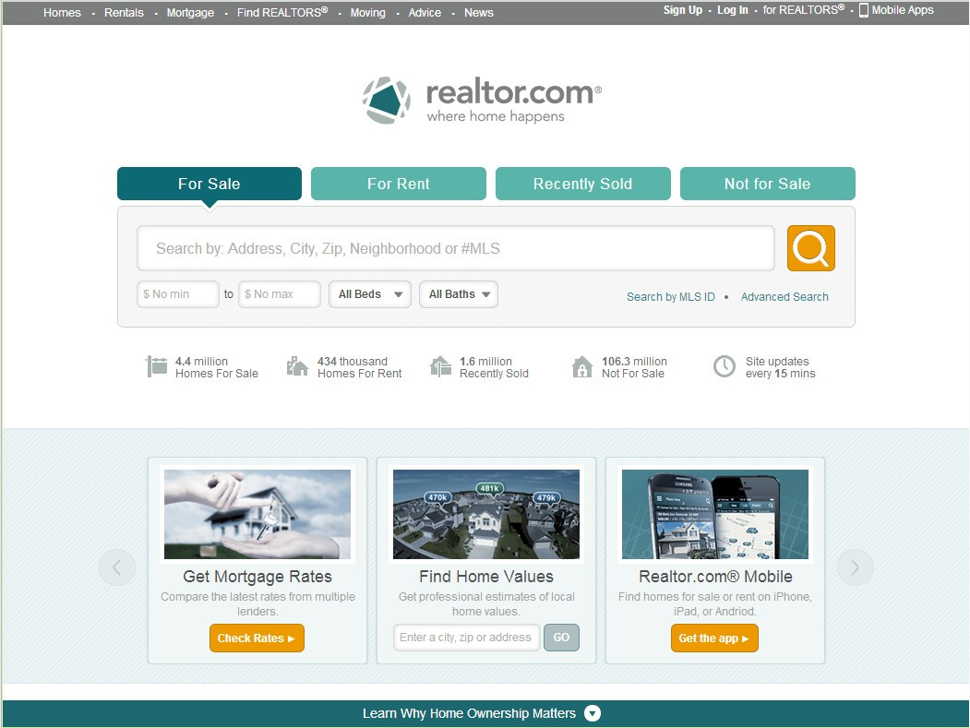
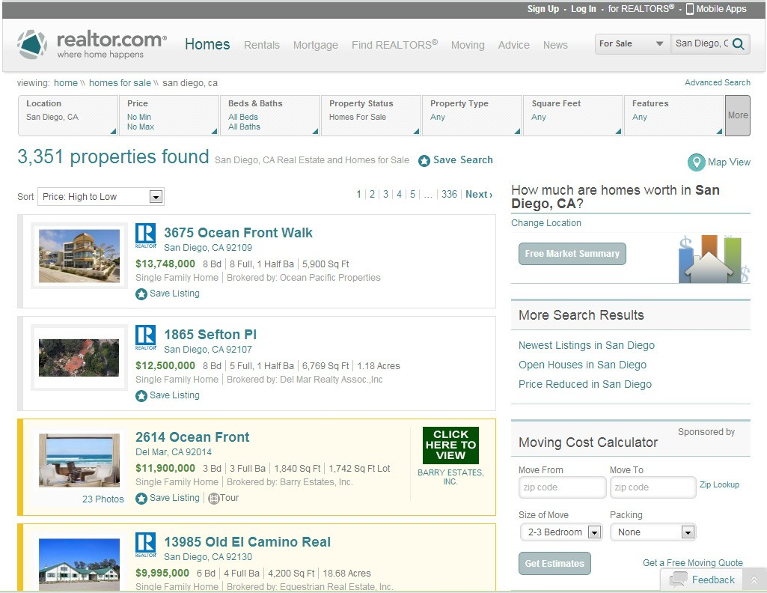
REALTOR.COM
Showcase Membership
Berkshire Hathaway HomeServices California Properties is a Showcase Member of realtor.com. Showcase membership gives us a range of powerful, exclusive tools for making your home stand out from the crowd on this high-traffic site. They include:
Gold Showcase banner on your listing
Up to 36 color photos
Two to three minutes of full motion video
All phone and email leads sent directly to your agent
Homeseekers can schedule showings right from your listing
Custom headline and description of your home on Search Results and Listing Details pages
Open House alerts to drive traffic to your home
Reports on viewer visits to your listing we can share with you
We look forward to leveraging our company’s Showcase Membership in realtor.com to see that your home catches buyers’ eyes first and fast!

Slide 15
LOCAL MARKETS
for National Reach
In addition to promotion on key real estate websites, your listing will be syndicated to a network of 120+ local newspaper sites, including:
AK | Anchorage Daily News | KY | The Courier-Journal | PA | The Morning Call
AL | Montgomery Advertiser | LA | The Town Talk | PA | Centre Daily Times
AL | Tennessee Valley Printing Co. | LA | The Daily Advertiser | SC | The Greenville News
 | Newspapers: Decatur Daily, | LA | The News-Star | SC | The Sun News
 | Times Daily, Moulton Advertiser | LA | Shreveport Times | SC | The Herald
AR | Baxter Bulletin | LA | Opelousas Daily World | SC | The State
AZ | Arizona Republic | MD | Baltimore Sun | SC | The Beaufort Gazette
CA | The Fresno Bee | MD | The Daily Times | SC | The Island Packet
CA | Los Angeles Times | MI | Battle Creek Enquirer | SD | Argus Leader
CA | Monterey County Herald | MI | Detroit Free Press | TN | The Leaf Chronicle
CA | Modesto Bee | MI | Lansing State Journal | TN | The Jackson Sun
CA | San Luis Obispo Tribune | MI | Livingston Daily Press and Argus | TN | The Daily News Journal
CA | The Desert Sun | MI | Observer & Eccentric | TN | The Tennessean
CA | The Californian | MI | The Times Herald | TX | Fort Worth Star Telegram
CA | Sacramento Bee | MN | St. Cloud Times | TX | El Paso Times
CA | Visalia Times Delta | MO | The Kansas City Star | UT | The Spectrum
CO | Fort Collins Coloradoan | MO | Springfield News-Leader | VA | The Daily Press
CT | Hartford Courant | MS | The Sun Herald | VA | The Daily News Leader
DE | The News Journal | MS | Hattiesburg American | VA | The Virginia Gazette
FL | Bradenton Herald | MS | The Clarion-Ledger | VT | Burlington Free Press
FL | Florida Today | MT | Great Falls Tribune | WA | Bellingham Herald
FL | The News-Press | NC | Citizen-Times | WA | The Olympian
FL | Miami Herald | NC | The Charlotte Observer | WA | Tri-City Herald
FL | Orlando Sentinel | NC | The News & Observer | WA | The News Tribune
FL | Pensacola News Journal | NJ | Courier News | WI | Gannett Wisconsin Newspapers:
FL | Sun-Sentinel | NJ | Courier-Post |  | Appleton, Fond duLac, Green Bay,
FL | Tallahassee Democrat | NJ | Asbury Park Press |  | Manitowac, Marshfield,
GA | The Ledger-Enquirer | NJ | Daily Record |  | Stevens Pt, WI Rapids, Wausau,
GA | Macon Telegraph | NJ | The Daily Journal |  | Oshkosh, Sheboygan
GUAM Pacific Daily News |  | NJ | Home News Tribune
IA | Des Moines Register | NM | Las Cruces Sun-News
IA | Iowa City Press-Citizen | NV | Reno Gazette Journal
ID | Idaho Statesman | NY | Press & Sun-Bulletin
IL | Belleville News-Democrat | NY | Star Gazette
IL | Chicago Tribune | NY | Poughkeepsie Journal
IN | The Indianapolis Star | NY | Rochester Democrat and Chronicle
IN | Journal and Courier | OH | Cincinnati Enquirer
IN | Muncie Star Press | OH | NNCO - Fremont, Mansfield,
NY | Ithaca Journal |  | Marion, Port Clinton, Bucyrus,
NY | The Journal News |  | Chillicothe, Coshocton, Newark,
KS | The Wichita Eagle |  | Lancaster, Zanesville
KY | Lexington Herald-Leader | OR | Statesman Journal
©2014 An Independently owned and operated franchisee of BHH Affiliates, LLC. Listing syndication is the process of publishing listings to other websites. Publishing listings is at the discretion of the 3rd party publishers in the listing syndication process. Berkshire Hathaway HomeServices California Properties subscribes to an upgraded, enhanced process of listing syndication, and follows industry best practices to help consumers easily find our listings.

Slide 16
EXTENSIVE ONLINE PROMOTION
Of Your Property
Your listing will be syndicated to the following websites:
AOL Real Estate | Daily Tribune | InvestorLoft | New York Times
ABC | DataSphere (formerly SecondSpace) | Iowa City Press-Citizen | New York Times Regional Group
Ad Express & Daily Iowegian | Decatur Daily | Ithaca Journal | News Herald
Allied News | Derry News / Weekender | Jacksonville Daily Progress | News-Journal
Americus Times Recorder | Detroit Free Press | Journal and Courier | Niagara Gazette
Anchorage Daily News | Eagle Gazette | Killeen Daily Herald | North Jefferson News
Andover Townsman | Edmond Sun | Kiplinger | Northern Nevada Regional MLS
Argus Leader | Effingham Daily News | Knoxville Journal Express | Oakland Tribune
Asbury Park Press | El Paso Times | Kokomo Tribune | Observer & Eccentric Newspapers
Athens Daily Review | Enid News & Eagle | KOMO News | OceanHomesUSA.com
Austin Home Search | eRealInvestor.com | KTVB | Olive Hill Times
Baltimore Sun | Express (Washington Post) | LakeHomesUSA.com | OpenHouse.com
Bangor Daily News | Facebook | LandWatch | OpenHouses.com
Batesville Herald-Tribune | Farm Talk | Lansing State Journal | OpenHousesInc.com
Battle Creek Enquirer | Florida Press Association | Las Cruces Sun-News | Orlando Sentinel
Belleville News-Democrat | Florida Today | Laurel Leader-Call | Oshkosh Northwestern
Bellingham Herald | Fort Collins Coloradoan | Ledger-Enquirer | Ottumwa Daily Courier
Bluefield Daily Telegraph | FreedomSoft | Lexington Herald-Leader | Pacific Daily News
Bradenton Herald | FrontDoor | Livingston Daily Press & Argus | Palestine Herald-Press
Burlington Free Press | Ft. Gibson Times | Local.com | Palladium-Item
Cedar Creek Pilot | Gainesville Daily Register | Lockport Union-Sun & Journal | Pauls Valley Daily Democrat
Centre Daily Times | Glasgow Daily Times | LoopNet | Pegasus News
Chicago Tribune | Gloucester Daily Times | Los Angeles Times | Pella Chronicle
Chickasha Express Star | GoHoming | luxsocal.com (qualifying listings) | Pensacola News Journal
Chillicothe Gazette | Goshen News | Luxury Registry | Picayune Item
Citizen-Times | Grand Traverse Herald | Lycos Classifieds | Pilot Media
Claremore Daily Progress | Grayson Journal Enquirer | Maine Homes | Poughkeepsie Journal
Classified Ad Network (CNHI-CAN) | Great Falls Tribune | Mankato Free Press | Press & Sun-Bulletin
Cleburne Times Review | Green Bay Press-Gazette | Marshfield News-Herald | Press of Atlantic City
Clinton Herald | Greensburg Daily News | McAlester News-Capital | Princeton Times
CLRSearch.com | Greenup News-Times | McCreary County Record | PropBot.com
Comcast | Greenville Herald Banner | Media General | Property Shark
Commerce Journal | Hartshorne Sun | Military.com | PropertyPursuit.com
Commercial Appeal | Hattiesburg American | Mineral Wells Index | Prudential.com
Commercial News | Hendricks County Flyer | Mlive | PrudentialCal.com
Commonwealth Journal | Herald Times Reporter | Modesto Bee | Pryor Daily Times
Contra Costa Times | Home Magazine | Monterey County Herald | Realtor.com
Cooperstown Crier | Home News Tribune | Montgomery Advertiser | RealtyTrac
Cordele Dispatch | Home on the Tube | Montgomery Herald | Relify.com
Corsicana Daily Sun | HomeAway Real Estate | Morehead News | Relocation.com
Coshocton Tribune | Homefinder.com | Moulton Advertiser | ReloHomeSearch.com
Courier News | Homes and Land | Mt. Vernon Register News | Reno Gazette-Journal
Courier-Post | Homes.com | My Home Renter | ResortScape
Cox Media | Homesbook.com | MyREALTY.com | Richmond Register
Crossville Chronicle | HomesDatabase.com (MRIS MLS Site) | MySpace | Rochester Democrat and Chronicle
Cumberland Times News | Homewinks | National Quick Sale | Rockwall County Herald Banner
Cyberhomes | HotPads.com | New Castle News
Daily Record | Idaho Statesman | New York Post
©2014 An Independently owned and operated franchisee of BHH Affiliates, LLC. Listing syndication is the process of publishing listings to other websites. Publishing listings is at the discretion of the 3rd party publishers in the listing syndication process. Berkshire Hathaway HomeServices California Properties subscribes to an upgraded, enhanced process of listing syndication, and follows industry best practices to help consumers easily find our listings.

Slide 17
EXTENSIVE ONLINE PROMOTION
Of Your Property (continued)
 | The Daily Citizen | The Mayo Free Press | The Tennessean
Royse City Herald Banner | The Daily Item | The Meadville Tribune | The Tifton Gazette
Rushville Republican | The Daily Journal | The Merced Sun-Star | The Times
Russian River Vacation Homes | The Daily News Journal | The Mercury News | The Times Herald
San Marcos Daily Record | The Daily News Leader | The Meridian Star | The Town Talk
San Mateo County Times | The Daily News of Newburyport | The Miami Herald | The Tribune
Shelbyville Daily Union Showing | The Daily Press | The Morning Call | The Tribune Star
Suite | The Daily Review | The Moultrie Observer | The Tribune-Democrat
Sierra Nevada Media Group | The Daily Southerner | The Muskogee Phoenix | The Union-Recorder
Smarter Agent | The Daily Star | The News & Observer | The Wichita Eagle
Sokous.com | The Daily Times | The News Courier | The Zionsville Times Sentinel
SpotlightPreview.com | The Daily World | The News Journal | Thomasville Times-Enterprise
Springfield News-Leader | The Danville News | The News Star | Times Daily
St. Clair News Aegis | The Denver Post | The News Tribune | Times Recorder
St. Cloud Times | The Des Moines Register | The News-Messenger | Times Tribune
St. Petersburg Times | The Desert Sun | The News-Press | Times West Virginian
Stanly News & Press | The Duncan Banner | The Norman Transcript | Times-Leader
Star-Gazette | The Eagle-Tribune | The Olympian | Tonawanda News
Star-Telegram | The Evening News | The Orange Leader | Tri-City Herald
Statesman Journal | The Fayette Tribune | The Oskaloosa Herald | Tri-Valley Herald
Stevens Point Journal | The Fresno Bee | The Pharos-Tribune | Trulia
Stilwell Democrat Journal | The Greenville News | The Poplarville Democrat | Tuttle Times
Suburban Real Estate News | The Hartford Courant | The Port Arthur News | U.S. News and World Report
Sun-Sentinel | The Haverhill Gazette | The Post-Crescent | Valdosta Daily Times
Suwannee Democrat | The Herald | The Press-Republican | Vast
Tahlequah Daily Press | The Herald Bulletin | The Randolph Guide | Virginian Pilot
Tallahassee Democrat | The Herald-Dispatch | The Record-Eagle | Visalia Times-Delta / Tulare Advance
Telegraph-Forum | The Honolulu Advertiser | The Register Herald | Register
The Ada Evening News | The Huntsville Item | The Reporter | Walmart
The Advocate | The Independent | The Sacramento Bee | Washington Post
The American | The Indianapolis Star | The Salem News | Washington Times Herald
The Argus | The Island Packet | The Sentinel Echo | Waurika News Democrat
The Arizona Republic | The Jackson Sun | The Sheboygan Press | Wausau Daily Herald
The Bakersfield Californian | The Jasper News | The Spectrum | Wayne County Outlook
The Baxter Bulletin | The Joplin Globe | The Star Beacon | Weatherford Democrat
The Beaufort Gazette | The Journal News | The Star Herald | Westville Reporter
The Californian | The Journal-Register | The Star Press | Woodward News
The Charlotte Observer | The Kansas City Star | The State | XL Marketing
The Cincinnati Enquirer | The Land | The Stillwater Newspress | Zillow
The Clarion-Ledger | The Leaf-Chronicle | The Sun Chronicle | ZingHome
The Courier-Journal | The Lebanon Reporter | The Sun Herald
The Cullman Times | The Leeds News | The Sun News
The Daily Advertiser | The Marion Star | The Telegraph
©2014 An Independently owned and operated franchisee of BHH Affiliates, LLC. Listing syndication is the process of publishing listings to other websites. Publishing listings is at the discretion of the 3rd party publishers in the listing syndication process. Berkshire Hathaway HomeServices California Properties subscribes to an upgraded, enhanced process of listing syndication, and follows industry best practices to help consumers easily find our listings.

Slide 18

QUALITY ONE-STOP SERVICES
All service companies are not created equal.
We work only with the best — so you can confidently entrust the many facets of your home sale to one central contact.
California Title Company
An industry leader serving counties throughout Southern California from regional offices in San Diego, Orange County and Los Angeles.
Pickford Escrow - The Escrow Firm
One of the largest full-service escrow companies in the state, with more than 30 offices in Southern California.
Disclosure Source
The California real estate industry’s premier provider of natural hazard (NHD), tax and environmental disclosure information. A subsidiary of Fidelity National Financial.
First American Home Warranty
Has provided over 1 million homeowners with high quality service since 1984. Rated “A” (Excellent) by A.M Best.

Slide 19

Important Ways to Promote
Your Property
By providing peace of mind to prospective buyers, these steps can enhance the salability of your property:
A written property disclosure statement will give buyers a clear understanding of this property and the surrounding neighborhood.
A home warranty can give prospective buyers peace of mind by providing repair-or-replace coverage of major home operating systems and appliances.
Professional inspections, such as structural, roof and termite, will reveal the current condition of the property.

Slide 20

ESTABLISHING
PRICINGSTRATEGY
pr I c I ng

Slide 21

Determining a Market Sensitive Price
An impartial evaluation of market activity is the most effective way to
estimate a property’s potential selling price. A Comparative Market Analysis considers similar properties that:
Have sold in the recent past
      This shows us what buyers in this market have actually paid for properties similar to yours.
Are currently on the market
      These are properties that will be competing with yours for the attention of available buyers.
Failed to sell
      Understanding why these properties did not sell can help avoid disappointment in the marketing of your property.

Slide 22
Comparative Market Analysis
Subject Property:
Address | Bdrms | Baths | Gar | Age | Style | Terms | Dys/Mkt | List $ | Sale $ | Remarks
Similar Properties That Sold Recently:
Address | Bdrms | Baths | Gar | Age | Size | Terms | Dys/Mkt | List $ | Sale $ | Remarks
 |  |  |  |  |  |  |  |  | 3,731,000
 |  |  |  |  |  |  |  |  | 4,468,000
Similar Properties Now Active On The Market:
Address | Bdrms | Baths | Gar | Age | Size | Terms | Dys/Mkt | List $ | Sale $ | Remarks
 |  |  |  |  |  |  |  |  | 5,189,000
Similar Properties That Failed To Sell:
Address | Bdrms | Baths | Gar | Age | Size | Terms | Dys/Mkt | List $ | Sale $ | Remarks
 |  |  |  |  |  |  |  |  | 5,195,000
Notes:
Suggested presentation points
General comments about the CMA:
• “I have prepared this Comparative Market Analysis for you. It shows similar properties that have sold recently, those that are active on the market right now, and those that failed to sell.”
• “In selecting properties to include in the Comparative Market Analysis, I have used the ones that match yours as closely as possible, and that would appeal to the same set of buyers.”
• “Of course, every property is different. As we look at other properties in the Comparative Market Analysis, we will need to allow for those differences.”
Comments about properties that sold recently:
• “[Address of property that sold recently] compares very closely with your home. That means that the price the buyers paid for it is probably a good indication of what someone will be willing to pay for your property.”
Comments about properties currently on the market:
• “The houses that are on the market at any given time are in competition with each other for the attention of a limited number of qualified buyers. This section of the Comparative Market Analysis shows us your competitors.”
• “Here are three properties that are currently on the market. When you list your house, a buyer will be able to choose between it and these three other properties in the neighborhood. Let’s consider the choice from the buyer’s point of view and imagine how they would compare the four properties.”
• “Our challenge is to price your property so that it will jump out as the clear choice when buyers compare it to these others.”
Comments about properties that failed to sell:
• “Let’s make sure of one thing. Six months from now, your house must not be the one people use as an example of a listing that expired.”

Slide 23
CMA Graph
Similar Properties That Sold Recently
150 | 152 | 154 | 156 | 158 | 160 | 162 | 164 | 166 | 168 | 170 | 172
X |  | X | xx |  |  | x
Actual sales price (in thousands)
Similar Properties Now Active on the Market
150 | 152 | 154 | 156 | 158 | 160 | 162 | 164 | 166 | 168 | 170 | 172
 |  |  |  | X |  | X X
Current list price (in thousands)
Similar Properties That Failed to Sell
150 | 152 | 154 | 156 | 158 | 160 | 162 | 164 | 166 | 168 | 170 | 172
 |  |  |  |  |  |  |  | X |  | X | X
Final list price (in thousands)
Notes:
Instructions:
Determine the CMA’s price range, from the very lowest price (usually a property that has sold) to the very highest (usually an expired listing) and establish a range in equal distances for each cell.
The next step is to fill in dollar amounts in each of the twelve cells on the scale (the scales for each of the three categories of properties will be identical). Do this by selecting a value below the lowest price on the CMA for the box on the left end of the scale, and a value above the highest price on the CMA for the box on the extreme right, with each box between the two extremes separated by an equal increment. (Example: 150, 152, 154, etc.)
Next, for every property in each of the categories (Sold Recently, Now Active on the Market, Failed to Sell) place an “X” mark on the scale below the corresponding price. You might want to use green marks for properties on the Sold Recently scale, yellow marks for those on the Now Active on the Market scale, and red marks for properties that Failed to Sell, or fill the cells with a color shade as shown.
Typically, the prices of properties that have sold will be clustered at the low end of the scale; houses currently on the market will be priced in the middle of the scale; and expired listings will show up at the high end.

Slide 24
Comparative Market Analysis
Subject Property:
… ?????? DR LB 1983 STD 4 3.00 4,200Sqf 4,600Sqf
Address YrBuilt Sale Type Date Br Bath DOM Sqft LSqft $/Sqft Price
Similar Properties That Sold Recently:
1074 Van Dyke DR LB 1932 STD 05/19/2015 5 4.00 99/344 3,800 16,000 $730.26 $2,775,000
4 Pacific Vista LB 2008 STD 05/08/2015 4 4.00 75/457 4,049 5,998 $711.29 $2,880,000
741 Summit DR LB 1928 STD 11/04/2014 2 3.00 22/22 2,606 16,988 $959.32 $2,500,000
802 Summit DR LB 2013 STD 04/15/2015 3 4.00 544/544 3,000 6,098 $866.67 $2,600,000
Similar Properties Active On The Market:
631 Buena Vista WY LB 1996 STD 06/12/2015 4 4.00 3/3 3,679 6,534 $951 $3,499,000
1090 Summit WY LB 2014 STD 04/06/2015 4 5.00 70/245 3,700 6,534 $1,013 $3,750,000
645 Buena Vista WY LB 1998 STD 02/23/2015 4 4.00 112/418 4,100 9,148 $974 $3,995,000
1047 Summit WY LB 2003 STD 06/01/2015 4 5.00 14/14 4,000 8,019 $1,049 $4,199,000
2330 Crestview DR LB 2009 STD 02/13/2015 3 4.00 122/122 3,800 6,800 $1,184 $4,500,000
Similar Properties That Failed To Sell:
1090 Summit WY LB 2014 STD 04/06/2015 4 5.00 175/175 3,700 6,534 $1,040.54 $3,850,000
645 Buena Vista WY LB 1998 STD 02/10/2015 4 4.00 306/306 4,100 9,030 $1,012 $4,150,000

Slide 25
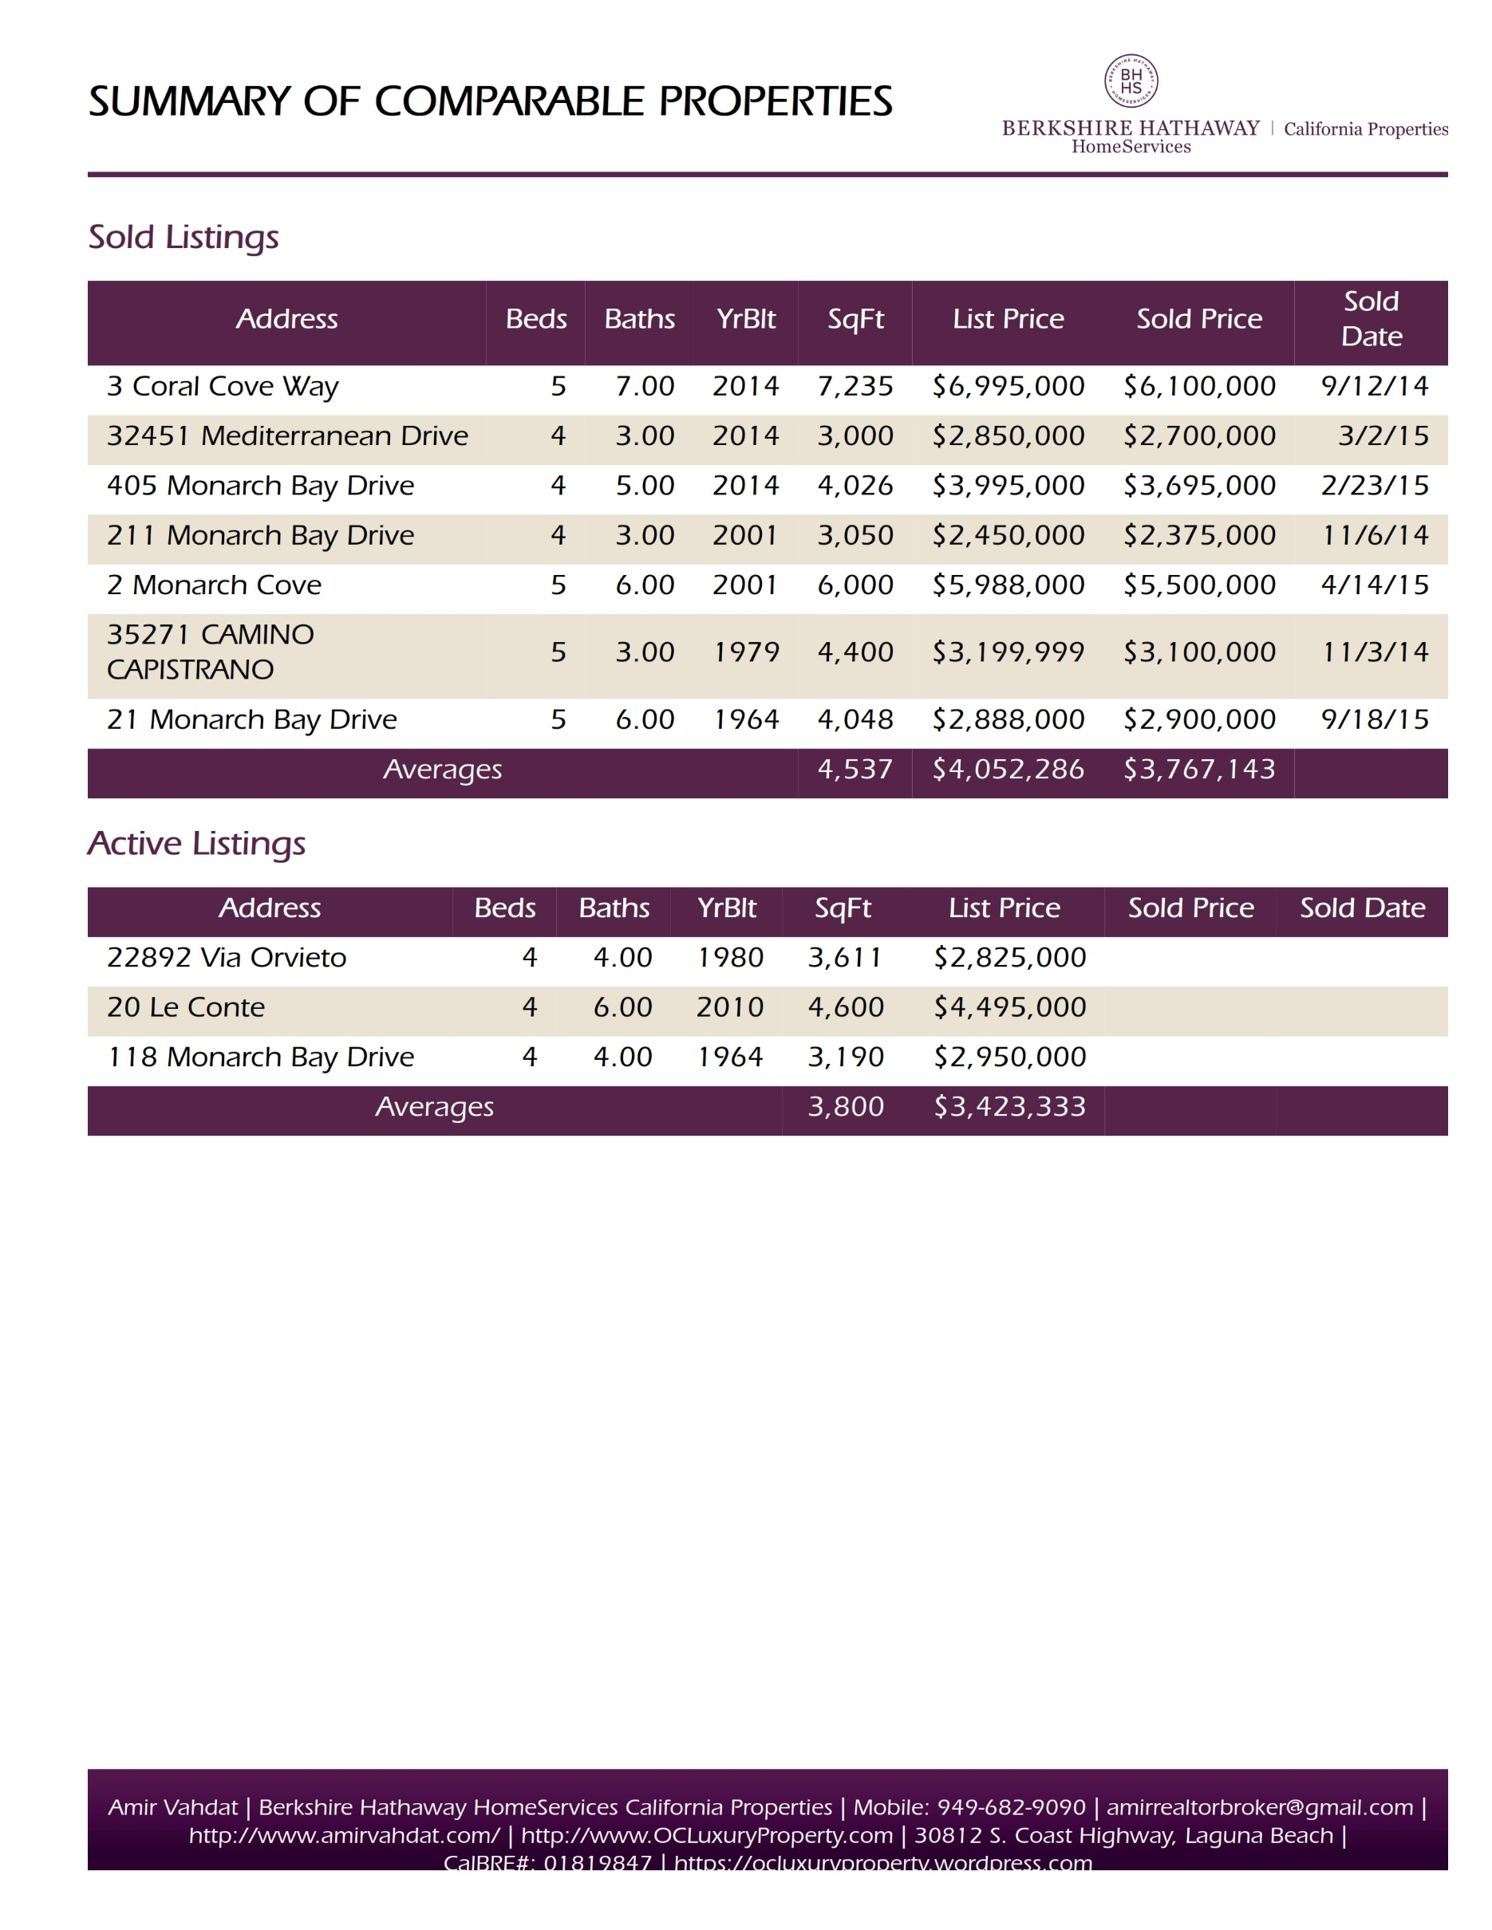

Slide 26
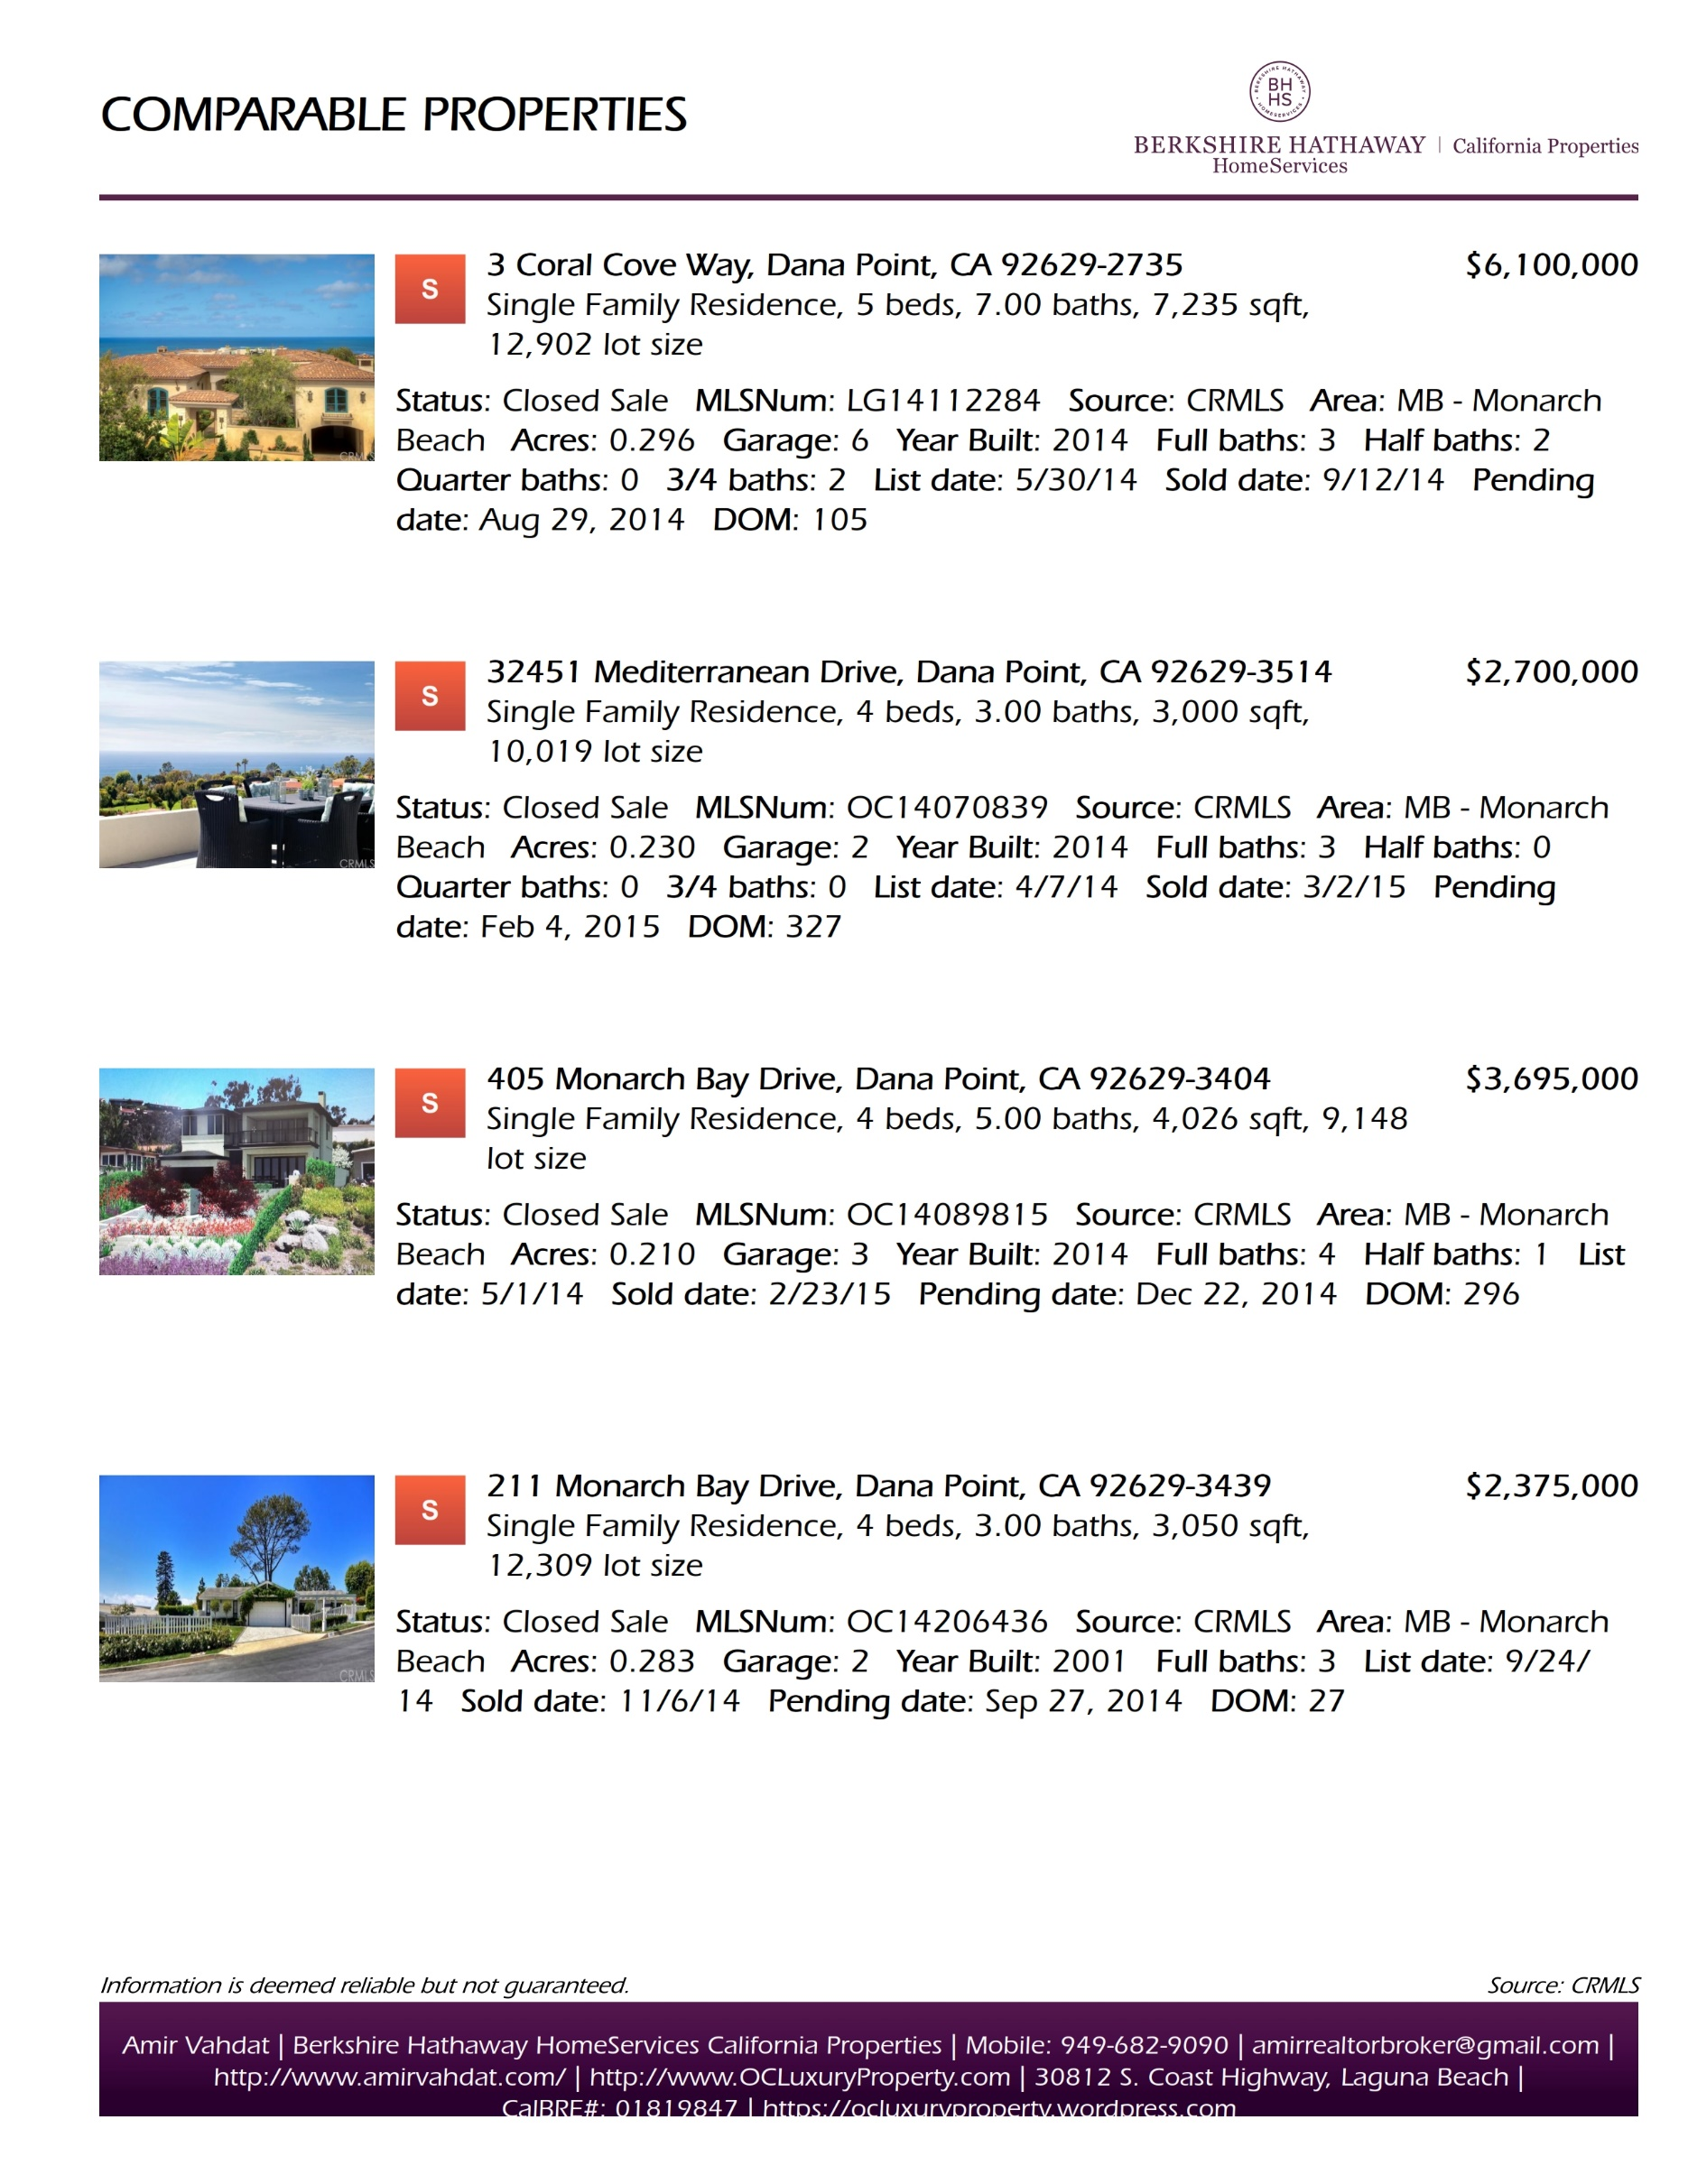

Slide 27
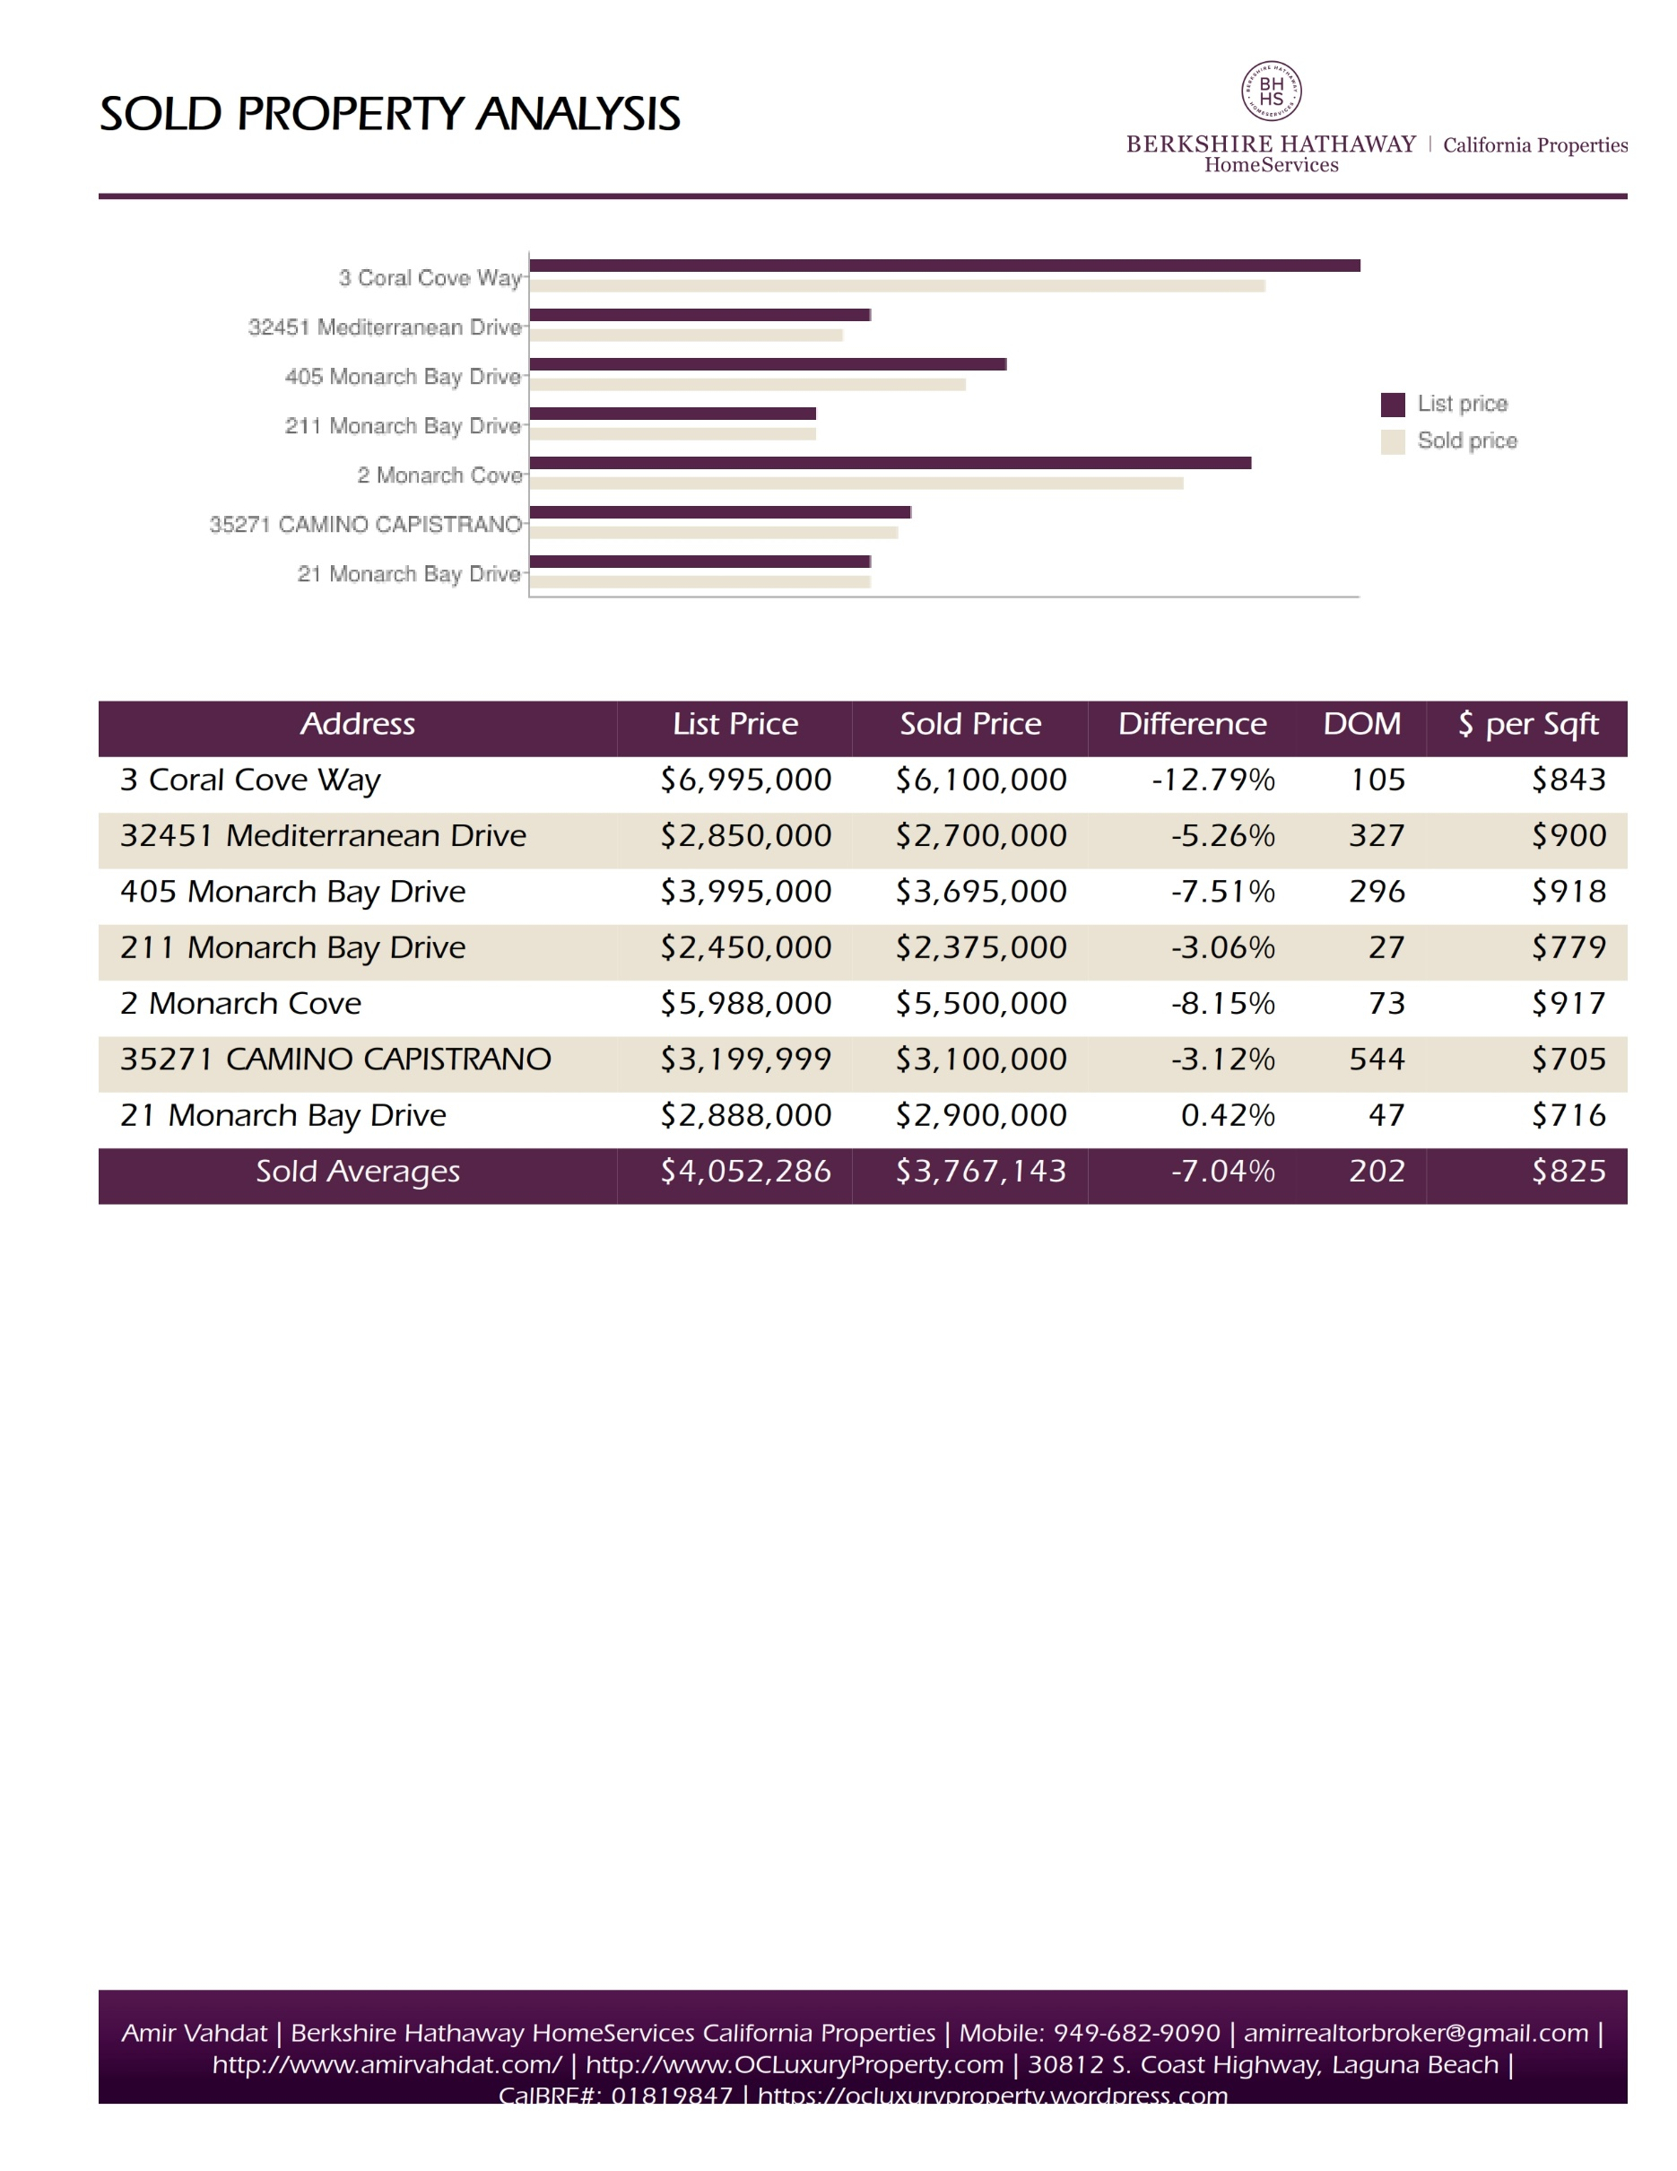

Slide 28
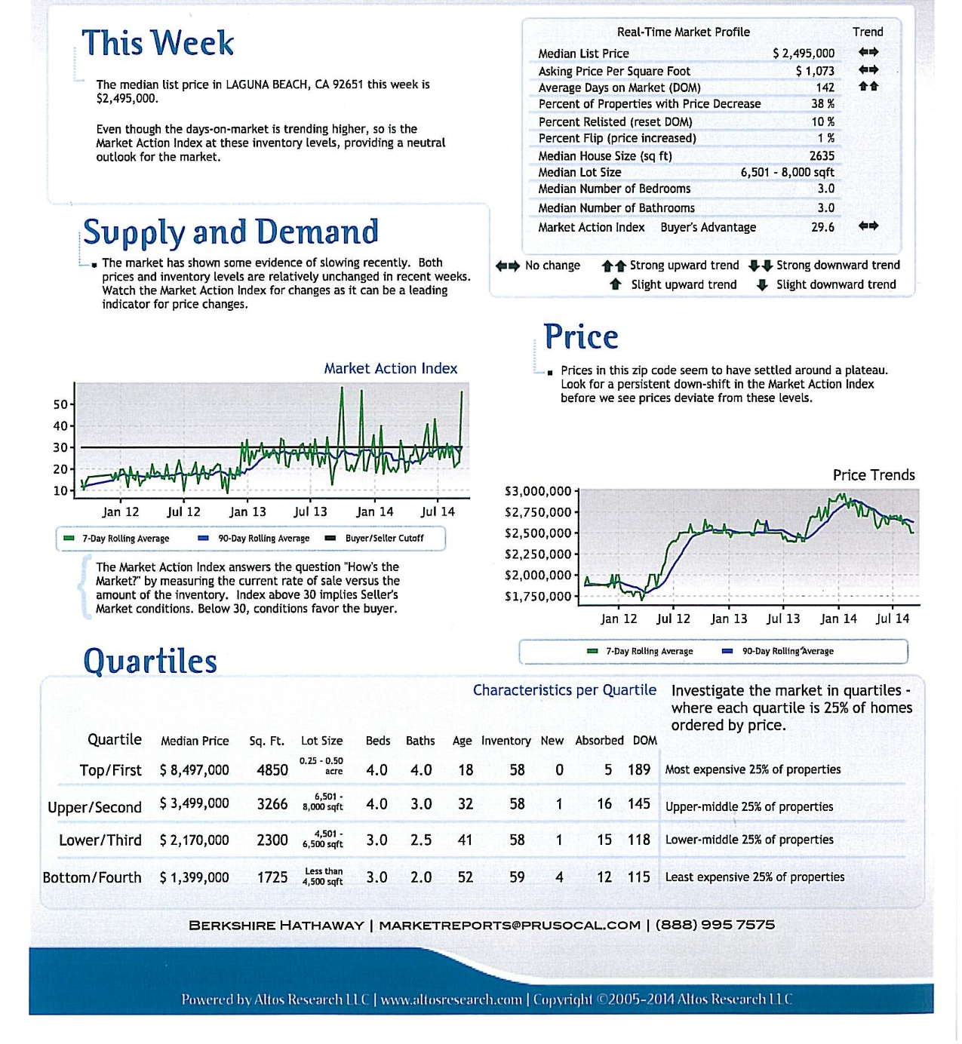

Slide 29

THE ART
Of Home Pricing
The majority of showings by sales associates on a new listing occur when the house is first placed on the market. Sales agents arrange for their active, qualified buyers to see a home when it is newly listed.
Once this group has seen the property, showing activity decreases to only those buyers new to the market.
Effect of Over-Pricing on Time and Selling Price
List Price
True Market Value
Sales Price
Number of Buyer Showings
1 2 3 4 5 6 7 8
Weeks on Market
1
2
3 4 5 6
Weeks on Market
It’s important to position your home at the best price during its first market exposure.

Slide 30

PREPARING YOUR
PROPERTY
FOR SALE
proper t y

Slide 31
You are the Key Player on the
Home selling Team
No one has a more important role in the homeselling process than you. Here are some ways your participation can contribute to a successful sale:
Maintain the property in ready-to-show condition.
Ensure that the house is easily accessible to real
estate professionals (lock box and key).
Try to be flexible in the scheduling of showings.
When you are not at home, let me know how you
can be reached in case an offer is received.
If approached directly by a buyer who is not represented by a real estate professional, please contact me. Do not allow them into the property unescorted.
Remove or lock up valuables, jewelry, cash and prescription medications.

Slide 32
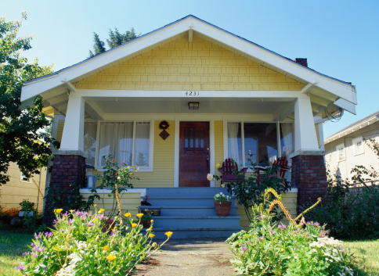

How Will Buyers See Your Property
It is important for a property to make the best possible impression on prospective buyers. The following can interfere with a buyer’s appreciation of a property:
Exterior
Clutter
Lawn needs mowing and edging
Untrimmed hedges and shrubs
Dead and dying plants
Grease or oil spots on the driveway
Peeling paint
Anything that looks old or worn
Interior
Worn carpets and drapes
Soiled windows, kitchen, baths
Clutter
Pet and smoking odors
Peeling paint, smudges or marks on walls

Slide 33


Maximizing First Impressions
© 2013 Berkshire Hathaway HomeServices California Properties

Slide 34
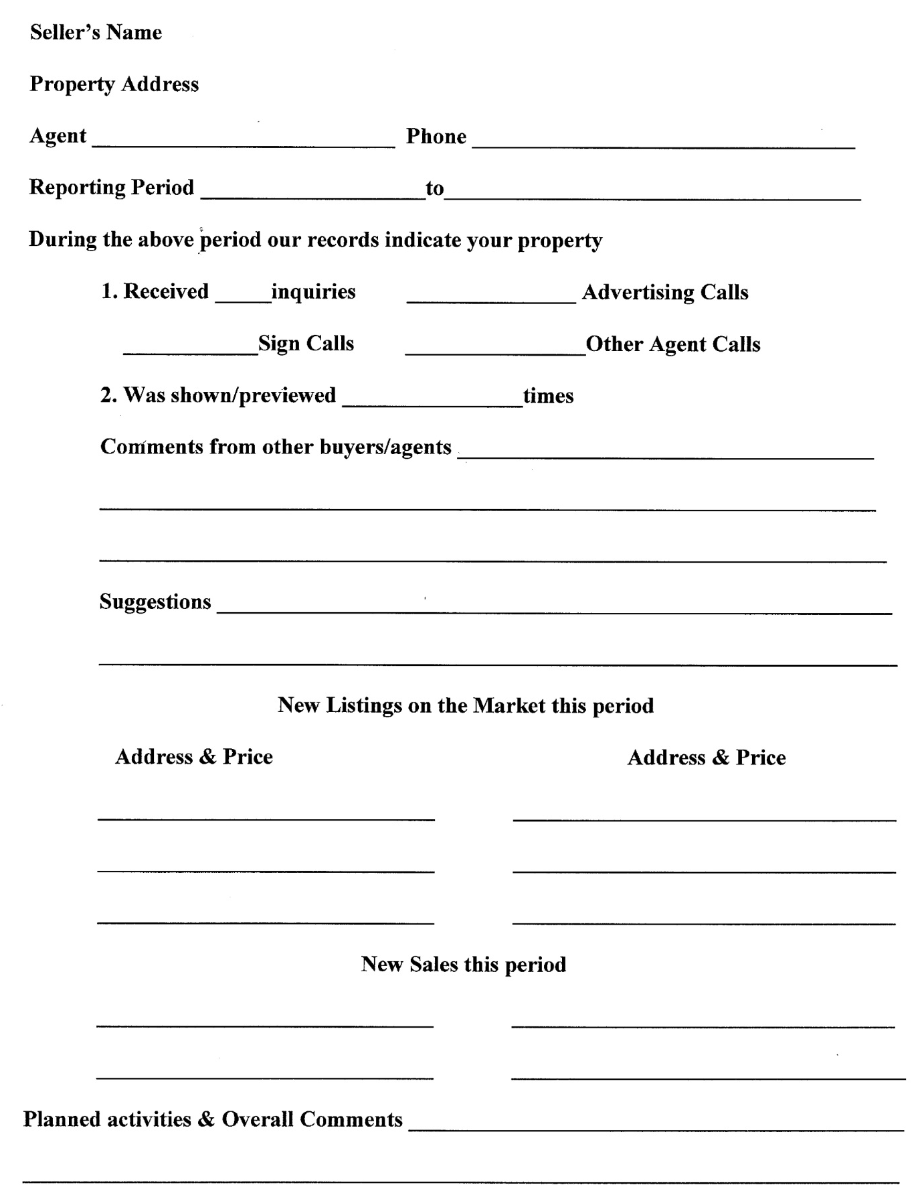
Activity Report for Seller

Slide 35
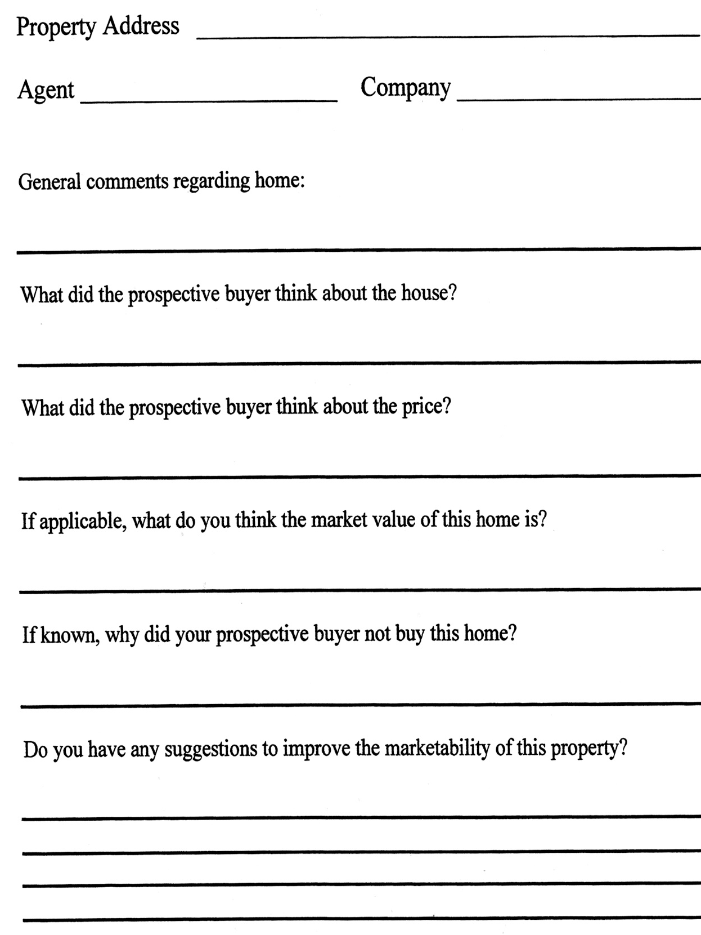
Showing feedback from other agents
© 2013 Berkshire Hathaway HomeServices California Properties

Slide 36

WHO
WE ARE
ab out u s

Slide 37

Strength
You Can Rely On
© 2013 Berkshire Hathaway HomeServices California Properties

Slide 38

Strength
You Can Rely On
© 2013 Berkshire Hathaway HomeServices California Properties

Slide 39
Company Overview
When the most respected brand in the world, Berkshire Hathaway, puts its name on a real estate sign, that’s good for the market and great for you.
California Properties
• More than $12 Billion sold in 2013
• One of the top 5 largest brokerages in the nation
• 3,000 sales professionals
• 60 offices across Southern California and the Central Coast
• More than 14,000 transactions in 2013
• Berkshire Hathaway HomeServices California Properties is the #1 company in the network, 2013
Berkshire Hathaway HomeServices Real Estate Brand
• In a little over one year, the Berkshire Hathaway HomeServices network has grown to 34,548 agents and
1,075 offices in 47 states
• Gold Stevie Award Winner - Berkshire Hathaway HomeServices 2014 American Business Award
• Berkshire Hathaway HomeServices No. 1 in real estate brand equity - 2014 Harris Poll Equitrend® Study
Berkshire Hathaway
• Berkshire Hathaway named Barron’s 2013 Most Respected Company in the World
• Berkshire Hathaway named Barron’s 2014 2nd Most Respected Company in the World
• Berkshire Hathaway ranked #4 on Fortune’s 2014 World’s Most Admired Companies
Real estate is local, but property marketing is global. When your home carries the Berkshire Hathaway brand, it’s immediately recognized and esteemed by buyers all over the world. The name stands for strength, integrity and trust, and buyers who see it on a yard sign are instantly impressed. Selling your home could be the biggest financial decision you’ll ever make. It’s reassuring to be backed by a company legendary for trust, integrity and stability. “Berkshire Hathaway wants to be in businesses that are enduring,” says Warren Buffett. He sees real estate as that kind of business.
Berkshire Hathaway HomeServices is also grounded in the financial strength, efficiency and long tradition of parent companies that are immersed in every aspect of residential real estate. Having that depth of expertise on your side is invaluable.
© 2013 Berkshire Hathaway HomeServices California Properties

Slide 40
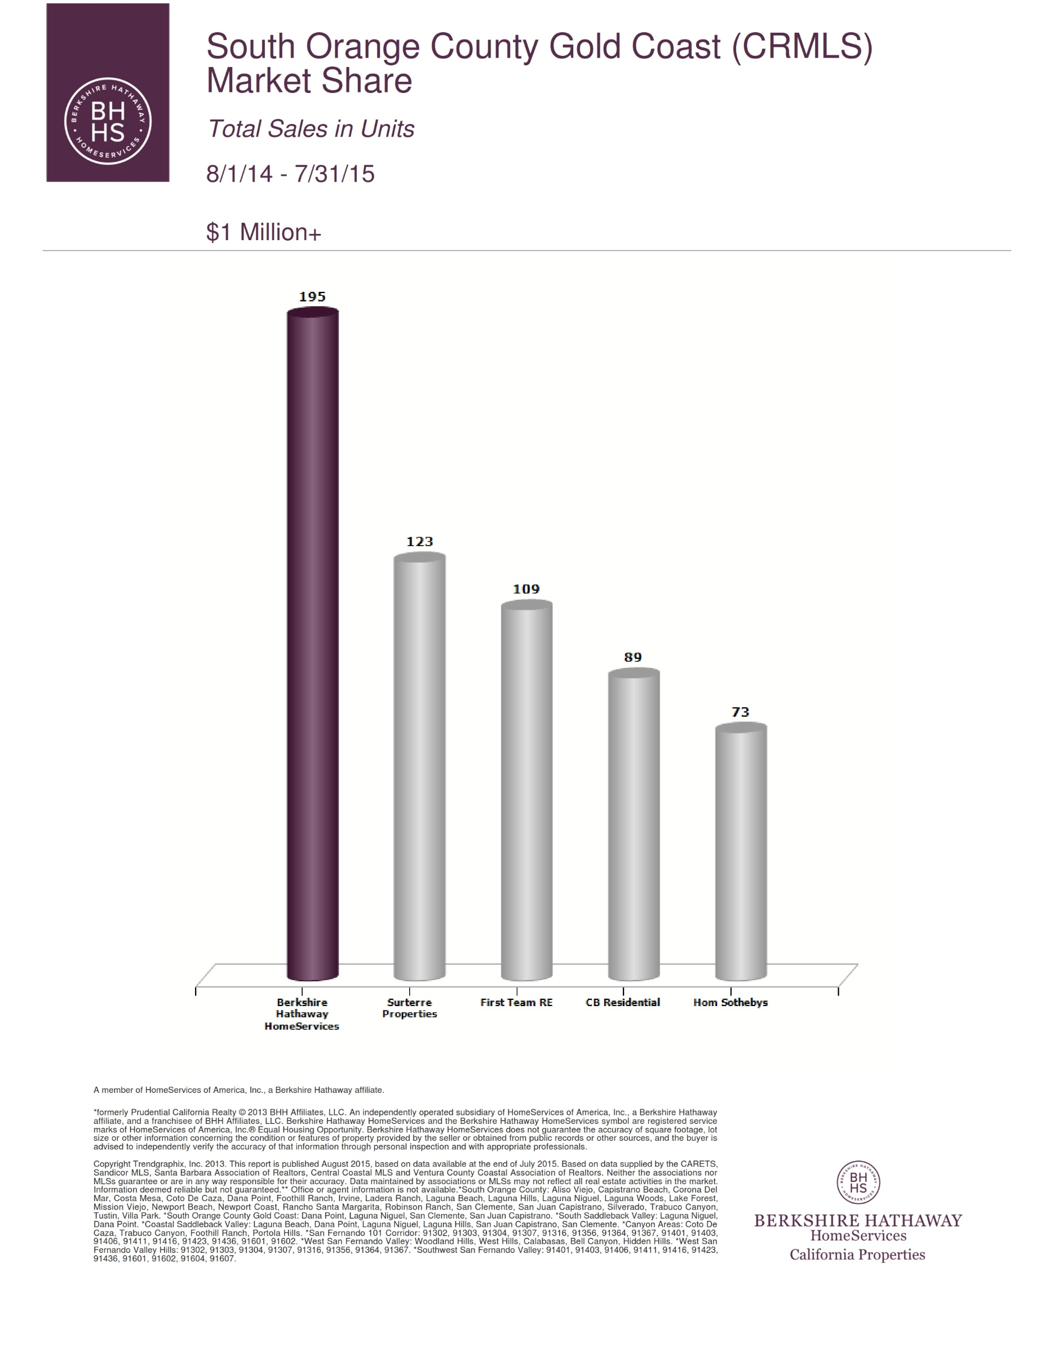

Slide 41

THE POWER
Of Berkshire Hathaway HomeServices California Properties
Thousands of home sellers have learned that Berkshire Hathaway HomeServices California Properties surrounds its clients in a total experience unmatched anywhere. Your real estate professional is committed to enhancing that signature experience… and its rewarding results.
The success of Berkshire Hathaway HomeServices California Properties:
More than $12 billion in annual sales volume
More than 14,000 transactions last year
One of the top two brokerages in the nation
Nearly 3,000 sales associates in more than 60 offices collaborate to locate the best buyers and properties for their clients.

Slide 42






REAL ESTATE BRAND OF THE YEAR
2014 Harris Poll EquiTrend®
Harris Poll finds Berkshire Hathaway HomeServices No. 1 in real estate brand equity.
“Warren Buffett’s brand-new real estate franchise brand, Berkshire Hathaway HomeServices, has the strongest brand equity of the real estate brands, according to a Harris Poll consumer survey.”
The survey gauged consumers’ emotional connection to brands, their awareness and familiarity of them and the influence they may have on them.
Brands that fell below average in the real estate category were, in alphabetical order: Coldwell Banker Real Estate, ERA Real Estate, Re/Max, Sotheby’s International Realty and Weichert Realtors.
Text is copyright © Inman News, March 20, 2014

Slide 43


ELITE ALLIANCES
The market for upper-tier properties is small, exclusive and global. As members of the distinguished Luxury Collection network, Berkshire Hathaway HomeServices California Properties agents are linked to offices in the nation’s leading upscale markets. They use these impeccable connections to cross-promote distinctive properties and share information on affluent buyers.
Our high-end network includes offices in:
Atlanta Beverly Hills Boca Raton Boston Brentwood Calabasas Charleston Chicago Coronado Dallas
Del Mar Encino Greenwich
Honolulu Jackson Hole La Jolla Laguna Beach Las Vegas Malibu Manhattan Miami Montecito
Newport Beach Pacific Palisades Pasadena
Point Loma
Princeton Rancho Santa Fe San Francisco San Marino Santa Barbara Santa Monica Santa Ynez Seattle Southampton Vail
Vancouver Washington, D.C.
The pool of buyers for exceptional estates is small and difficult to reach. Your agent has inside access to these exclusive circles nationwide.

Slide 44

WORLDWIDE CONNECTIONS
Many real estate transactions involve corporate relocations. Your agent has many ways to expose your property to this huge pipeline of relocating buyers
The Berkshire Hathaway HomeServices California Properties agent network, generating over 100,000 referrals a year
Berkshire Hathaway HomeServices California Properties Relocation, working with the employees and members of over 900 major organizations across North America
Primary broker for highly successful worldwide relocation companies including Brookfield, SIRVA, AIReS, Weichert, Altair, Cartus, Graebel and many more
Major corporations nationwide look to us for relocation assistance. This creates a rich source of highly motivated buyers for your home

Slide 45
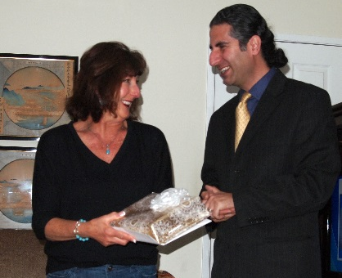



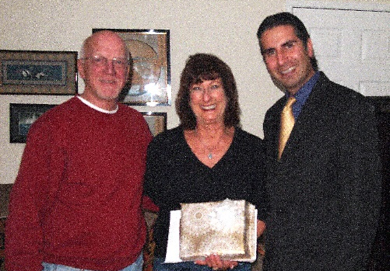

THE CHARITABLE FOUNDATION
Agent Community Outreach
At Berkshire Hathaway HomeServices California Properties, we know our clients are investing not only in homes, but in the quality of life that surrounds them. That’s why we contribute part of every commission to The Charitable Foundation.
For a list of our beneficiaries, or to request grant funds, visit foundation.bhhscalifornia.com.
Aliso Viejo community
The Sunshine Kids Foundation
Guide Dogs of America
Aliso Viejo community
Since its inception, our foundation has provided hundreds of grants totaling some $4 million to local organizations that promote health, education, community and environment. We also actively volunteer our own time and talents to the causes we support.

Slide 46

Home selling Services Commitment
I commit that I will:
Communicate with you in a timely and efficient manner.
Identify your needs.
Develop and implement an effective Marketing Plan for your property.
Help you determine an effective pricing strategy.
Recommend steps to prepare your property for market.
Represent you in negotiations with prospective buyers.
Work to protect your interests through the completion of the transaction.

Slide 47
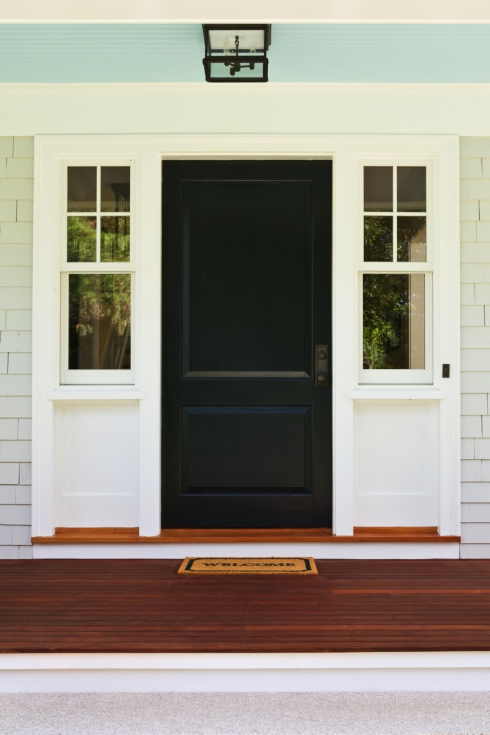
Thank You
Thank you for taking the time to review this presentation. I look forward to working with you.
Amir Vahdat
30812 S. Coast HWY.
Laguna Beach, CA 92651
949-682-9090
www.OCLuxuryProperty.com

