Slide 1
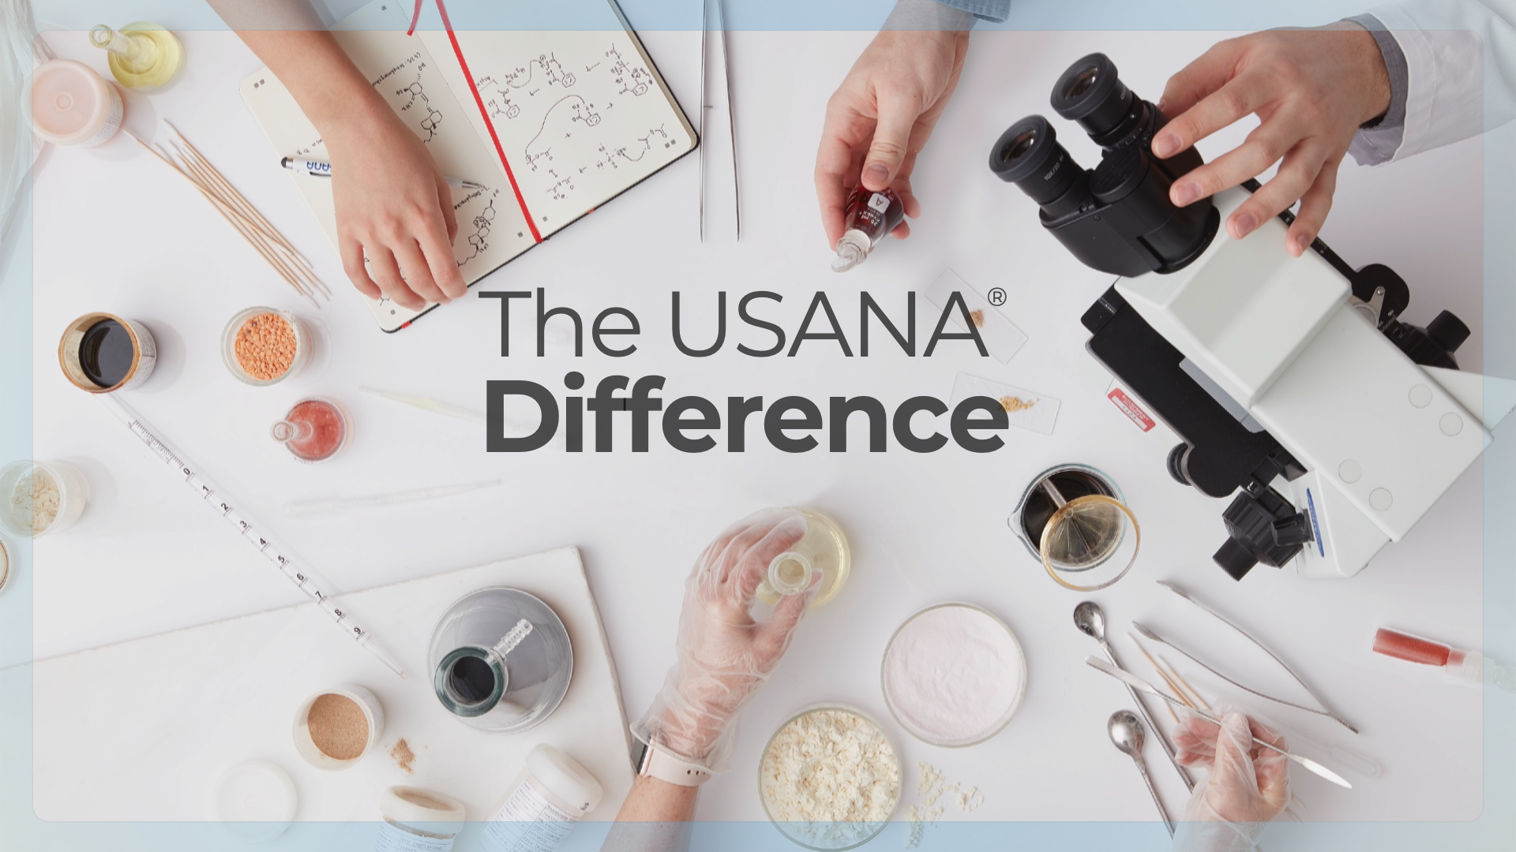
Notes:
Associate notes:
A script is included with each slide to help you get comfortable with this presentation, the flow, and the overall tone of the USANA story.
Once you feel more at ease with the content, focus on the shorter talking points (also included with each slide) to guide your own message.
Be mindful of your potential new Preferred Customer or Associate’s needs and wants and highlight what matters most to them throughout the presentation.
As an Associate, you’ll find more success when you help new people discover their best fit within USANA. The right level of engagement puts them in a happier place. They’re positioned to thrive. They’ll receive relevant, targeted USANA communications that meet their expectations. And their dedication and time commitment will align with their path. This will, in turn, help you be more successful in meeting your long-term goals.
SCRIPT
Thanks for your time today!
I’m excited to introduce you to USANA—a nutrition company that’s obsessed with the health of your cells. They’ve turned that obsession into a revolutionary, holistic approach to wellness you can’t find anywhere else.
[Share your personal product story.]
USANA’s approach to cellular nutrition works. It’s why they can sell through Associates like me, rather than through traditional advertising.
We believe in and love USANA products so much that we can’t help but share them with others. And as we do, we earn additional income and other rewards.
I’ll talk more about those rewards later, but right now I’d like to tell you all about what makes USANA different, and why it’s so difficult for other companies to match their passion for cellular health.
TALKING POINTS
Introduction
Personal USANA product experience
Why USANA? in your own words

Slide 2

Notes:
SCRIPT
Sometimes it’s important to take a step back and remember: you only have one body throughout your entire life, and it’s under your care.
It’s made of trillions of intricate cells, all working on different tasks while you go about your day. Each of these cells needs specific fuel to operate at its best.
USANA is obsessed with the health of your cells.
This makes them the perfect partner to help you find what you need so you can feel the difference optimal cellular health can make in your body.
TALKING POINTS
You have one body made of trillions of cells—all requiring specific nutrients to thrive.
Are you feeding your cells what they need?
With a healthy body, we can get the most out of life
USANA is obsessed with the health of your cells.
Share a personal USANA product experience.

Slide 3

Notes:
SCRIPT
Just as it’s important to understand that healthy cells are your key to a healthy body, it’s also vital to understand your time in this life is incredibly valuable.
With USANA, you can earn additional income simply by experiencing the benefits of cellular health and sharing your story with others.
USANA can easily be integrated into your existing lifestyle using the simple tools USANA gives you to connect all your friends, family, and social media followers with the products I know you’ll love.
TALKING POINTS
Your time is incredibly valuable.
Share the benefits of USANA products and get paid for your efforts.
USANA makes this easy with simple, link-based sharing tools you can use in person or online.

Slide 4

Notes:
SCRIPT
The choices you make every day shape the health of your body and mind, and how you use your time ultimately determines the kind of life you live.
It’s important to ask yourself, “What will help me live my healthiest, happiest life?”
USANA makes it possible to seize your full potential, giving your body what it needs to thrive and allowing you to earn additional income simply by sharing your favorite products while you live the life you love.
TALKING POINTS
The choices you make determine the health of your body and mind.
How you use your time ultimately shapes the kind of life you live.
What will help you live your healthiest, happiest life?
USANA makes it possible to seize your full potential.

Slide 5

Notes:
SCRIPT
Before you begin sharing USANA products, it’s important to understand their unique science and benefits.
USANA believes your life begins at the cellular level.
While you can’t feel your individual cells, you can feel the difference that feeding them right makes for your body.
So, ask yourself, “Am I feeding my cells the nutrients they need to support and maintain normal body functions?”
USANA’s products are uniquely formulated to do exactly that.
It’s a company that’s been obsessed with cellular health since before it was founded in 1992.
TALKING POINTS
Why should you choose to take and share USANA products?
USANA’s products are uniquely developed with the idea that your life begins at the cellular level.
The company has been obsessed with cellular health since before it was founded in 1992.

Slide 6

Notes:
SCRIPT
USANA’s founder is Dr. Myron Wentz, an internationally recognized microbiologist, immunologist, and pioneer in the development of human cell culture technology and infectious disease diagnoses.
In 1974, Dr. Wentz founded Gull Laboratories, where he worked with human cell cultures, spending decades keeping them healthy and free from degeneration.
He realized it takes more than simply providing those cells with vitamins, minerals, and nutrients to keep them healthy.
What they need is the right nutrients, in the right form, and in the right amounts.
He studied a wide range of nutritional supplements and compared them to what he was feeding the cells in his laboratory.
This realization is what led him to create USANA.
TALKING POINTS
Dr. Wentz, USANA’s founder, is an internationally recognized microbiologist, immunologist, and pioneer in the development of human cell culture technology and infectious disease diagnoses.
Before USANA, he worked with human cell cultures for decades and kept them healthy and free from degeneration.
He studied a wide range of nutritional supplements and compared them to what he was feeding the cells in his laboratory, and this is why he founded USANA.

Slide 7

Notes:
SCRIPT
He made USANA what it is today by taking a full-spectrum approach to product creation. Rigorous practices and protocols ensure that every USANA product is built on smart science and delivers proven efficacy for you and your family.
Each product goes through six stages before arriving at your doorstep:
Research
Formulation
Clinical trials (most products go through this stage, but not all)
In-house and third-party manufacturing
USANA’s state-of-the-art quality control process
And finally, third-party verification
USANA controls or oversees products through 100% of the creation process—concept to delivery.
TALKING POINTS
A full-spectrum approach to product creation, rigorous protocols for testing ideas, and developing and verifying products ensures USANA delivers what is promised.
This process includes:
Research.
Clinical Trials—both in-house and with our third-party research partners. This applies to most products, but not all.
Manufacturing in-house where it makes sense and holding outside manufacturers to our high standards.
Testing ensures we meet agency standards in many countries around the world.
Third-party verification validates USANA’s rigorous testing protocols.

Slide 8

Notes:
SCRIPT
Let’s talk more about the research and clinical trials USANA uses to verify product claims.
More than 150 scientists make up its research and development team—with backgrounds in biochemistry, molecular and cellular biology, pharmacy, genetics, and sports science.
They collaborate with third-party research institutions to research and validate products before they are put into development.
TALKING POINTS
More than 150 scientists make up USANA’s research and development team.
These scientists work with third-party research institutions to validate product claims and run clinical trials.

Slide 9
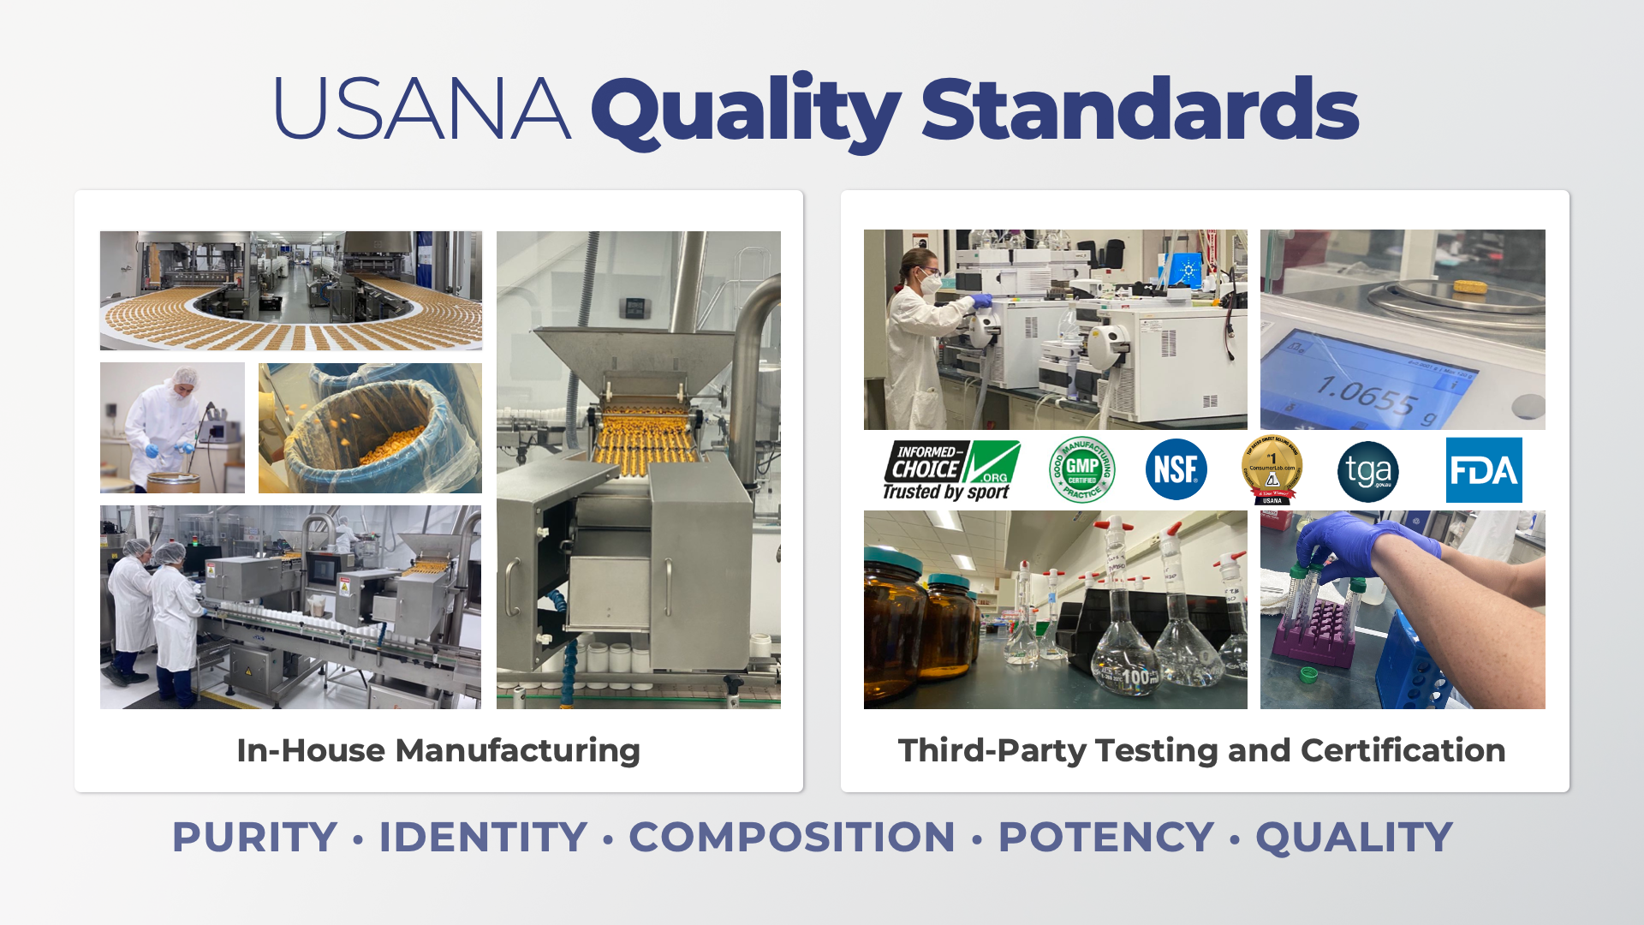
Notes:
SCRIPT
Let’s build a bit more on USANA’s quality standards and certification processes.
USANA is transparent about how products are made and the rigorous testing and certification they undergo to ensure quality.
Each product goes through five major areas of quality testing.
First, they are tested for purity. This means raw ingredient material is free from adulteration, heavy metals, pesticides, and other forms of contamination.
Second, they are tested for identity. USANA’s ingredients are inspected, sampled, and analytically tested to ensure quality.
Every product batch is tested for composition. USANA products are guaranteed to deliver nutrients to help support normal cellular function. A multi-method approach analyzes and documents details like weight, disintegration, thickness, and stability.
Product strength is evaluated, taking into account ingredient interaction and half-life to ensure potency.
And finally, in addition to in-house testing, third parties are brought in to test for safety. The safety of USANA products is of the highest importance.
You can be confident that USANA’s products have been thoroughly analyzed for effectiveness and quality, ensuring that what’s on the label is in the product.
TALKING POINTS
USANA is transparent about how their products are made.
Each product is tested for purity, identity, composition, potency, and quality.
This ensures that what is on the label is what’s in the product.

Slide 10

Notes:
SCRIPT
USANA’s strict manufacturing standards is a big reason thousands of professional and Olympic athletes trust USANA more than any other supplement company in the world.*
And the Athlete Guarantee Program lets athletes know the quality in each USANA product is guaranteed to be pure and free of any banned substances—backed up by up to $1 million USD if an athlete tests positive for a banned substance.
*USANA Athletes have received 3,500+ World Cup Medals.
ADDITIONAL ATHLETE INFORMATION
265 USANA-affiliated athletes competed at the Tokyo Games representing 11 different countries—Australia, Canada, China, France, Indonesia, Korea, Malaysia, Mexico, Philippines, Spain, and the United States. USANA Athletes captured a total medal count of 100—44 gold, 35 silver, and 21 bronze—and set 25 Olympic records and four World records.
In the Tokyo Summer Paralympics, USANA Athletes earned 13 podium finishes—seven gold, three silver, and three bronze—across athletics, judo, shooting, swimming, and wheelchair fencing and tennis events. American sprinter Nick Mayhugh and swimmer Jessica Long led the pack with a combined five World records, two American records, and six gold medals.
With 146 athletes from six countries—Canada, Germany, Italy, Mexico, South Korea, and the United States—USANA Athletes competed in a dozen disciplines and left the Beijing Winter Olympics with 21 medals—eight gold, eight silver, and five bronze.
TALKING POINTS
Because of USANA’s high quality standards, thousands of professional and Olympic athletes trust USANA.

Slide 11
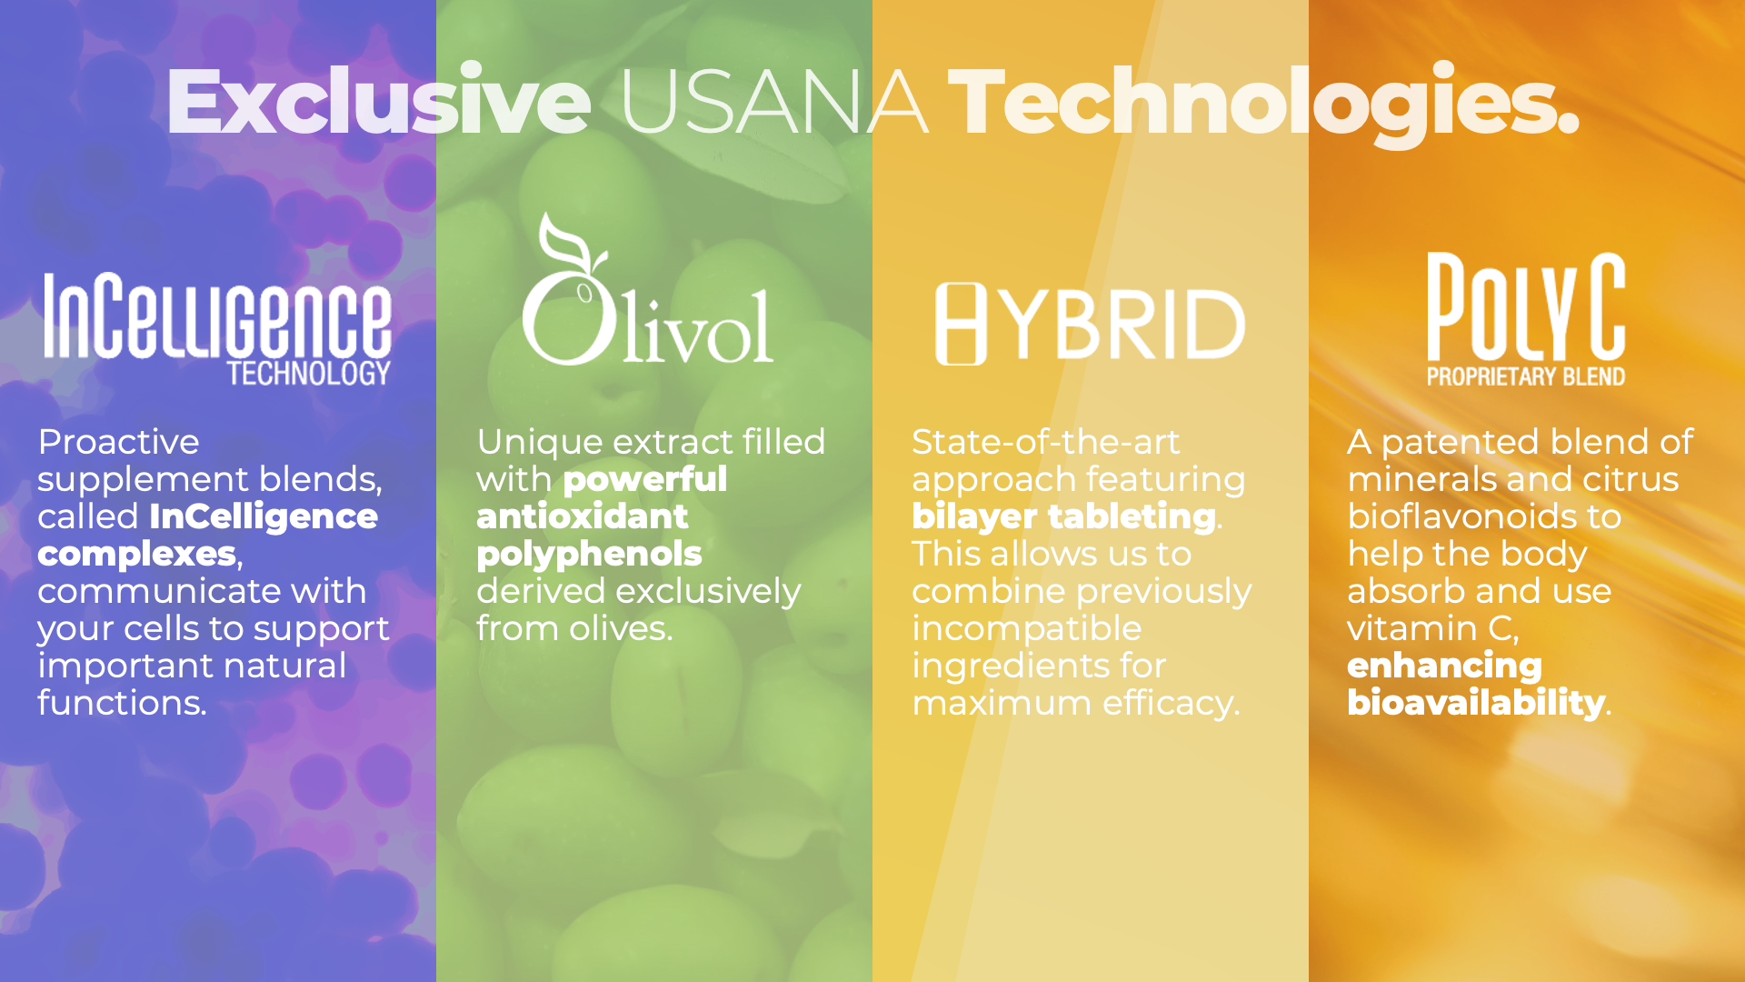
Notes:
SCRIPT
I’ve told you a bit about USANA, how their products are developed and manufactured, and why they’re trusted by athletes who value the importance supporting their cells.
But what makes USANA products truly unique?
USANA has developed exclusive technologies that enhance your body’s natural ability to support overall health and well-being.
InCelligence Technology is USANA’s premier formulation method that allows the products to communicate with your cells to support normal health responses. I’ll talk more on this patented design process next!
Olivol is a powerful olive-fruit extract packed with antioxidant polyphenols derived from olives through a distinct extraction process.
Hybrid Technology is a state-of-the-art bilayer tableting approach to nutritional supplementation. It allows USANA to combine ingredients that historically have not been able to be paired together into a single tablet.
Poly C is a patented blend of minerals and citrus bioflavonoids to help the body absorb and use vitamin C and help enhance the nutrients’ bioavailability and effectiveness.
TALKING POINTS
USANA’s focus on cellular health has led them to discover unique technologies exclusively found in USANA products.

Slide 12

Notes:
SCRIPT
Let’s dive deeper into one of my favorite topics when it comes to USANA’s advanced nutrition—InCelligence.
This formulation method is what USANA calls “proactive supplementation.” InCelligence Technology uses cell-signaling—the body’s way of communicating—to enhance USANA’s products for more personalized benefits. It’s in several of USANA’s top-selling products.
InCelligence Technology works inside the body like this:
First, the InCelligence technology sends a specific message to your cells.
Then, your cells receive the message and respond.
Finally, your cells support a targeted function in your body.
This process of supporting specific health needs means a more personalized approach to nutrition.
TALKING POINTS
InCelligence Technology uses cell-signaling—the body’s way of communicating at the cellular level—to enhance USANA’s products in unique ways.
By tapping into cell signaling, USANA uses your own body’s natural abilities to support targeted health benefits based on your unique needs.

Slide 13
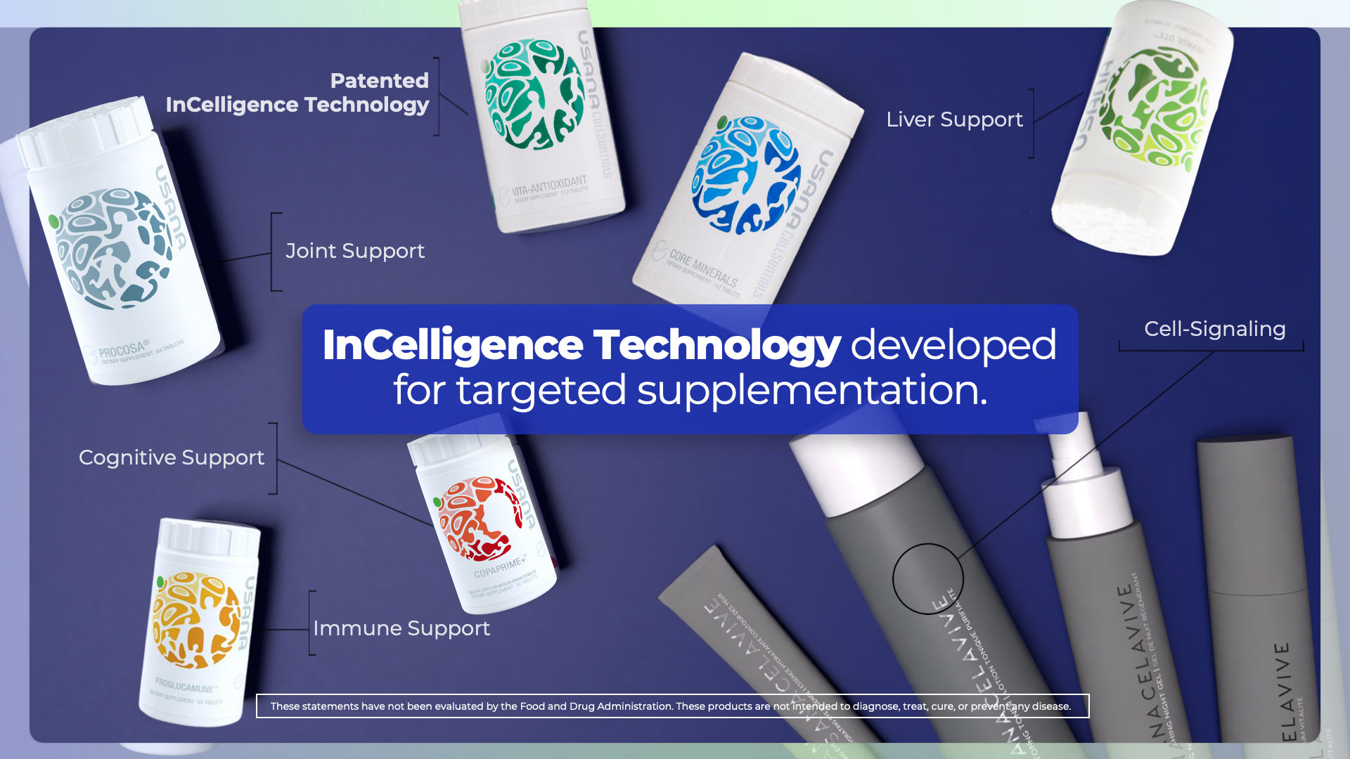
Notes:
SCRIPT
USANA uses InCelligence Complexes in a variety of its core products for supplementation that supports your unique needs:
Starting with the most important, foundational product, the CellSentials contains the patented InCelligence Complex.
This combination of nutrients and phytochemicals work together with your body to support healthy cellular function.
Proglucamune contains InCelligence to support normal immune function.
Hepasil DTX is formulated with InCelligence to support your liver’s natural cleansing functions.
Procosa contains InCelligence to support your body’s normal joint function, range of motion, and mobility.
Copaprime+ uses InCelligence to support normal cognitive function, learning, memory, focus, alertness, and mood.
Celavive is formulated with InCelligence which helps the skin maintain moisture, look firm, smooth, glowing, and radiant.
TALKING POINTS
By tapping into cell signaling, USANA uses your body’s natural ability to support targeted health benefits based on your unique needs.
InCelligence complexes are found in several of USANA’s top-selling products.
Share a personal USANA InCelligence product experience.

Slide 14

Notes:
SCRIPT
Thinking about cellular health may be new to you. And if you’re not sure where to start, that’s okay!
USANA makes it easy with world-class nutritional supplements.
Scientific advancements have given us greater insight into the human body, its systems, and the delicate balance at work inside each of us.
And USANA has a simple place for everyone to start.
TALKING POINTS
It’s okay if thinking about cellular health is new to you.
USANA gives everyone an easy place to start.

Slide 15

Notes:
SCRIPT
The simplest action you can take for health is to supplement with science-based cellular nutrition, so your cells have the energy to function.
USANA’s number one top-selling product of all time is the CellSentials:
Core Minerals, and Vita Antioxidant, made with InCelligence Technology.
U.S. patented InCelligence Technology is designed to support and maintain normal cell function.
Plus, tablet delivery allows for maximum nutrient density, and optimal bioavailability and absorption.
Your body’s cells use the vitamins and minerals in the CellSentials InCelligence Complex to support strong and resilient response pathways, so they become prepared to respond to the trillions of vital signals they receive every day. When you take USANA CellSentials regularly, your body becomes healthy—from the cell up.
If you take a quality supplement, nutrients can support necessary systems of your body. With balanced vitamins and minerals in scientific forms, cellular function can be maintained.
TALKING POINTS
USANA CellSentials featuring InCelligence Technology is USANA’s core product and an easy step everyone can take to support cellular health

Slide 16
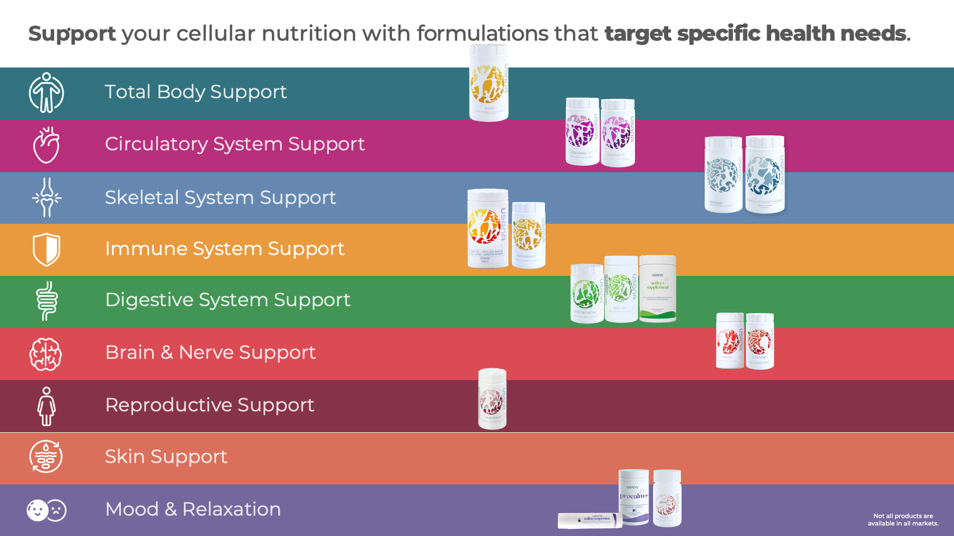
Notes:
SCRIPT
Start with CellSentials as your foundation. Then, customize your routine based on your goals with USANA’s Optimizers.
Each balanced formulation offers specific benefits to support your body’s normal cellular functions and help maintain your well-being.
TALKING POINTS
Start with the CellSentials as your foundation.
Customize your daily supplement routine with USANA Optimizers.
These products help support your body’s specific needs.
Share a personal story about the Optimizers you take and any product recommendations you have for the person you are speaking with.

Slide 17

Notes:
SCRIPT
Of course, we can’t survive on supplements alone! A healthy diet is vital to your overall health and well-being.
But USANA understands it’s not always easy or convenient to prepare whole-food meals every day of the week. So they’ve created a variety of functional food products to support your nutrition and body composition goals.
Because weight management is a top concern for so many, USANA has delicious products, including meal-replacement shakes, to give you the macronutrients and micronutrients you need to feel full, stay energized, and curb cravings.
USANA’s digestive health products are designed to support your gut—your body’s second brain—at the cellular level. People are becoming more interested in supporting digestive health, and USANA has options to help balance your belly and support digestive function.
USANA’s energy and hydration products are scientifically formulated to help maintain your energy levels throughout the day.
Most people don’t even realize they are dehydrated on a regular basis.
Energy and hydration are often overlooked as critical components in everyday health.
Focusing on sustained energy and making sure your body has the minerals it needs to maintain hydration will help you conquer daily tasks and, ultimately, your personal health goals.
TALKING POINTS
USANA also has weight management, digestive health, and energy and hydration products designed to support your holistic health.
Share a personal story about Active Nutrition products you take and any product recommendations you have for the person you are speaking with.

Slide 18
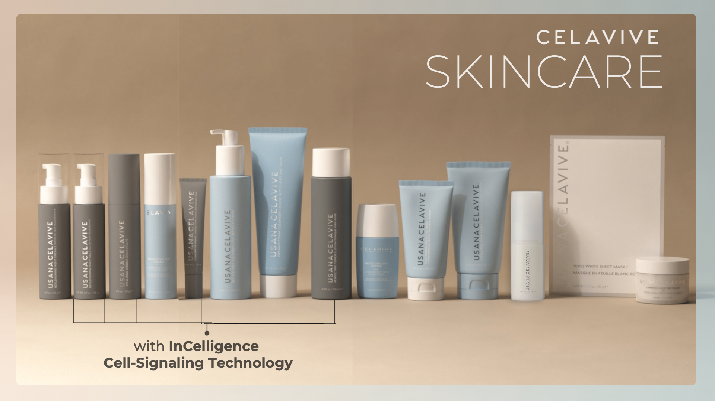
Notes:
SCRIPT
Finally, go beyond what you see with USANA’s Celavive skincare.
This high-performance skincare line has everything you need to cleanse, tone, hydrate, and enhance your skin for a radiant, healthy-looking glow.
Celavive products also feature USANA InCelligence Technology to fight visible signs of aging—like fine lines and wrinkles—and provide intense hydration to reveal beautiful, younger-looking skin.
TALKING POINTS
Go beyond what you see with USANA’s Celavive skincare line.
Share personal benefits you’ve noticed from your favorite Celavive products and any product recommendations you have for the person you are speaking with.

Slide 19

Notes:
SCRIPT
I’ve told you about USANA and how an obsession with cellular health drives their product philosophy.
And, I’ve shown you all the products they’ve developed as a result of their commitment to the health of the human cell.
Let’s talk about what it means to truly own your time with USANA.
With USANA, you can share the cellular health message and the products you love, and get paid for your efforts.
You choose when, where, and how you share—including if you’re more comfortable interacting online or in person.
You also choose whether you want to simply share the products, or do what I’m doing now—promoting the benefits of sharing and earning.
TALKING POINTS
Share USANA and the products you love and get paid for your efforts.
You choose when, where, and how you share, including whether you want to share in person or online.
You also decide what’s best for you—simply sharing USANA’s products or doing what I am doing to share the benefits of earning.

Slide 20

Notes:
SCRIPT
So, how is sharing and earning with USANA different from other ways to earn a supplemental income?
As you know, there are tons of side gigs these days, and it seems like everyone has one.
Some are jobs, like driving Uber or Lyft.
Some are small businesses, like having an online retail store on Etsy, or maybe even a drop-shipping business on a website like Amazon.
Some are investments, like franchises or rental properties.
Each way to earn supplemental income has pros and cons.
With Uber or Lyft, you get to choose your own hours, but you’re still trading hours for dollars and missing out on time with friends and family.
With a franchise or rental property, you’re making a large investment of time, money, and energy before you’ll expect to see a return.
And with an ecommerce or drop-ship business, you’ll require extensive training, experience, skill, or all three to see success, and these types of businesses can be complicated and difficult to learn.
All of these options will take you away from the lifestyle you want to enjoy.
Earning with USANA is unique because it takes advantage of social selling.
TALKING POINTS
Supplemental income can be a great advantage in today’s world.
There are a lot of options out there, but some are better than others.
Sharing and earning with USANA is one of simplest and best, because it takes advantage of social selling.

Slide 21
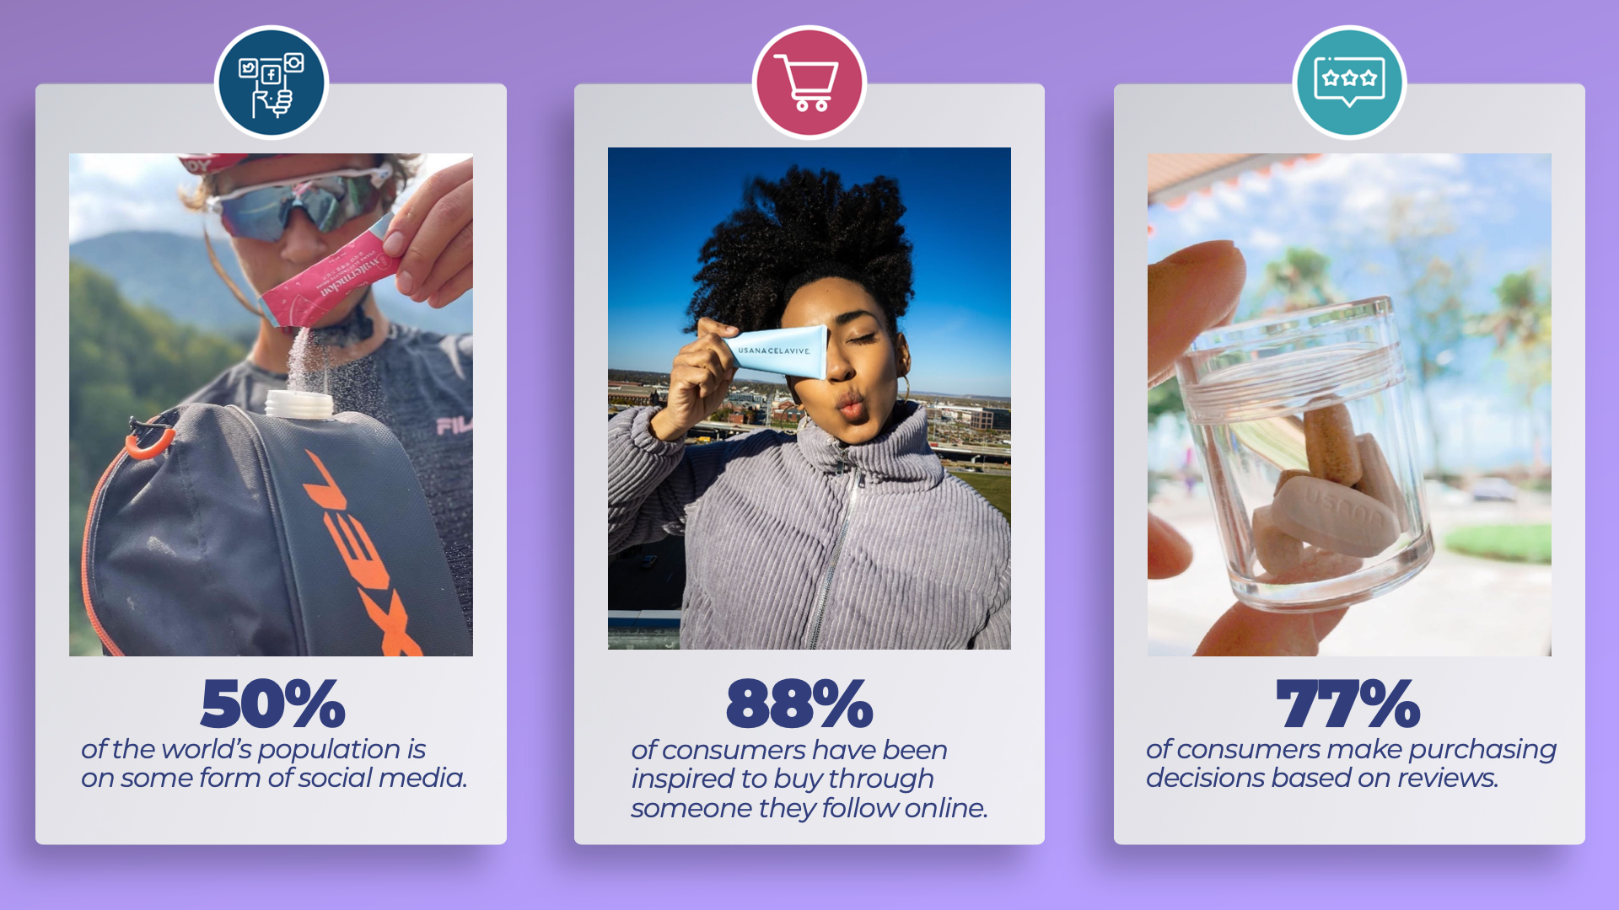
Notes:
SCRIPT
Social selling with USANA means you can connect with people when and where they’re already looking for product recommendations from a trusted source. This means in person, in daily conversations, or online.
People have become more comfortable purchasing products recommended by those they follow on social media.
And according to Nielsen, a global, independent measurement and data company for consumer behavior, 92% of all consumers report that a word-of-mouth recommendation is the leading reason they buy a product or service.
It’s normal to see product recommendations and links on Facebook, Instagram, Twitter, WeChat, WhatsApp, and other social platforms.
This is exactly how you share USANA.
USANA gives you personalized product links you can share anywhere, anytime.
When someone purchases from those links, you earn.
Quick for you.
Simple for your customer.
TALKING POINTS
Social selling allows you to connect with potential customers where they’re at.
Your personal recommendations are incredibly powerful and exactly what motivates people to purchase products today.
USANA gives you personalized product links you can share anywhere, anytime.
You recommend a product and share a link. Your potential customer clicks on the link and buys. You earn.
Quick, simple, easy.

Slide 22

Notes:
SCRIPT
Social selling is how you earn with USANA.
But with USANA, you get so much more.
USANA is a direct-selling company in the health and wellness space. They give you the best of two very successful industries.
The health and wellness industry is now worth more than $4.2 trillion USD—and it’s still growing.
And, more than 128 million people around the world are currently in the direct-selling industry, adding approximately $186 billion USD to the global economy in 2021.
TALKING POINTS
As a direct-selling company in the health and wellness space, USANA combines the best of two very successful, growing industries.

Slide 23

Notes:
SCRIPT
With a 30-year history behind them, there are a ton of great benefits to partnering with a direct-selling company like USANA.
USANA operates in 24+ markets around the globe and gives you options to make your personal business a global one by building across borders.
You’re partnering with a member of the Direct Selling Association (DSA) and World Federation of Direct Selling Associations (WFDSA). This means you can trust in USANA’s products and business operations.
USANA is also one of very few direct-selling companies that’s publicly traded on the New York Stock Exchange (NYSE).
How they do business is no secret, so you can feel confident about partnering with them.
USANA is also focused on giving back. They understand that not everyone has the same access to premium supplements, nutritious food, and a healthy environment.
In 2012, USANA started the USANA Foundation to eliminate childhood hunger.
The Foundation runs Kids Eat—a local organization in Salt Lake City, Utah—and partners with China’s Foundation for Poverty Alleviation (CFPA) and Love Meals, among other organizations globally, to work toward this goal.
And they show a commitment to sustainability by focusing on people, products, and planet.
USANA believes in a brighter future, and they understand that healthy bodies need a healthy planet in order to thrive.
Three of their top priorities are lowering their environmental footprint at their offices around the world, reducing their use of plastics, and ensuring packaging is recyclable.
They are truly working toward creating The Healthiest Family on Earth through their healthy living products, their corporate activities, and through Associates like me.
TALKING POINTS
USANA is a global company, operating in 24+ markets and allowing Associates to have global businesses.
USANA is a member of the Direct Selling Association (DSA) and the World Federation of Direct Selling Associations (WFDSA).
USANA is one of very few direct-selling companies that’s publicly traded on the New York Stock Exchange (NYSE).
USANA is working to create The Healthiest Family on Earth.

Slide 24
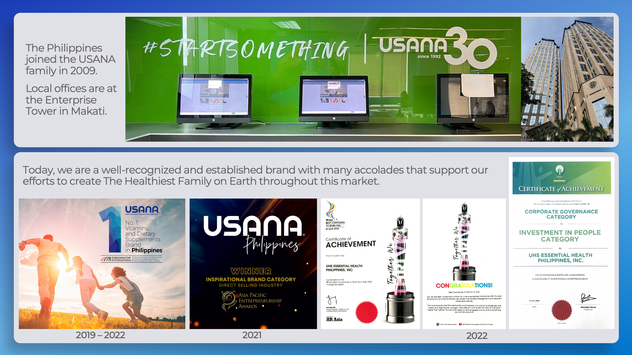

Slide 25

Notes:
SCRIPT
USANA isn’t just a leader in the industry.
Low set-up fees make it easy to get started with just the cost of the very helpful Starter Kit.
And there’s absolutely no stockpile of products.
USANA handles all your orders for you.
You’re given a personal website to share with potential customers, so you can focus on sharing your website links and recommending the company and the products to others.
TALKING POINTS
USANA makes it easy to get started.
Share why and how you joined USANA.

Slide 26

Notes:
SCRIPT
So, are you ready?
Get obsessed with the health of your cells and start living your best life with USANA.
Your wellness is worth it.
And, because I know you’ll love your experience with USANA, when you share USANA products and this message with others, you’ll get rewarded for your efforts.
Choose your rewards now.
TALKING POINTS
Are you ready?
Start living your best life with USANA.
I know you’ll love your experience with USANA so much that you’ll want to share the products with others.
Choose your rewards.

Slide 27
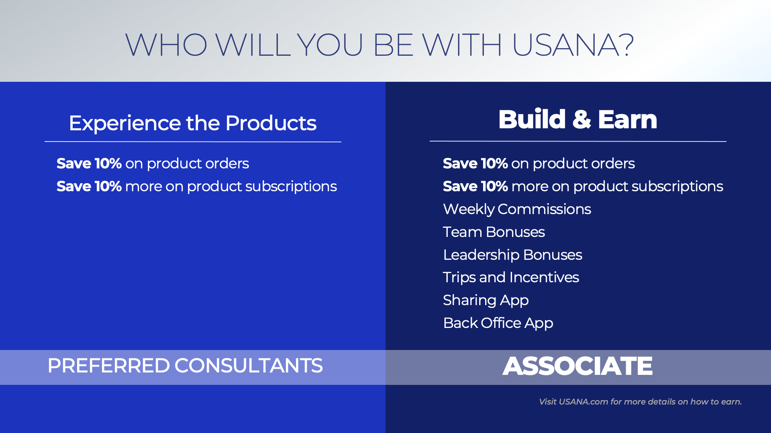
Notes:
SCRIPT
If you’re interested in USANA’s products, become a Preferred Consultant to save 10%.
Or, if you’re interested in sharing not just the products, but also the USANA lifestyle like I do, consider becoming an Associate.
You’ll have more opportunities to earn additional bonuses and commissions, as well as trips and incentives based on your efforts.
You’ll also have access to additional tools and resources to support you.
So, what do you think? Who will you be with USANA?
TALKING POINTS
Become a Preferred Consultant today for free and save 10% on your products
Become an Associate, like me, to access more benefits and rewards based on your efforts from selling USANA products and helping others share the USANA Story.
Who will you be with USANA?

Slide 28
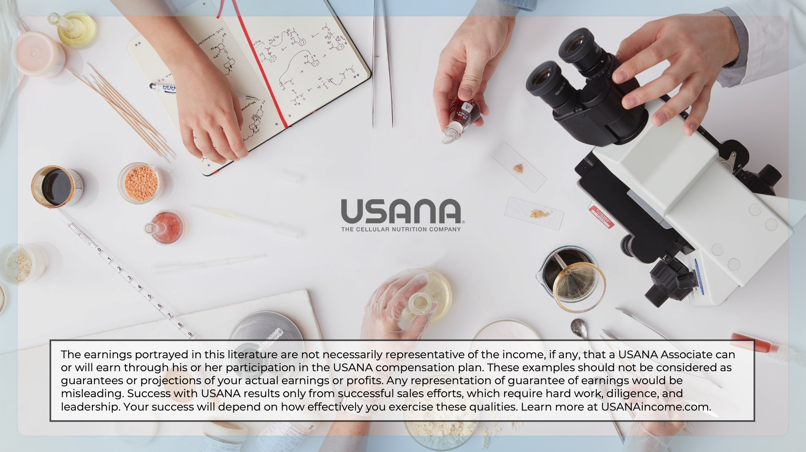
Notes:
Associate notes:
This is the end of the presentation.
Thank your participant(s) for their time.
Ask if they have any questions or need any more information to make a decision about USANA.
If they are ready, text or email them a direct enrollment link—created from your back office Hub—so they can enroll as a Preferred Consultant or Associate depending on their interest with USANA.
This lets them control their experience—allowing them to self-enroll—and also lets you choose their placement in your organization.
As they enroll, this ensures their personal contact information is entered, allowing USANA to send them relevant communications based on their enrollment level. Ultimately, this will help support your earning potential.
Finally, this keeps your new contact’s private and personal information secure.
You can view your contact’s information on The Hub in Team Manager using the PC Report, the Order History Report (if they placed an order), or the Sponsorship Report (available with Business Accelerator Suite).

Slide 29
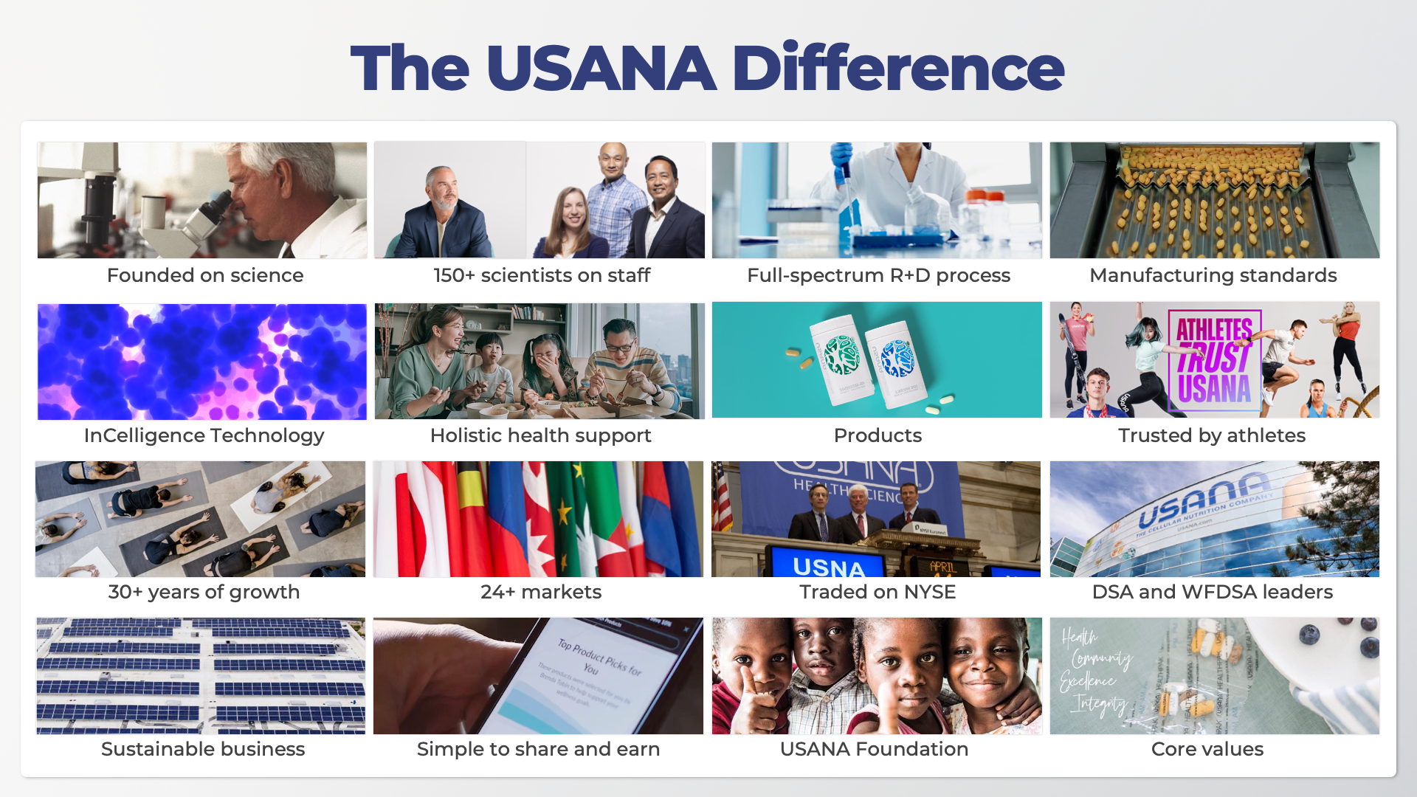
Notes:
SCRIPT
USANA believes your life begins at the cellular level.
The USANA Difference encompasses everything from our obsession with cellular health to the way our products are shared, person to person.
What’s most important to you in choosing a nutritional company for you and your family, or in choosing a way to supplement your income?
Company
Founded in 1992 by Dr. Myron Wentz, microbiologist and immunologist
Publicly traded on the New York Stock Exchange
Member, Direct Selling Association and World Federation of Direct Selling Associations
Sustained global growth, operating in 24+ markets
Sustainability focused, How to Recycle partner
Provided 70+ million meals through the USANA Foundation
Holistic approach to cellular health means free community support at AsktheScientists.com
Core values of health, integrity, excellence, and community
Product
Supplements, weight management, energy, and skincare
150+ scientists globally in research and development
In-house manufacturing facilities
Ensured product purity, identity, composition, potency, and quality
Trusted by thousands of professional and Olympic athletes
Unique formulations use cell-signaling for personalized support
Share and Earn Rewards
USANA is so confident you’ll be satisfied with their products that you’ll be excited to share them with everyone you know.
When you refer others to USANA and they buy, you earn.
TALKING POINTS
Everyone has different reasons why they choose USANA.
Here are a few highlights.
Let me explain why I chose USANA.
What stands out to you?

Slide 30
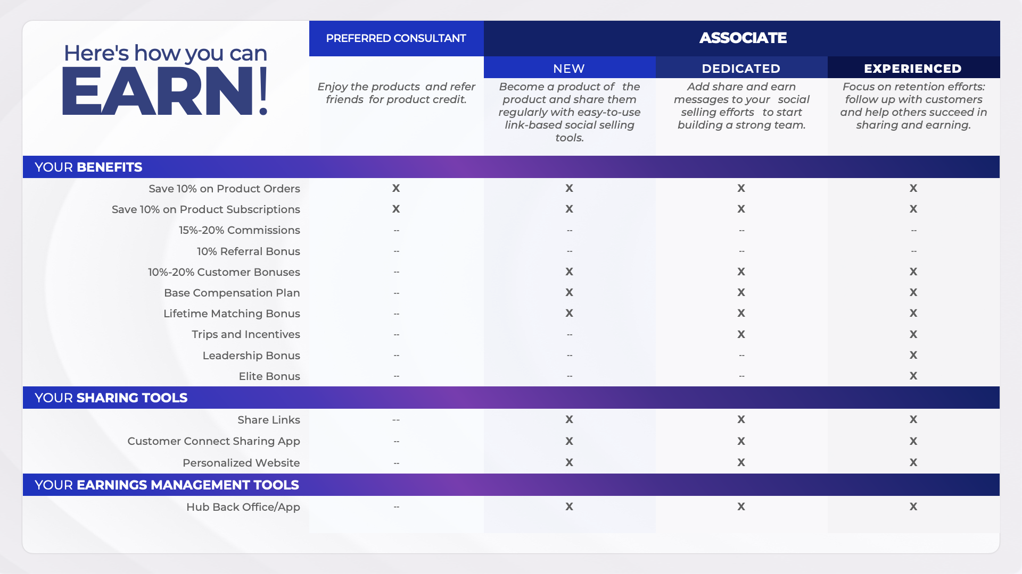
Notes:
SCRIPT
USANA is so confident you’ll be satisfied with our products that you’ll be excited to share them with everyone you know.
When you refer others to USANA and they buy, you earn.
Become a Preferred Customer and earn 10% back in product credit to use toward your next purchase on any products purchased through your unique links.
Become an Associate and earn commissions, bonuses, trips, and other rewards.
A successful Associate is interested in…
Using their influence online and in person to share USANA.
Sharing the products and USANA’s simple earning potential.
Earning commissions for their personal product sales, product sales generated by their team, and based on their efforts, learning and growing to earn additional rewards like trips and bonuses.
Compensation Plan Specifics
All USANA products have a point value. When a product is purchased, those points are assigned to the left or right side of your Business Center, depending on which side of your Business Center the sale takes place/your Default Business Center Placement Settings, chosen in your Back Office Hub. You receive a 20% commission based on the matching points on the left and right sides of your Business Centers. Matching points are called Commission Volume Points (CVP).
Eligibility for points-based commissions, incentives, and bonuses require a sales-based commission qualification requirement: 200+ points in Personal Sales Volume (PSV) every four weeks. PSV includes any products purchased for personal use, along with purchases made by your personally sponsored PCs.
Stay commission qualified by making sales to regular customers, family members, or yourself each month.
An Associate can still earn the 10% Retail Bonus without a commission qualification, but they will not receive any points associated with the product sale.
Trips and incentives are available for commission-qualified Associates meeting stated requirements for each event.
Associates may earn all or part of any particular trip or incentive depending on their efforts.
Leadership Bonus is for qualified Gold Directors and above—they earn a 3% cut of our worldwide commissionable sales each week.
Elite Bonus is for the top 60 income earners worldwide. At the beginning of each quarter they’ll receive a share of 1% of the total Sales Volume Points (SVP) earned.
Lifetime Matching Bonus rewards you for the life of your USANA business. Earn this bonus by becoming a Premier PaceSetter or Premier Platinum PaceSetter and then helping new team members do the same. This Bonus is activated when you make the required sales to the required number of new Preferred Consultants and/or USANA Associates on your team within eight weeks of your initial enrollment date and hit certain point thresholds. You will then earn varying weekly bonuses—between 2.5% and 15%—on Commission Volume Points (CVP) for all personally sponsored Associates who become Premier PaceSetters or Premier Platinum Pacesetters.

Slide 31
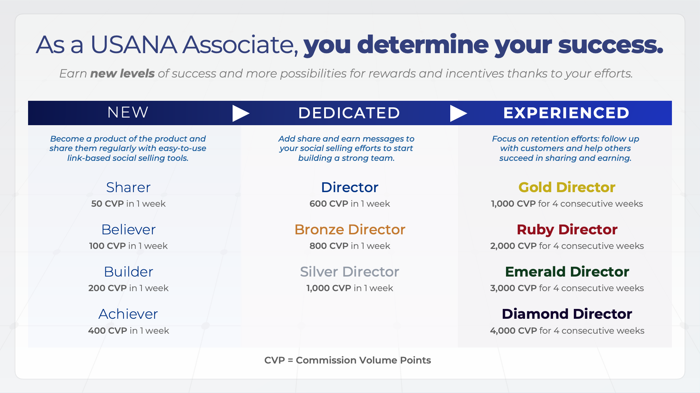
Notes:
SCRIPT
When you become a USANA Associate, your efforts determine your success.
New Associate Titles
At this level, focus on becoming a product of the product and sharing the products regularly with USANA’s easy-to-use link-based social selling tools.
• Sharer. Earn 50 Commission Volume Points (CVP) in one week.
• Believer. Earn 100 CVP in one week.
• Builder. Earn 200 CVP in one week.
• Achiever. Earn 400 CVP in one week.
Dedicated Associate Titles
Once you reach this level, add Share & Earn messages to your social selling messages to start building a strong team.
• Director. Earn 600 CVP in one week.
• Bronze Director. Earn 800 CVP in one week.
• Silver Director. Earn 1,000 CVP in one week.
Experienced Associate Titles
Associates at these levels are masters at sharing product and Share & Earn messages. They focus on retention, following up with customers, and offering overall team guidance and strategy.
• Gold Director. Earn 1,000 CVP for four consecutive weeks.
• Ruby Director. Earn 2,000 CVP for four consecutive weeks.
• Emerald Director. Earn 3,000 CVP for four consecutive weeks.
• Diamond Director. Earn 4,000 CVP for four consecutive weeks.
TALKING POINTS
Associates earn commissions, bonuses, trips, and other rewards.
A successful Associate is interested in…
Using their influence online and in person to share USANA.
Sharing the products and the simple earning potential of USANA.
Building a business by building a team and leveraging group volume sales along with personal efforts to earn additional bonuses, commissions and incentive trips.

Slide 32
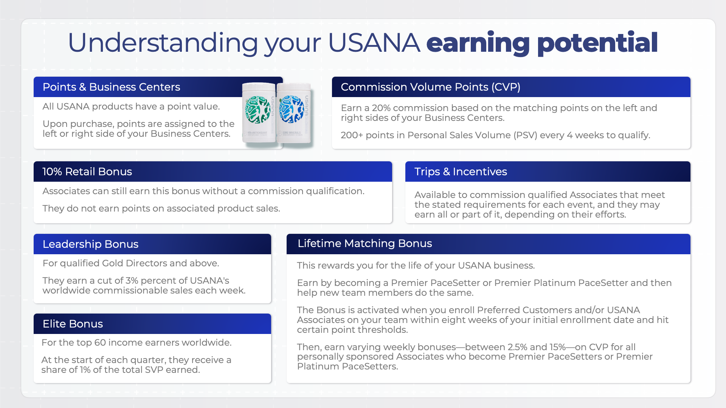
Notes:
SCRIPT
Compensation Plan Specifics
All USANA products have a point value. When a product is purchased, those points are assigned to the left or right side of your Business Center, depending on which side of your Business Center the sale takes place/your Default Business Center Placement Settings, chosen in your Back Office Hub. You receive a 20% commission based on the matching points on the left and right sides of your Business Centers. Matching points are called Commission Volume Points (CVP).
Eligibility for points-based commissions, incentives, and bonuses require a sales-based commission qualification requirement: 200+ points in Personal Sales Volume (PSV) every four weeks. PSV includes any products purchased for personal use, along with purchases made by your personally sponsored PCs.
Stay commission qualified by making sales to regular customers, family members, or yourself each month.
An Associate can still earn the 10% Retail Bonus without a commission qualification, but they will not receive any points associated with the product sale.
Trips and incentives are available for commission-qualified Associates meeting stated requirements for each event.
Associates may earn all or part of any particular trip or incentive depending on their efforts.
Leadership Bonus is for qualified Gold Directors and above—they earn a 3% cut of our worldwide commissionable sales each week.
Elite Bonus is for the top 60 income earners worldwide. At the beginning of each quarter they’ll receive a share of 1% of the total Sales Volume Points (SVP) earned.
Lifetime Matching Bonus rewards you for the life of your USANA business. Earn this bonus by becoming a Premier PaceSetter or Premier Platinum PaceSetter and then helping new team members do the same. This Bonus is activated when you make the required sales to the required number of new Preferred Customers and/or USANA Associates on your team within eight weeks of your initial enrollment date and hit certain point thresholds. You will then earn varying weekly bonuses—between 2.5% and 15%—on Commission Volume Points (CVP) for all personally sponsored Associates who become Premier PaceSetters or Premier Platinum PaceSetters.

Slide 33

Notes:
Replace the placeholder image here with a nice image of yourself. Share a solo picture or something that represents your lifestyle with your family or community around you. Just make sure you’re the focal point.

Slide 34


Slide 35

Notes:
Incentive Trips
Work with your market manager to make sure you are representing the latest upcoming trips for your region.
2023
Executive Diamond Summit - San Francisco/Napa Valley
Global Spring Elevate - Disneyland - Americas Markets
Asia Pacific Growth - Athens - AP Markets
Autumn Elevate - Puerto Vallarta - Americas Markets
2024
Spring Elevate - Disneyland - Americas Market
Global Elite Growth - Monaco - Global
Asia Pacific Growth - Berlin - AP markets

Slide 36

YOUR NAME
HERE
Notes:
Replace the placeholder image here with a nice image of yourself. Share a solo picture or something that represents your lifestyle with your family or community around you. Just make sure you’re the focal point.

Slide 37
A little about YOU.
Take some time to tell us a little about your life. Be bold in talking about the many things there are to love right now. Friends, family, hobbies, lifestyle … the more we know about you the more we trust you! Include images of whatever you’re sharing.
Notes:
Take some time to tell us a little about your life. Be bold in talking about the many things there are to love e right now. Friends, family, hobbies, lifestyle… the more we know about you the more we trust you! Include images of whatever you’re sharing.

Slide 38

Life Before
USANA
Paint a picture of what your life was like before starting with USANA. What sort of challenges were you facing? Were there goals that seemed out of reach? People want to know where you started so they can appreciate how much you’ve grown!
Notes:
ASSOCIATE NOTES:
Please reference the Ethics & Education guidelines on The Hub (found under Training > Ethics and Education > Ethics Guidelines) to ensure you stay compliant when sharing your USANA lifestyle and experience with USANA products.

Slide 39
Today
You've come a long way since you joined USANA. Time to take stock and do a little humble-bragging. Feel free to add as many pictures here as you want to tell your success story!

