Slide 1
Notes:
Introducing USANA Celavive®—high-performance skincare featuring USANA InCelligence Technology®.

Slide 2
Notes:
Years ago, with the vision of Dr. Wentz, we created Sensé Beautiful Science. This skincare line was groundbreaking and helped shape the industry. Today, we are focused on the future with advanced formulas that have again changed the competitive skincare landscape.
<Read Quote>
“Years ago, USANA helped shape the global skincare market by launching Sensé - face and body care products formulated without chemical preservatives and other toxic ingredients - establishing us as a leader in the personal care industry. We are now focused on the future and have found a way to incorporate our groundbreaking USANA InCelligence Technology®, into our skincare products. These high-performance products utilize key phytonutrients, natural botanical extracts, and powerful peptides that go beyond traditional beauty formulations to improve our natural, youth-preserving functions and fight the major signs of visible aging. By introducing Celavive® to the world, we will once again change the competitive landscape as we know it.”

Slide 3
Notes:
Celavive® formulations are founded on the science of cellular nutrition. By using key nutrients, we are able to better support youth-preserving beauty functions already within your body, going beyond anything we’ve done before. This comprehensive product offering helps each Celavive user to have a unique and personalized experience, targeting individual skin-aging concerns.

Slide 4
Notes:
By specifically targeting your body’s ability to fight visible aging, Celavive® is able to provide better beauty support against environmental stressors like stress, sun damage, and pollution.

Slide 5
Notes:
Celavive®’s difference is found in its exclusive technologies. The Cell-Signaling Complex helps to visibly counteract fine lines and wrinkles by targeting key skin receptors while also supporting major elements like collagen that can help produce a healthy skin matrix. The Olivol™ Botanical Blend focuses on moisture and includes our patented Olivol olive-fruit extract to provide lasting moisture for up to 24hrs after just one application.

Slide 6
Notes:
In clinical tests conducted through Toyo Beauty in Japan, participants noticed a nearly 180% increase in moisture within the first 30 minutes.

Slide 7
Notes:
When evaluating the effectiveness of Celavive® Replenishing Night Cream, participants observed a significant decrease in transepidermal water loss.

Slide 8
Notes:
Celavive® Vitalizing Serum was also evaluated and showed that the participants’ skin elasticity doubled in just 3 hours.

Slide 9
Notes:
Here you’ll see the noticeable difference in fine lines around the subject’s eye area.

Slide 10
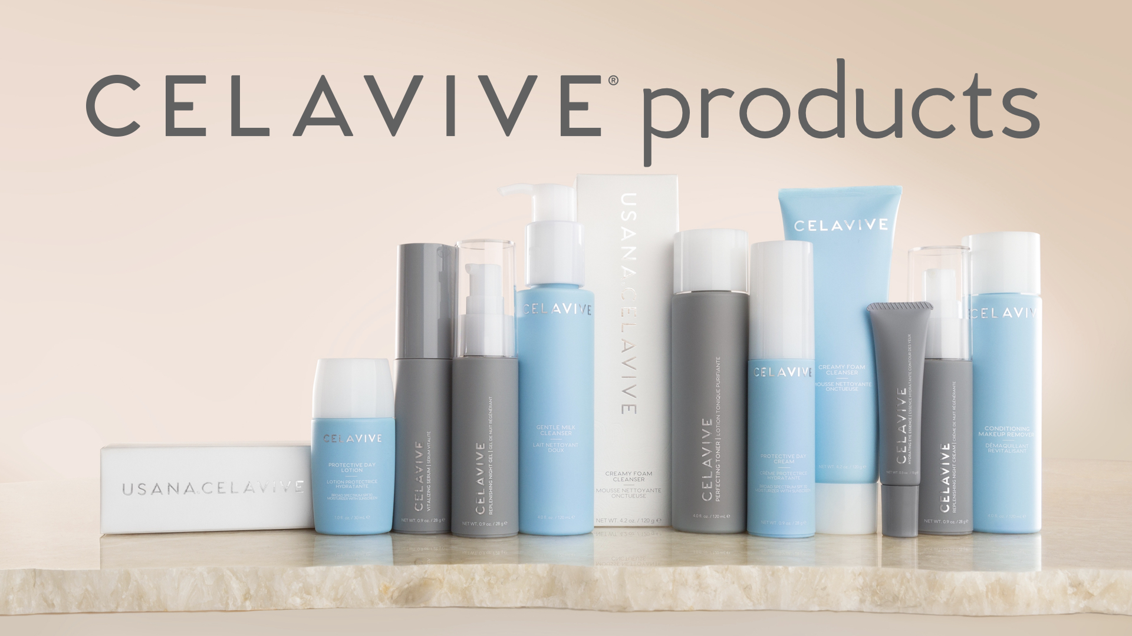
Notes:
Celavive® clearly can perform but we want you to experience the difference for yourself. Let’s go through the regimen step-by-step to discover how these high-performance products can work for you. Start by snapping a “before” photo of your face. After completing the regimen, we will take an “after” photo so you can see the difference after just 1 application.

Slide 11
Notes:
Celavive® products come in a variety of formulations to address your individual concerns and preferences. It’s important to understand your skin type before beginning the regimen. Remember, these are just guidelines and the goal is to create a routine with the products that respond best to your skin.

Slide 12
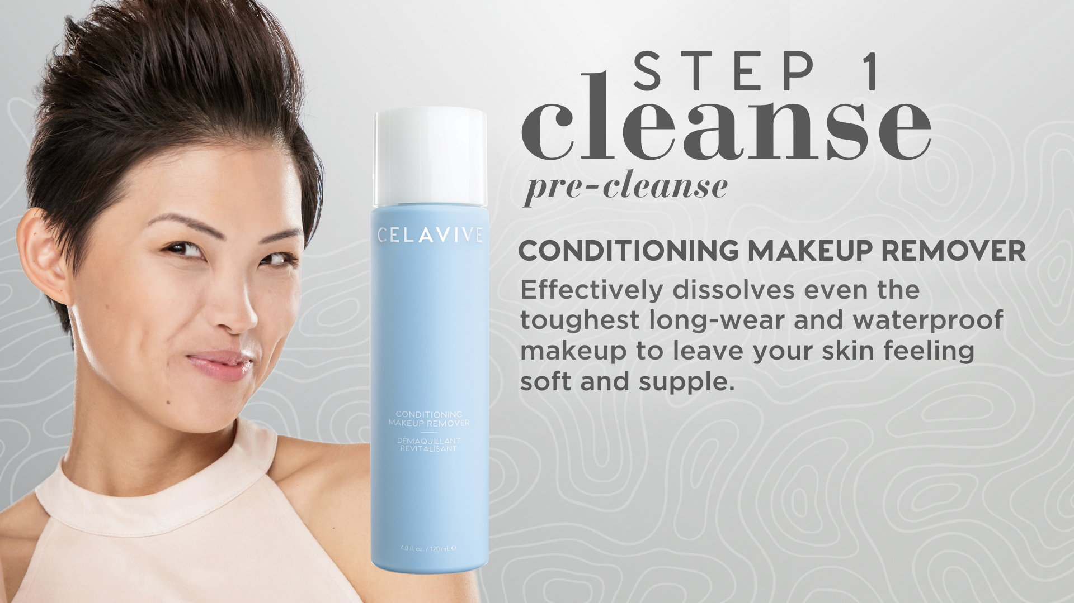
Notes:
Makeup Remover is an important step in your evening routine and can double as a pre-cleanse for those who do not need to remove makeup. Simply saturate a cotton round and sweep over eyes, lips, and face to remove even longwear cosmetics, dirt, and pollution so your skin is prepped for proper cleansing.

Slide 13
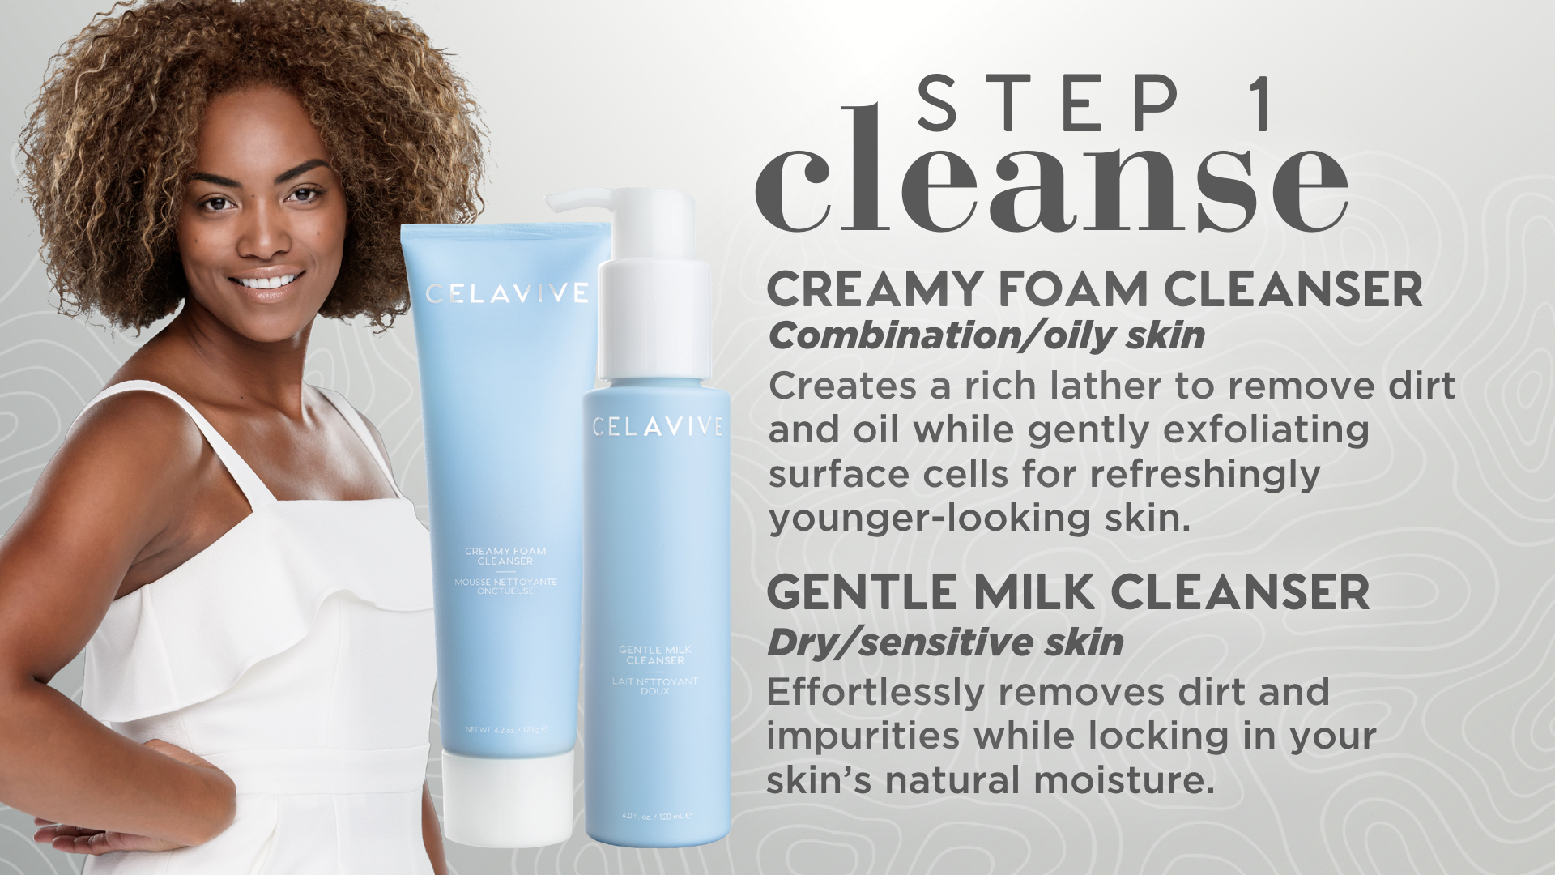
Notes:
Creamy Foam Cleanser is more of an aggressive cleanser formulated to deep clean for refreshingly younger-looking skin. You only need a very small amount (about the size of a pea) to achieve the desired results. Simply apply to damp skin, working the product into a rich lather and then rinsing with warm water. The Gentle Milk Cleanser is a more mild formula that effortlessly removes dirt and impurities while locking in skin’s natural moisture.

Slide 14
Notes:
Toning is a critical step in your skincare routine. It helps to replace any lost moisture and balance your skin’s pH levels after cleansing. This helps to prepare your skin for the products to follow.

Slide 15
Notes:
Reveal your youthful radiance with USANA’s new Hydrating + Lifting Sheet Mask. This nourishing, at-home beauty treatment noticeably lifts and smooths the look of your skin, while providing intense hydration for visibly tighter and brighter-looking skin. This new mask features our exclusive Celavive Cell-Signaling Complex with USANA InCelligence Technology® technology that supports natural collagen and lipid production from within—creating a plumper, younger-looking complexion.

Slide 16
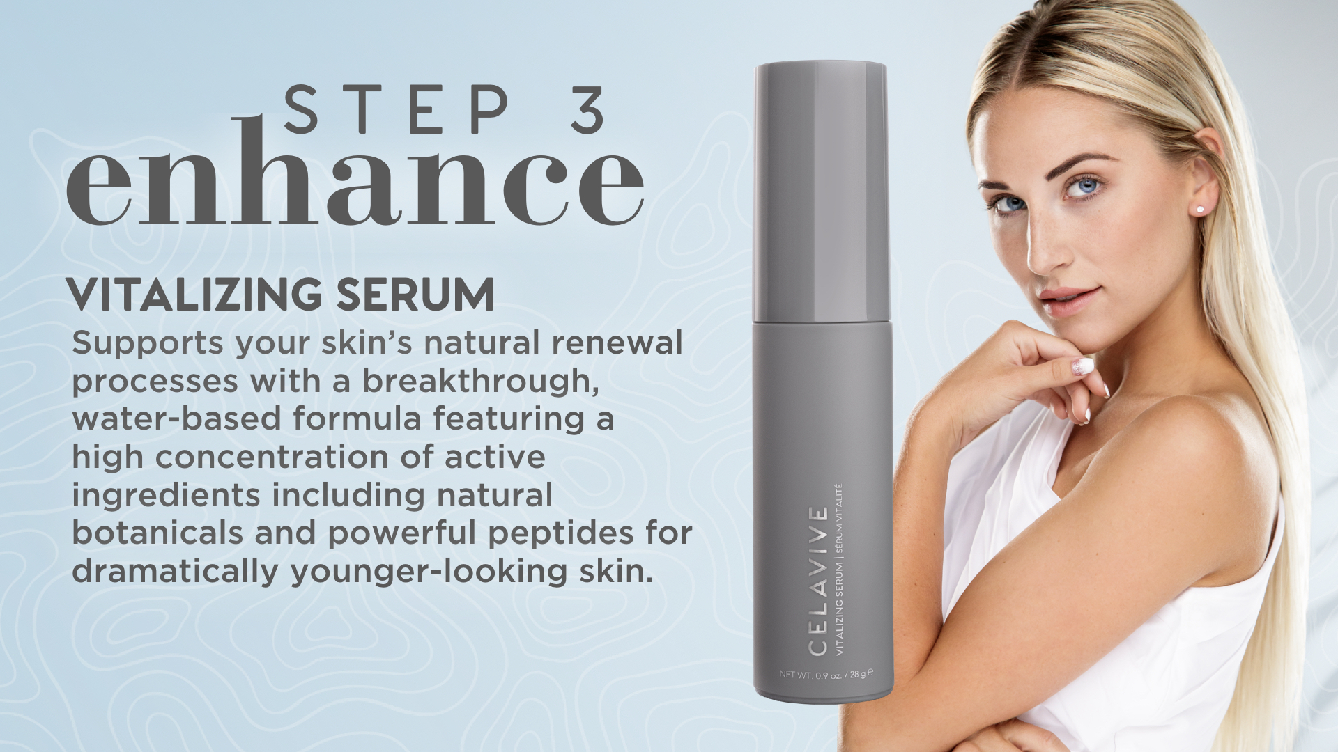
Notes:
Vitalizing Serum contains a high concentration of active ingredients including the Cell-Signaling Complex to visibly transform your skin into a radiant, youthful complexion. This Serum is targeted to help with the appearance of uneven skin tone, wrinkles, pore size, and skin texture.

Slide 17
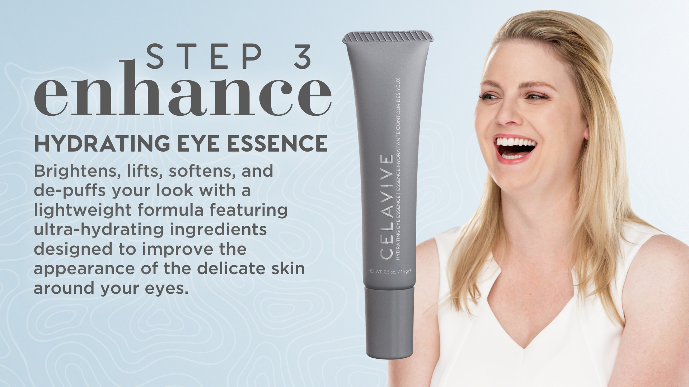
Notes:
Celavive® Hydrating Eye Essence is designed to address the delicate skin around your eyes. Improve the look of dark circles, crow’s feet, and puffiness by gently massaging the product into your skin using our unique applicator.

Slide 18
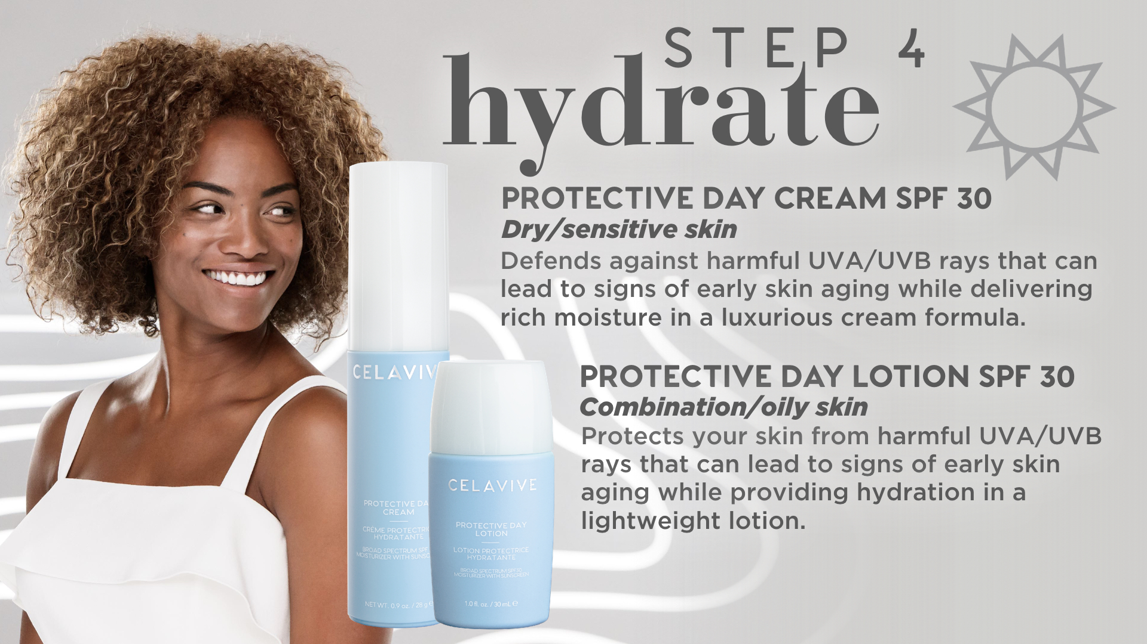
Notes:
During the day, you’ll want to moisturize and protect your skin from the harsh elements. Both the Day Cream and Lotion helps fortify your skin from visible sun damage while providing plenty of moisture with our Olivol™ Botanical Blend.

Slide 19
Notes:
Your skin is working overtime while you sleep to visible repair the damage from the day. Support this natural process by applying Celavive® Replenishing Night Gel (or Cream) to restore youthful radiance and moisture overnight.

Slide 20
Notes:
That completes the Celavive® regimen, but creating a beautiful complexion doesn’t stop there. Consuming the proper nutrients on the inside will help create a healthy glow on the outside. Your skin is your body’s largest organ and often the last to receive important vitamins and antioxidants that are needed to defend your skin against visible aging. USANA believes in nourishing your skin through a healthy diet, plenty of water, and high-quality nutritional supplements.

Slide 21
VITA-ANTIOXIDANT
Notes:
Nourish, Protect, and Renew with USANA CellSentials to provide a foundation for better health and naturally beautiful skin.

Slide 22
Notes:
For those on-the-go that enjoy a simple, convenient approach, try USANA’s HealthPak—our best-selling daily dose of the vitamins and minerals you need to build a foundation for better health

Slide 23
Notes:
After you’ve chosen your core products with either CellSentials™ or HealthPak™, it’s time to customize your supplement routine based on your individual needs. Some of our favorite supplements to support your beauty routine include these products shown here known for support healthy-looking skin.

Slide 24
Notes:
I want you to take a moment and touch your skin to feel the incredible difference. Share how your skin now looks and feels after just 1 application on your social media pages. Post your “after” photo with #CelaviveSelfie for a chance to featured on the official Celavive® pages. And don’t worry, you’ll continue to enjoy increasing moisture during the next 24hrs. Who’s ready to place their first Celavive order?

Slide 25
Notes:
The results are best if you use a complete regimen of Celavive® products. It’s time to experience high-performance skin and begin your Celavive journey. Order your regimen pack to get started today.

