Slide 1
Market update
March 23, 2015

Slide 2
Warren Buffett
“Be greedy when others are fearful, and be fearful when others are greedy.”
"When we own portions of outstanding businesses with outstanding managements, our favorite holding period is forever."
"Rule No. 1: never lose money; rule No. 2: don't forget rule No. 1."

Slide 3
World Class Ownership
Leucadia National
> $8.5B – Market Cap
TTM Revenue $12.56B
TTM EBITDA $1.45B
Is in a variety of other businesses, including investment banking & capital markets, beef processing, oil and gas exploration & production, telecommunication, automobile dealerships, gold & silver mining
Berkshire Hathaway
> $350B – Market Cap
Fourth-Most-Valuable Company in the World (Apple/Exxon/Microsoft)
Per Share Value has increased 6,952 fold since 1964
Trading at >$220,000 Per Share

Slide 4
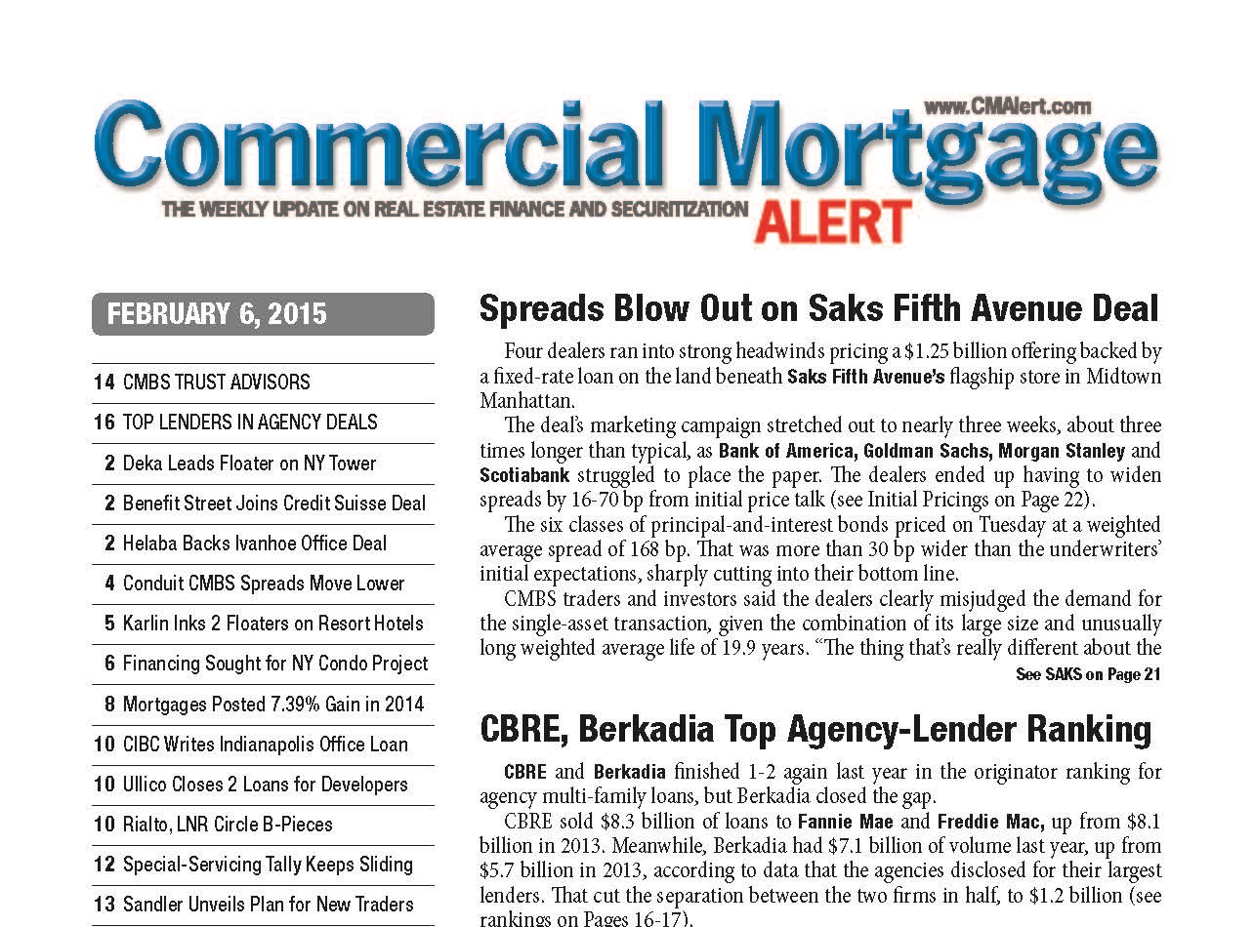
Berkadia closed the gap.

Slide 5
About Us
Our History
Began in 1994 when GMAC Commercial Mortgage (GMACCM)
Became one of the largest commercial real estate finance companies in the industry, with operations around the globe
In March 2006, an investor group comprising Kohlberg, Kravis Roberts & Co. (KKR), Five Mile Capital Partners, LLC and Goldman Sachs Capital Partners took a majority interest in GMAC Commercial Holding Corp.
The company then changed its name to Capmark Financial Group Inc. (Capmark).
In December 2009, Berkshire Hathaway and Leucadia National Corporation (LUK) acquired Capmark’s North American loan origination and servicing business, forming Berkadia.
Our Ownership
Berkshire Hathaway Inc.
(NYSE: BRK.A and BRK.B) is a holding company owning subsidiaries engaged in a number of diverse business activities including property and casualty insurance and reinsurance, utilities and energy, retailing and services.
Leucadia National Corporation
(NYSE: LUK) is a diversified holding company. Leucadia’s largest business is Jefferies, a global, full-service investment banking firm. Leucadia also owns and holds investments in a range of other businesses, including manufacturing, beef processing, telecommunications, real estate and energy.

Slide 6
Nationwide Reach, Local Expertise
Over 75 Offices across the United States and India

Slide 7
The Berkadia Difference
The market’s most comprehensive offering.
Average of 25 years experience
Full range of services to support the entire property life cycle
All property types: multifamily, retail, office, industrial, affordable housing, seniors housing, student housing and manufactured housing communities.
The flexibility you need. The agility the marketplace demands.
Non bank-regulated, closely held company, we have the flexibility to respond to the market and non-recourse loans that can be customized to each client’s unique needs and circumstances
Strong leadership in turbulent times.
We can provide the financial stability owners need in all market conditions.

Slide 8
A Year of Records and New Heights!
$13.1 billion in production
25% increase in production over 2013
Dominated the Agency/FHA business:
#1 HUD
#2 Freddie
#3 Fannie
Only mortgage banker in top 3 of for Fannie, Freddie, and FHA
2nd only to CBRE in combined Fannie/Freddie and cut gap in half last year
#1 combined Agency/FHA producer!.

Slide 9
The Big Picture
$17 billion
Berkadia’s 2014 loan origination volume surpassed $13 billion, while investment sales exceeded $4 billion.
2014
Berkadia’s Fannie Mae lending increased 33% from 2013, moving us from 5th to 3rd in their rankings.
14,000
Over 14,000 transactions financed throughout our history.
$12.1 billion
Since 2012, our Investment Sales division has closed more than 1,200 transactions, totaling $12.1 billion.
3x $1 billion
We’ve arranged three large portfolio loan executions that exceed $1 billion for each of the last three consecutive years.
$4.6 billion
We arranged $4.6 billion with Freddie Mac in 2014, which marks the third consecutive year that Berkadia has been named Freddie Mac’s second-largest lender.

Slide 10
Investment Sales

Slide 12
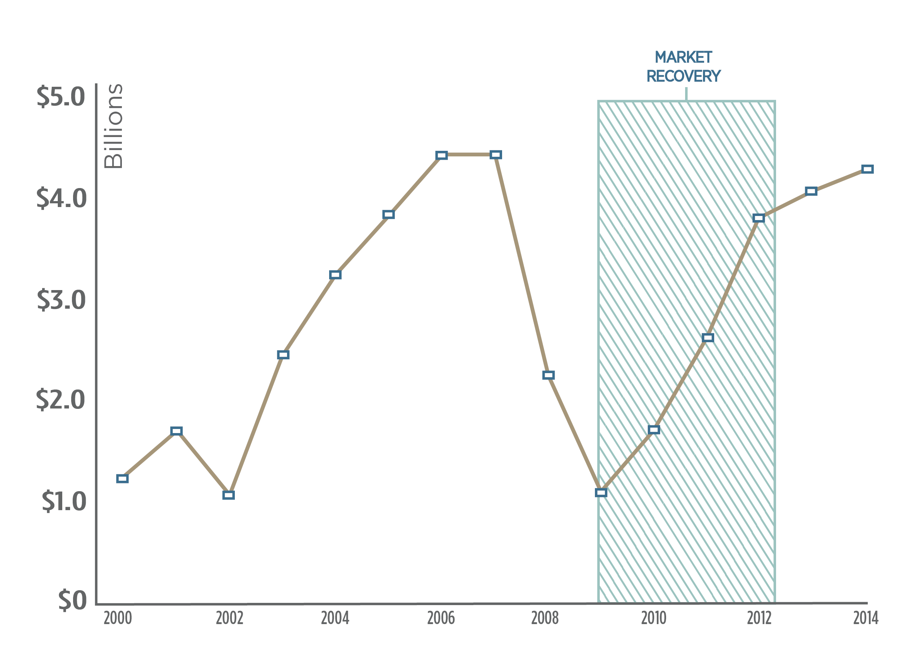
Investment Sales – Market Recovery

Slide 13
Why it’s Important
In one of the best Historical Markets Ever – We need to Seize The Opportunity
On the Outside to Clients – Everyone Looks the Same
Competition is Getting Better and Bigger
The Margin between Victory and Defeat is very Small.

Slide 15
A Golden Opportunity

Slide 16
Investment Sales

Slide 17
Mortgage Banking
$9 Billion

Slide 18
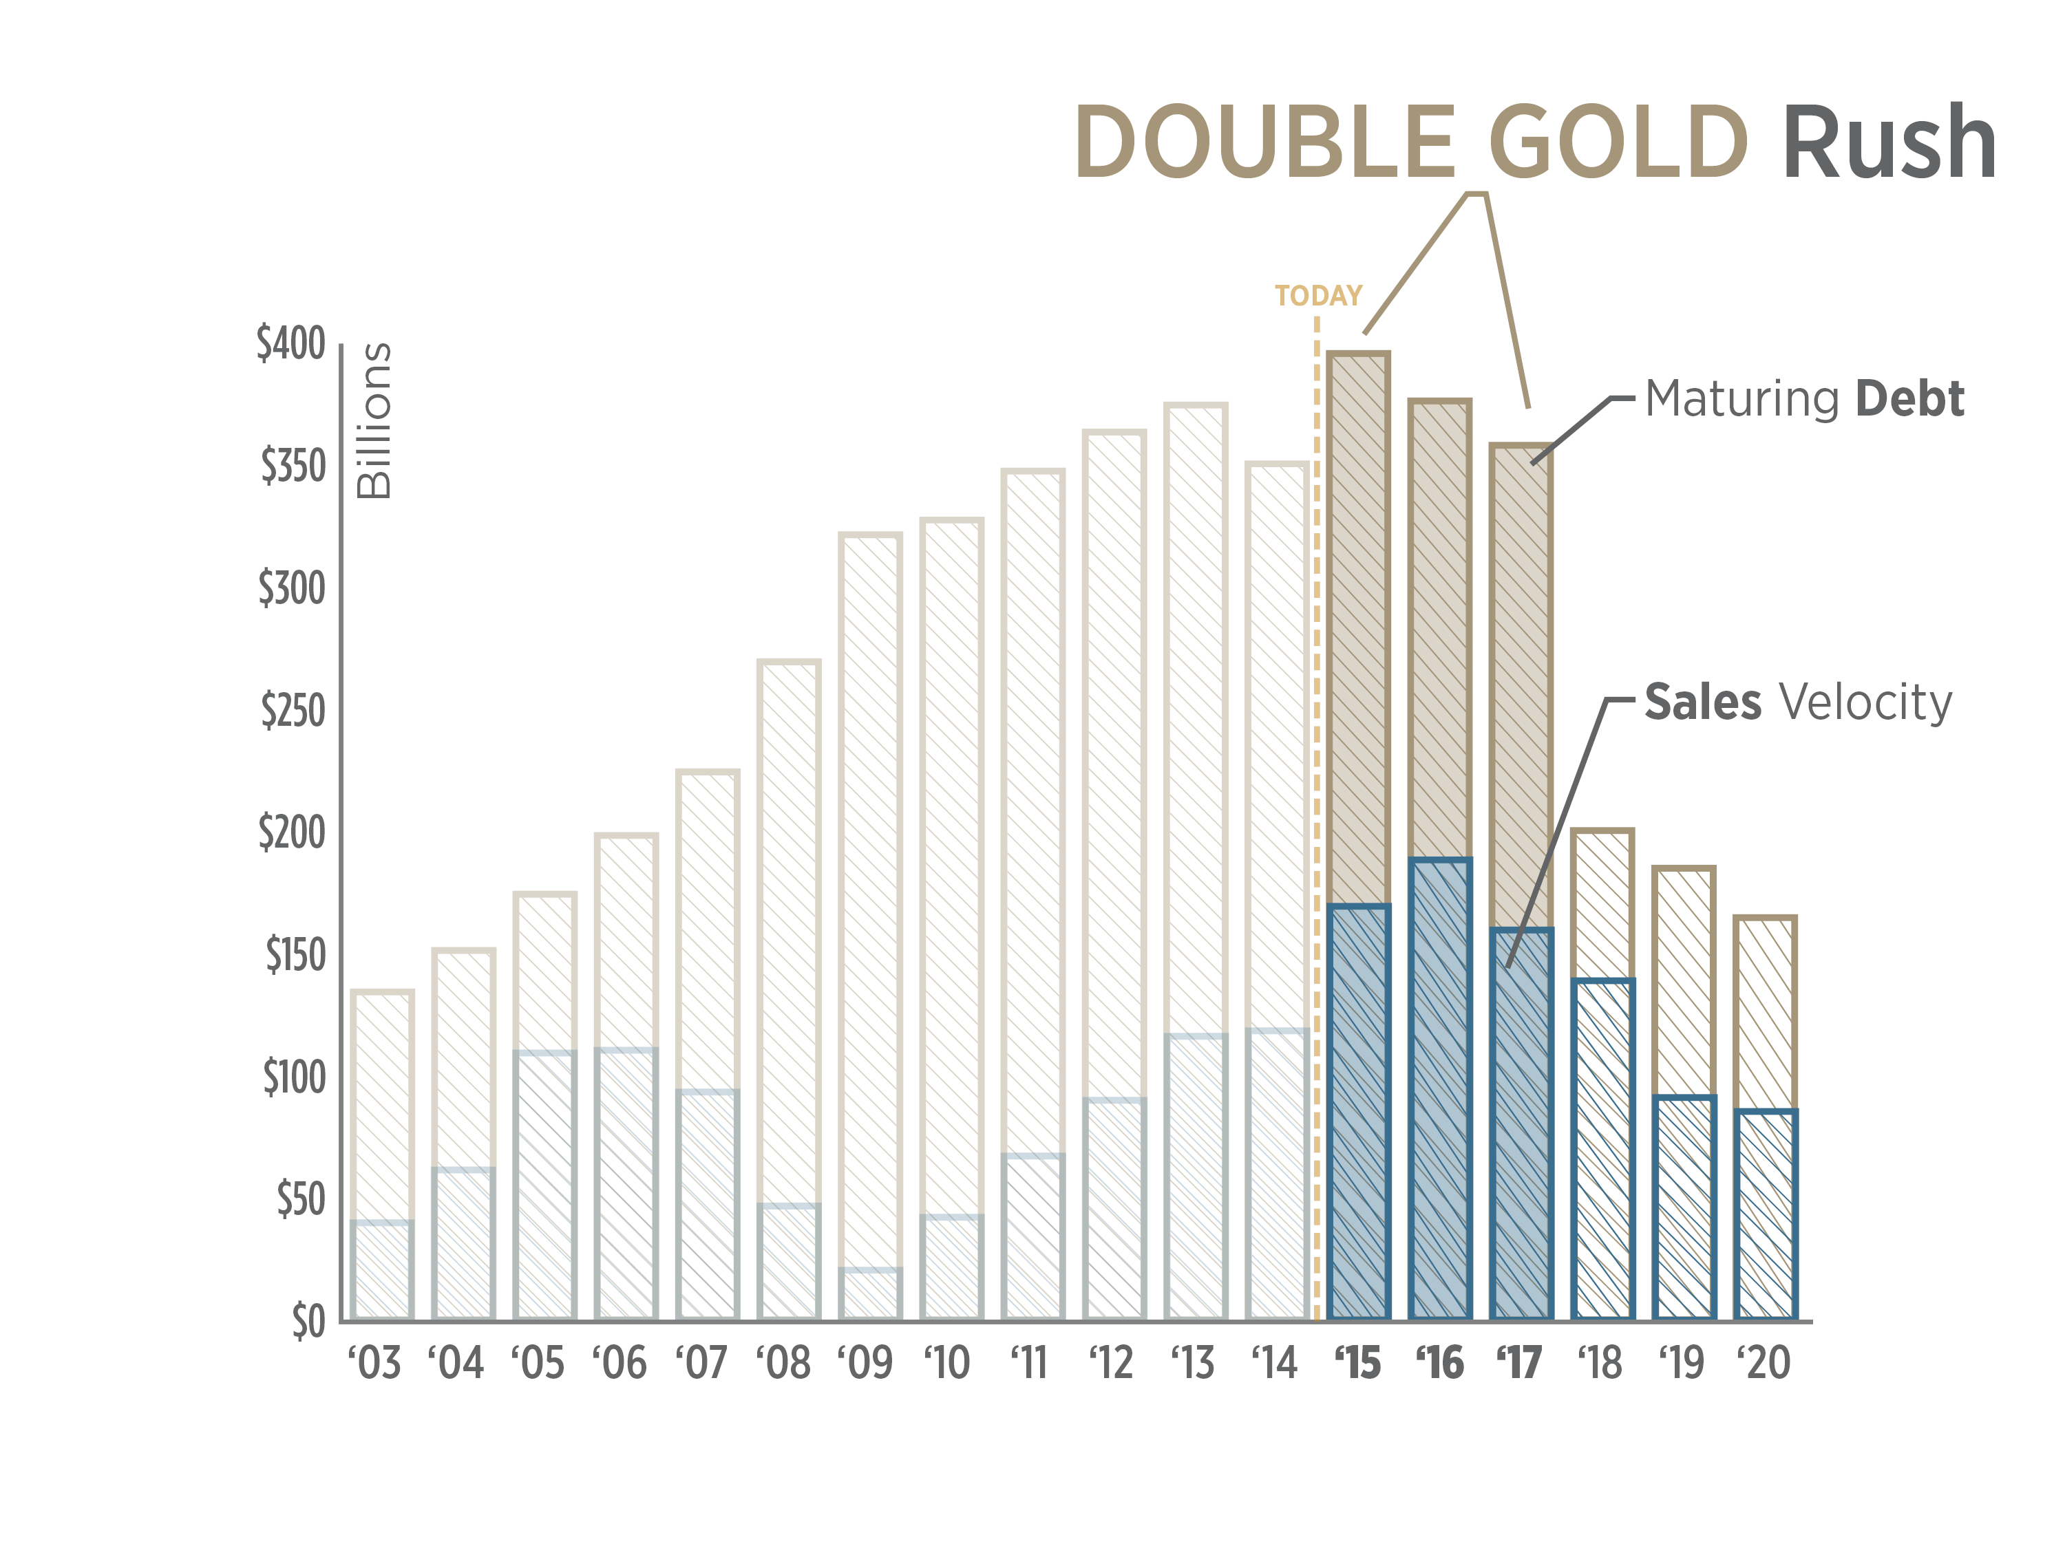
What are We Waiting For?

Slide 19
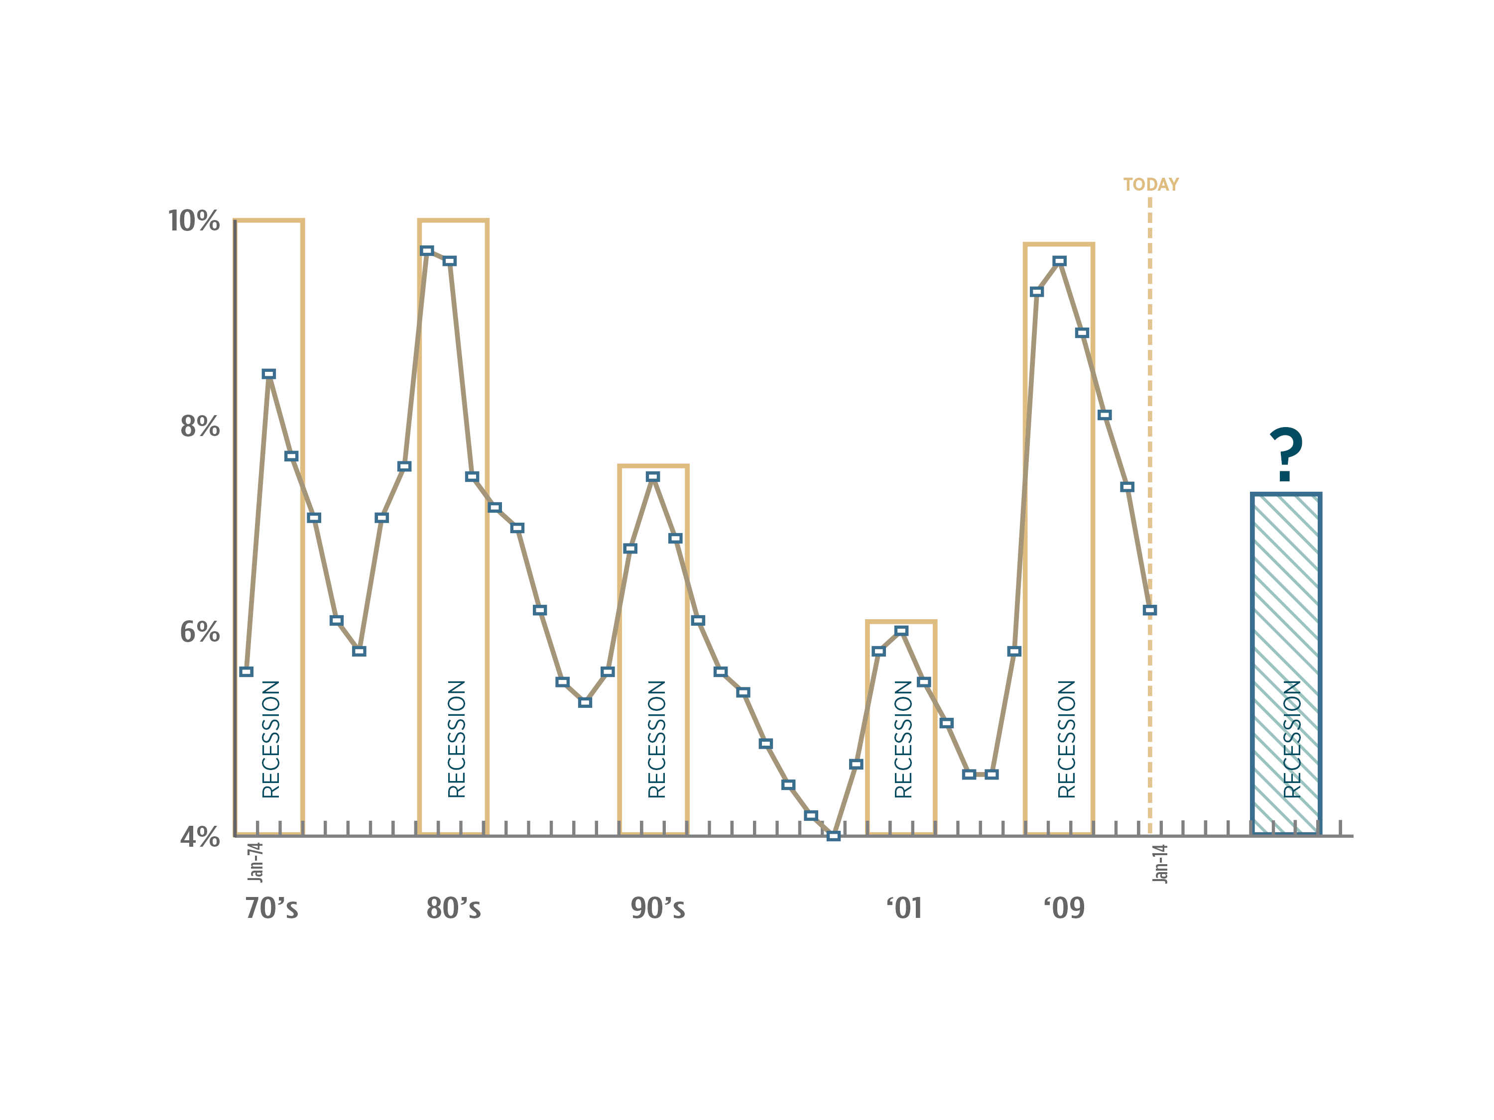
Has the World Really Changed?

Slide 20
Why Sell Now?
Historically low cap rates
Historically low interest rates
Unprecedented surge of capital driving demand
Aging rental stock
Development – how many $2 Renters
All markets are in vogue – with little difference in caps
The statement –” the market is different” is fools gold
Better to sell a year early than a day late.

Slide 21
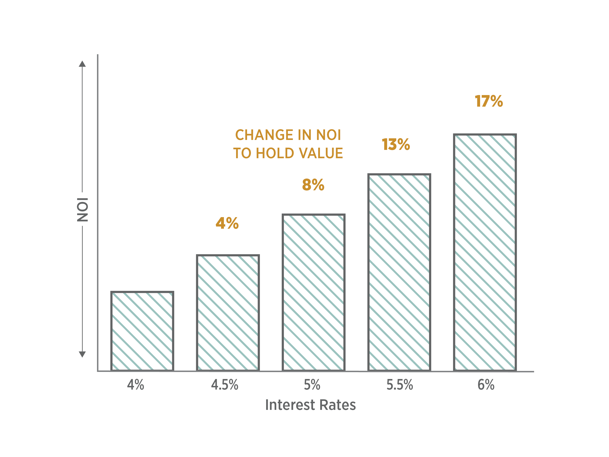
A Powerful Message

Slide 22
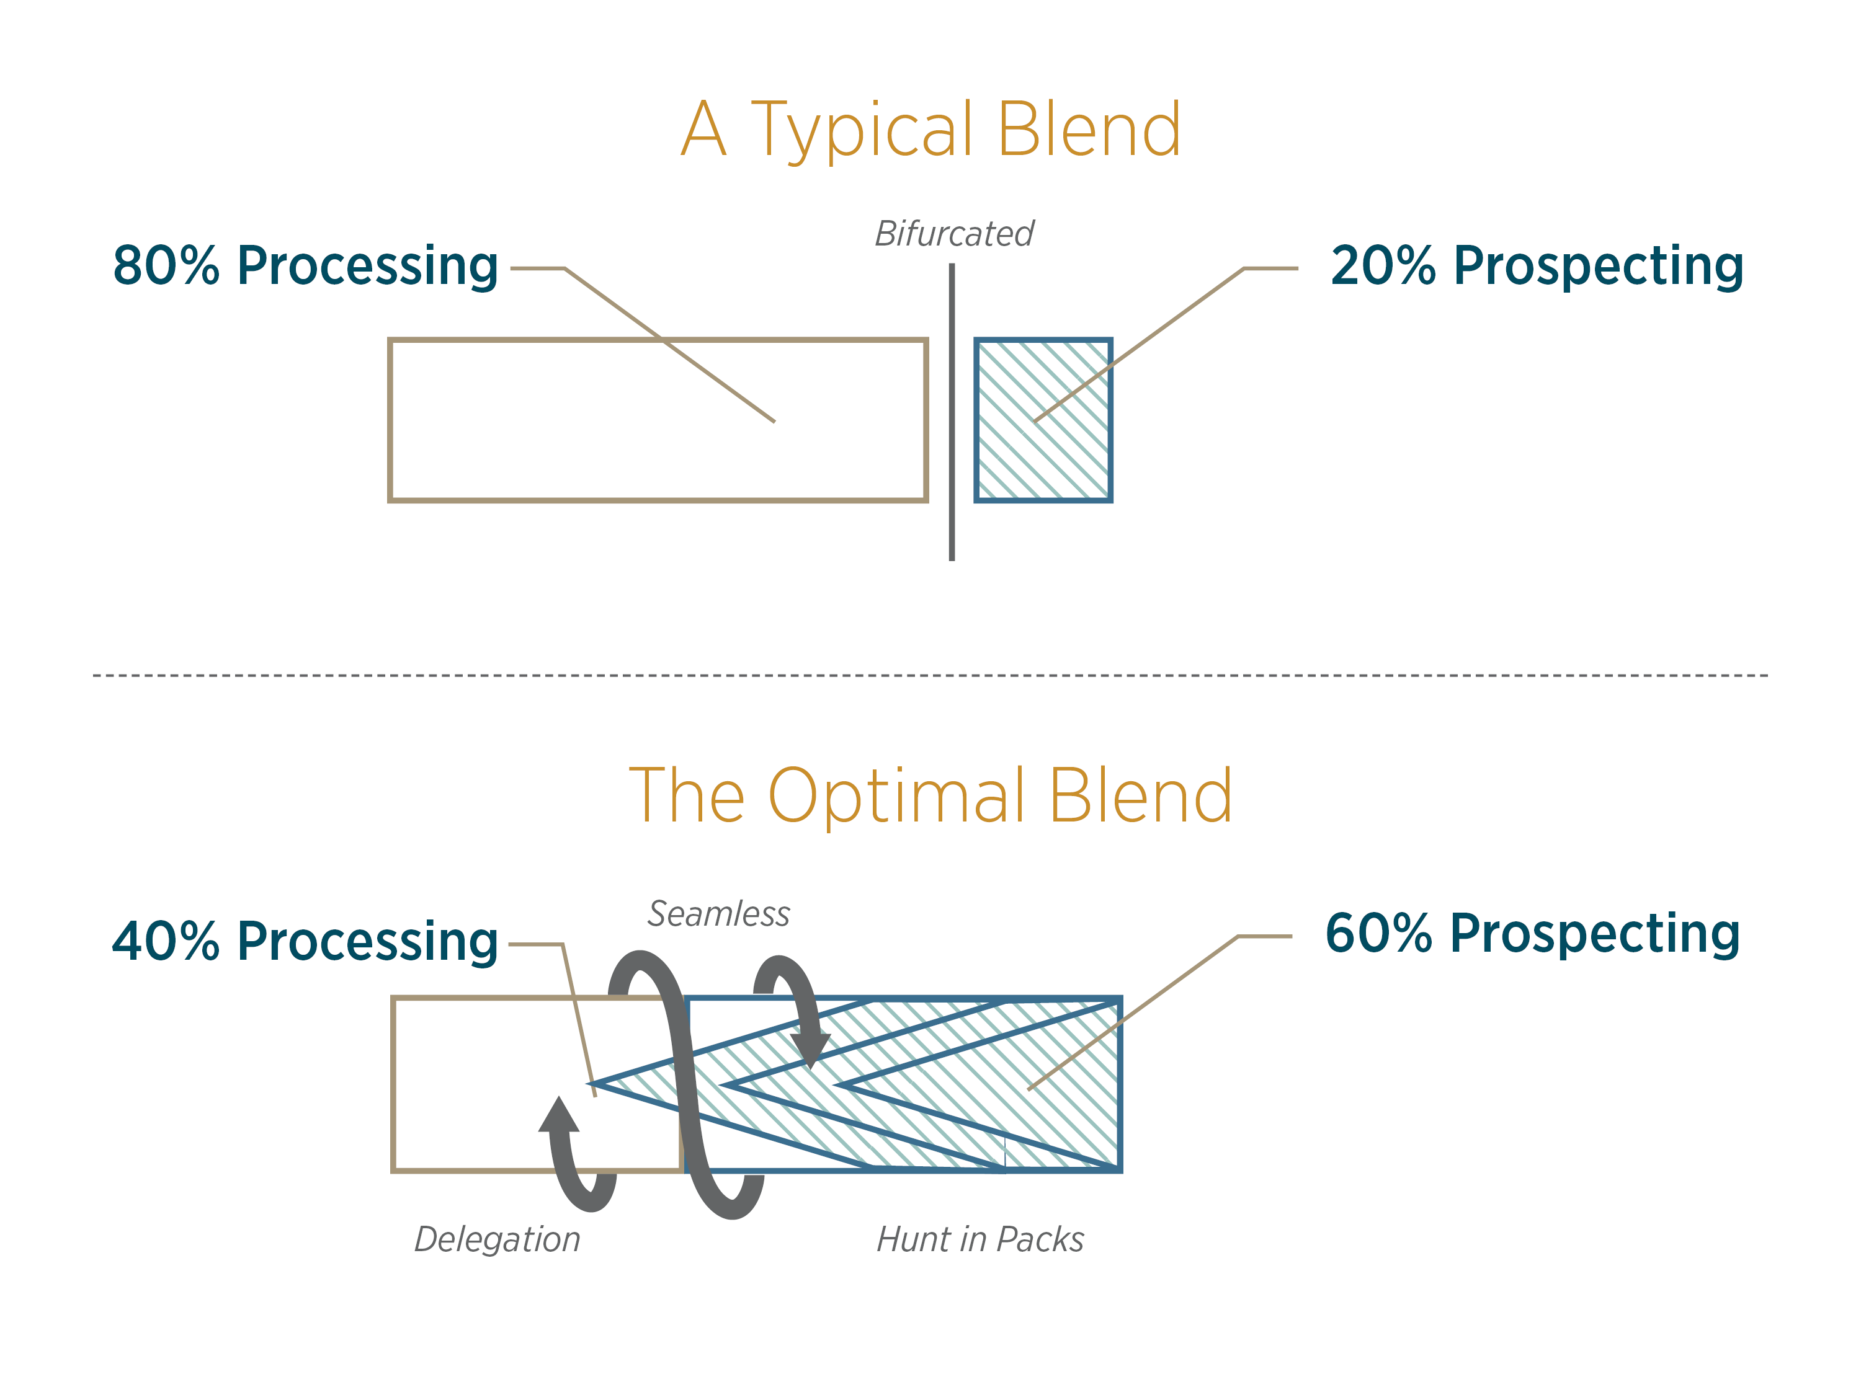
Where do We Create Maximum Value ?

Slide 23
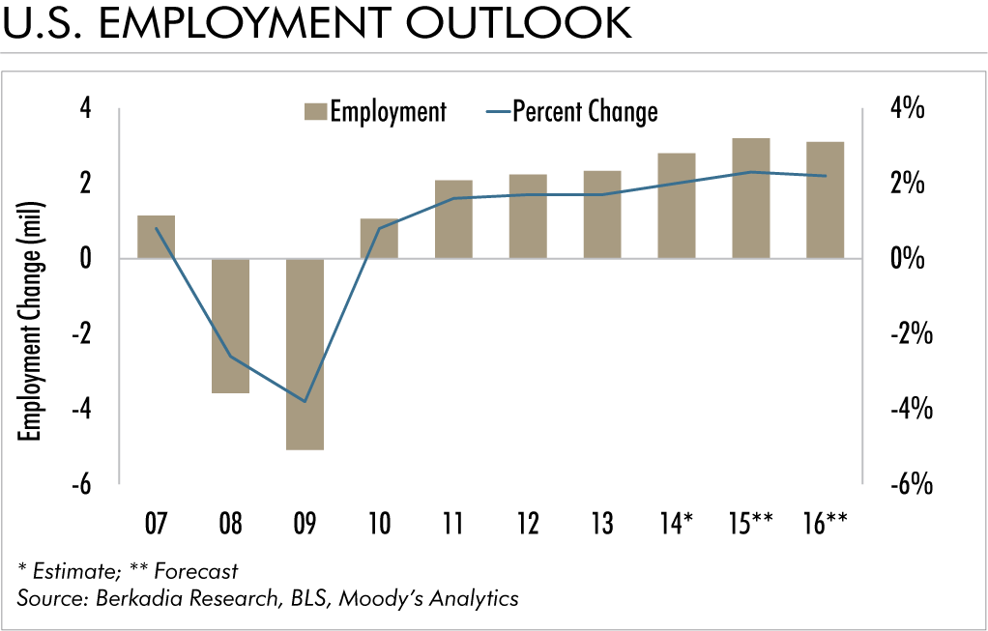

Slide 24
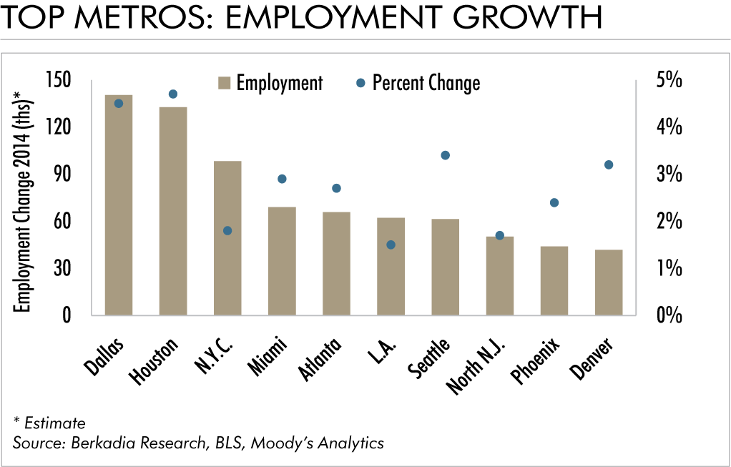

Slide 25
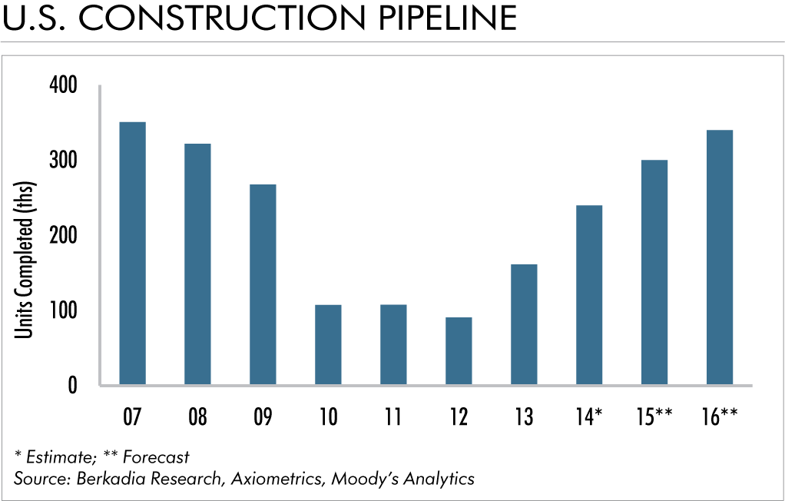

Slide 26
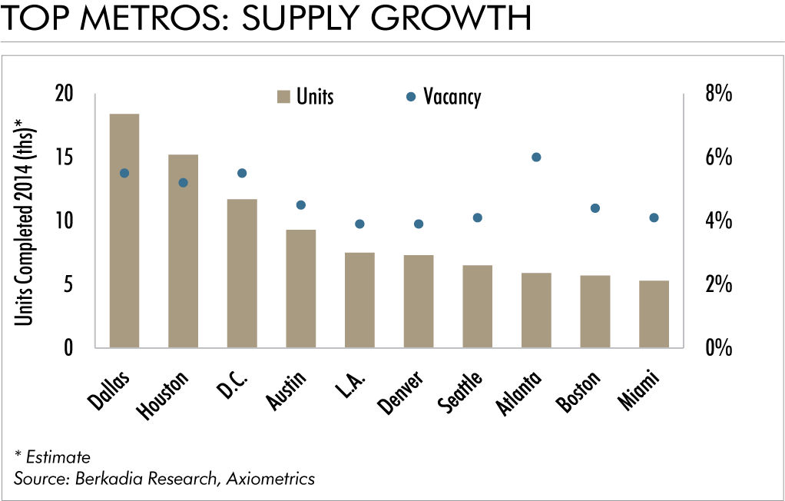

Slide 27
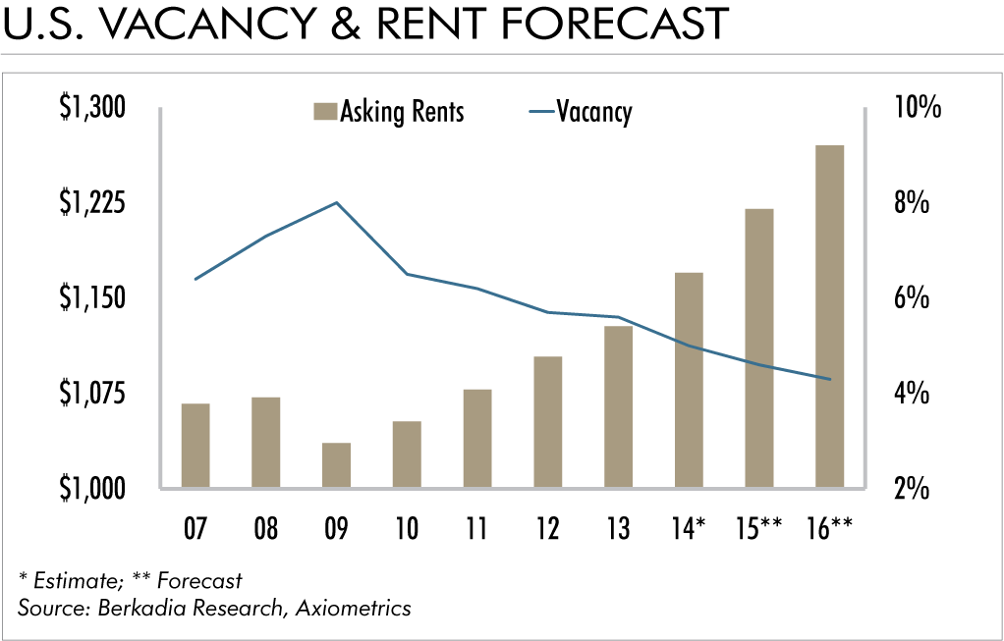

Slide 28
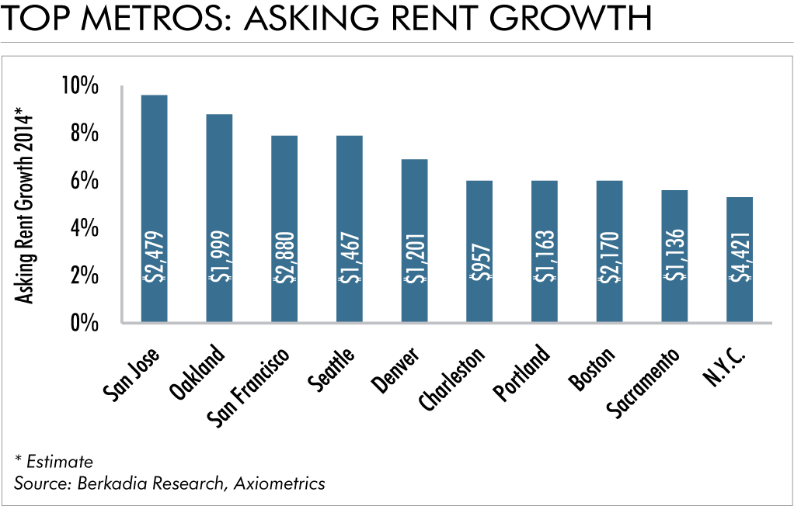

Slide 29
